Slide 1
Description du modèle géométrique d’une rue pour son étude thermique par éléments finis
Nicolas Duport
Chaire Architecture et Physique Urbaine
Benoit BECKERS
UPPA Université de Pau et des Pays de l’Adour – ISA BTP, Anglet, France
Club Cast3M 2020

Slide 2
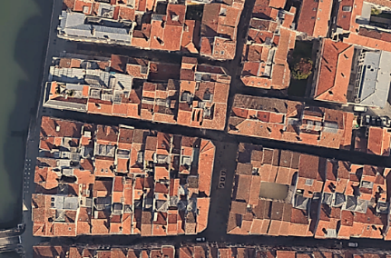
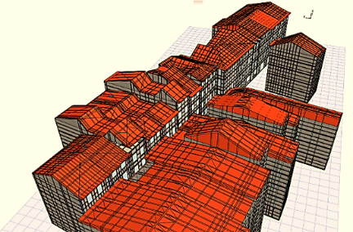
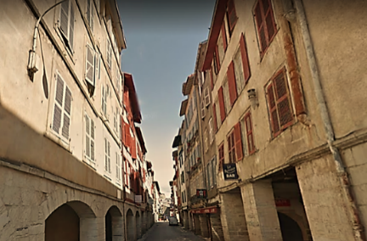
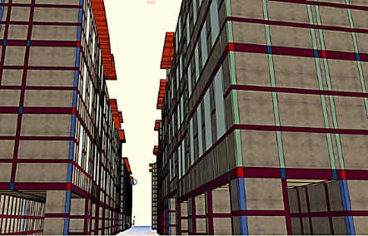
Modèle géométrique
Ouvertures
Enveloppe
Etude thermique
Rue des Tonneliers, quartier du petit bayonne Bayonne, France
Notes:
An element's Jacobian Matrix relates the quantities wrote in the natural coordinate space and the real space. The bigger the element is distorted in comparison with a ideal shape element, the worse will be the transformation of the quantities from the natural space to the real space. In fact, it means that the distortion on the element shape will introduce error in the mathematical transformation from natural space to the real space.

Slide 3
Modèle géométrique
Ouvertures
Enveloppe
Etude thermique
Maillage CAO
Structuré
Hexaèdres et prismes
Conforme par blocs
Mesh gluing
Différents matériaux
Intégration à
Notes:
An element's Jacobian Matrix relates the quantities wrote in the natural coordinate space and the real space. The bigger the element is distorted in comparison with a ideal shape element, the worse will be the transformation of the quantities from the natural space to the real space. In fact, it means that the distortion on the element shape will introduce error in the mathematical transformation from natural space to the real space.

Slide 4
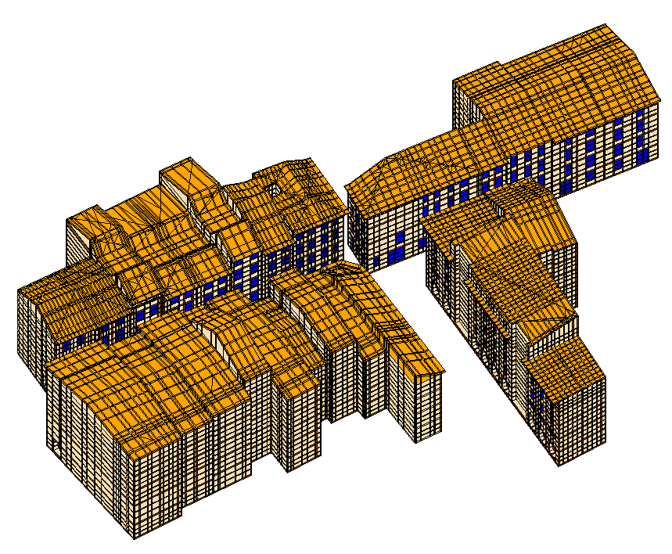
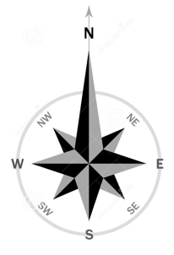
Modèle géométrique
Ouvertures
Enveloppe
Etude thermique
Notes:
An element's Jacobian Matrix relates the quantities wrote in the natural coordinate space and the real space. The bigger the element is distorted in comparison with a ideal shape element, the worse will be the transformation of the quantities from the natural space to the real space. In fact, it means that the distortion on the element shape will introduce error in the mathematical transformation from natural space to the real space.

Slide 5
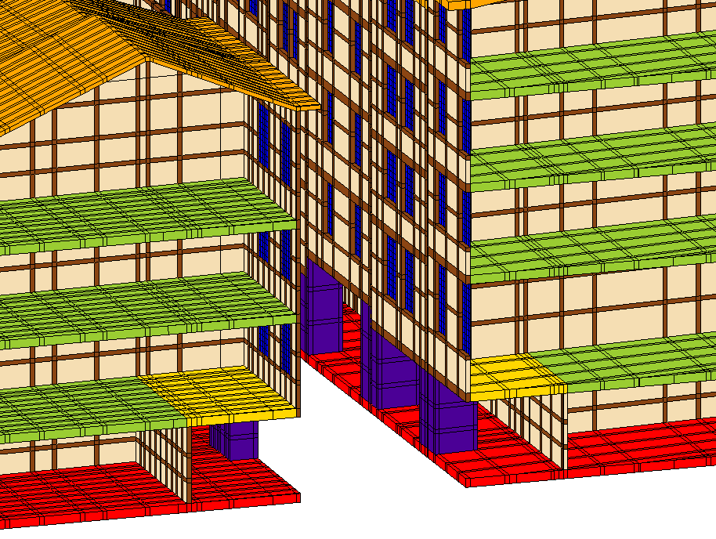
Modèle géométrique
Ouvertures
Enveloppe
Etude thermique
Notes:
An element's Jacobian Matrix relates the quantities wrote in the natural coordinate space and the real space. The bigger the element is distorted in comparison with a ideal shape element, the worse will be the transformation of the quantities from the natural space to the real space. In fact, it means that the distortion on the element shape will introduce error in the mathematical transformation from natural space to the real space.

Slide 6
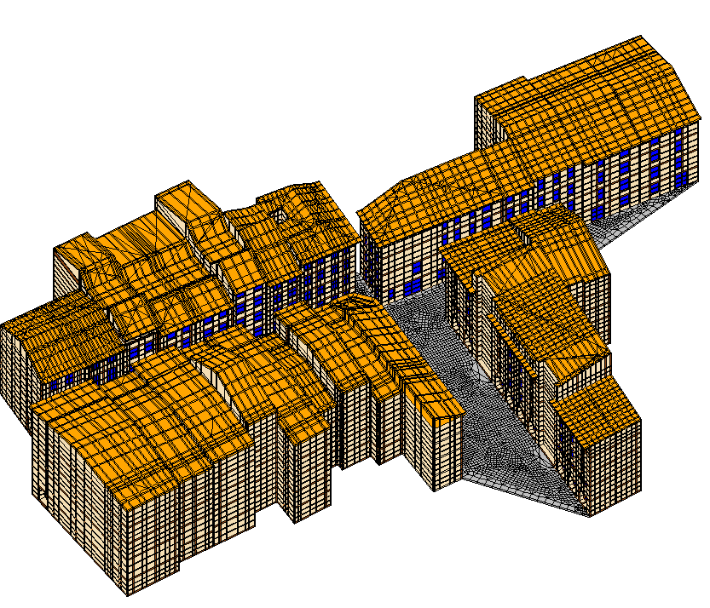
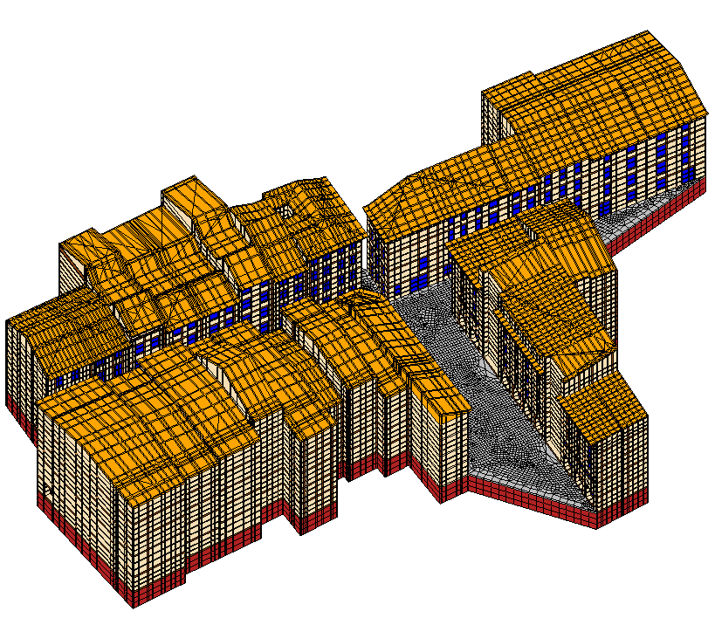
Modèle géométrique
Ouvertures
Enveloppe
Etude thermique
Notes:
An element's Jacobian Matrix relates the quantities wrote in the natural coordinate space and the real space. The bigger the element is distorted in comparison with a ideal shape element, the worse will be the transformation of the quantities from the natural space to the real space. In fact, it means that the distortion on the element shape will introduce error in the mathematical transformation from natural space to the real space.

Slide 7
Modèle géométrique
Ouvertures
Enveloppe
Etude thermique
Notes:
An element's Jacobian Matrix relates the quantities wrote in the natural coordinate space and the real space. The bigger the element is distorted in comparison with a ideal shape element, the worse will be the transformation of the quantities from the natural space to the real space. In fact, it means that the distortion on the element shape will introduce error in the mathematical transformation from natural space to the real space.

Slide 8
Modèle géométrique
Ouvertures
Enveloppe
Etude thermique
Epaisseur 6mm
Face intérieure
Face extérieure
Eléments coques ?
Notes:
An element's Jacobian Matrix relates the quantities wrote in the natural coordinate space and the real space. The bigger the element is distorted in comparison with a ideal shape element, the worse will be the transformation of the quantities from the natural space to the real space. In fact, it means that the distortion on the element shape will introduce error in the mathematical transformation from natural space to the real space.

Slide 9
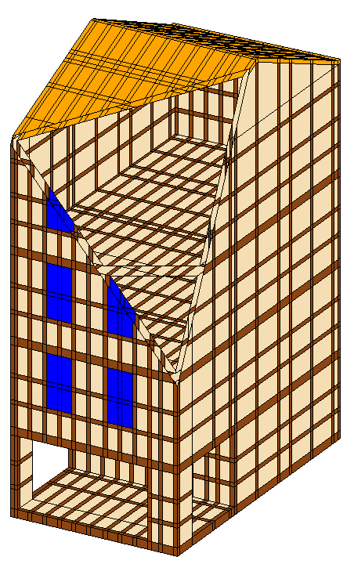
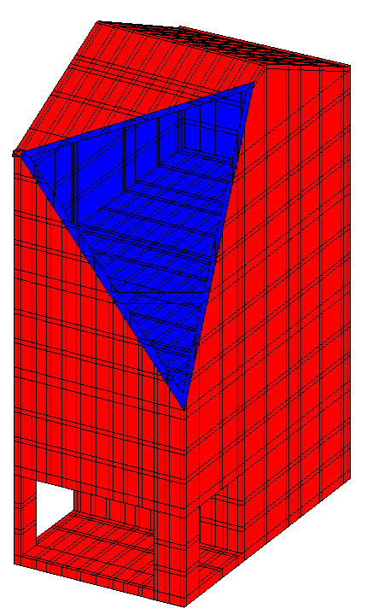
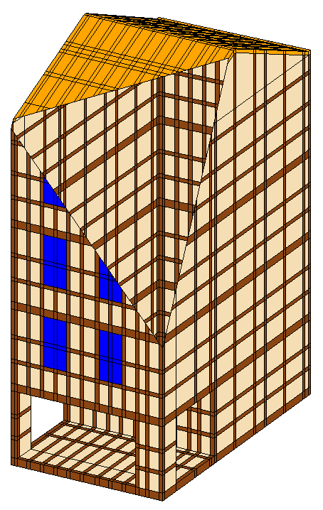
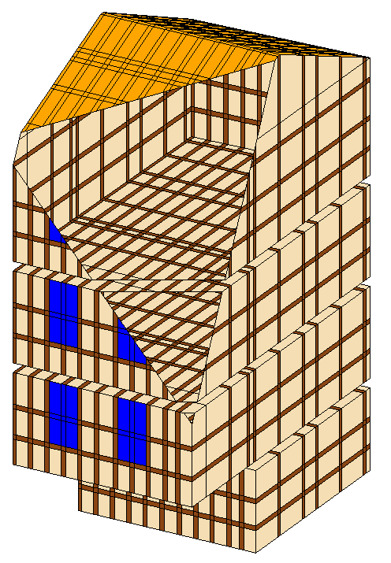
Modèle géométrique
Ouvertures
Enveloppe
Etude thermique
Méthode de diffusion de chaleur
T (°C)
10
8
6
4
2
0
Enveloppe
Peau extérieure
Peau intérieure
Notes:
An element's Jacobian Matrix relates the quantities wrote in the natural coordinate space and the real space. The bigger the element is distorted in comparison with a ideal shape element, the worse will be the transformation of the quantities from the natural space to the real space. In fact, it means that the distortion on the element shape will introduce error in the mathematical transformation from natural space to the real space.

Slide 10
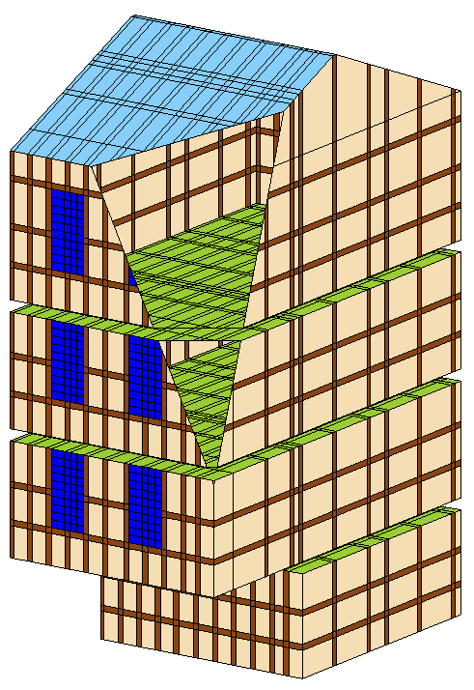
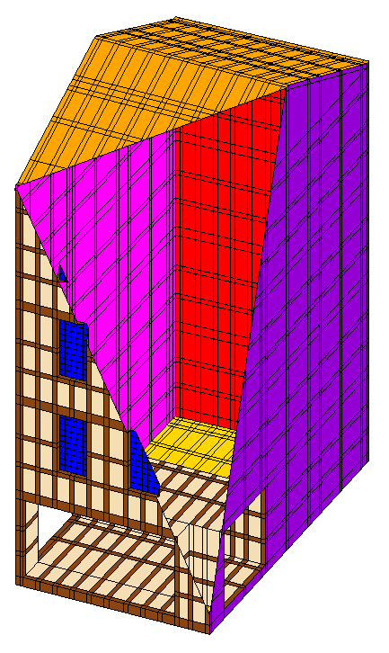
Modèle géométrique
Ouvertures
Enveloppe
Etude thermique
Peaux intérieures et extérieures
Coefficients de convection
Modèles radiatifs
Notes:
An element's Jacobian Matrix relates the quantities wrote in the natural coordinate space and the real space. The bigger the element is distorted in comparison with a ideal shape element, the worse will be the transformation of the quantities from the natural space to the real space. In fact, it means that the distortion on the element shape will introduce error in the mathematical transformation from natural space to the real space.

Slide 11
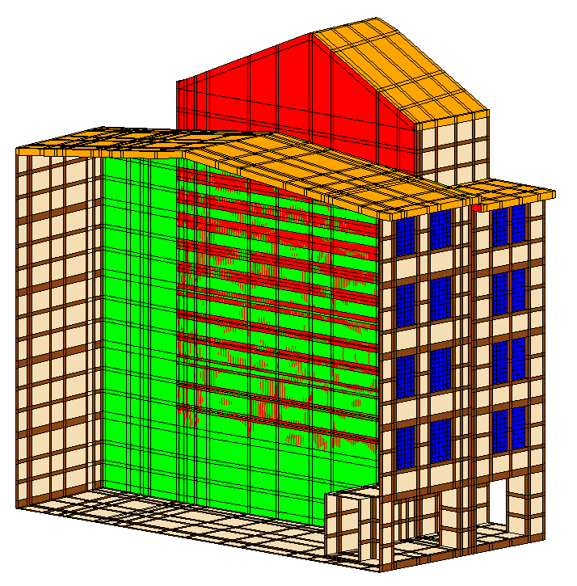
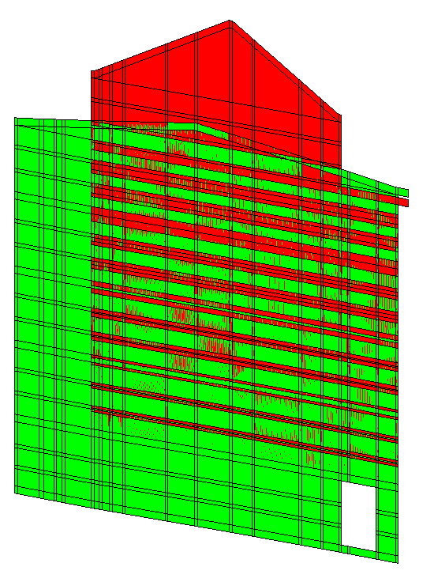
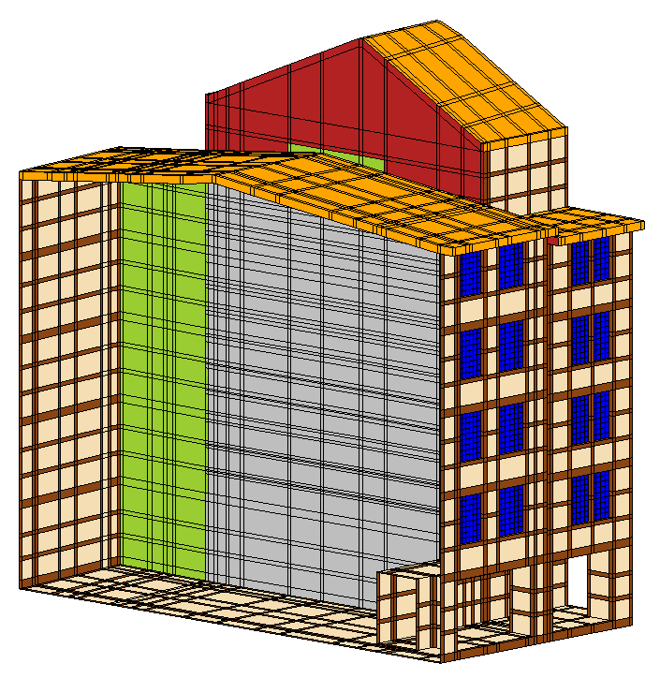
Modèle géométrique
Ouvertures
Enveloppe
Etude thermique
Assemblage des peaux extérieures
Notes:
An element's Jacobian Matrix relates the quantities wrote in the natural coordinate space and the real space. The bigger the element is distorted in comparison with a ideal shape element, the worse will be the transformation of the quantities from the natural space to the real space. In fact, it means that the distortion on the element shape will introduce error in the mathematical transformation from natural space to the real space.

Slide 12
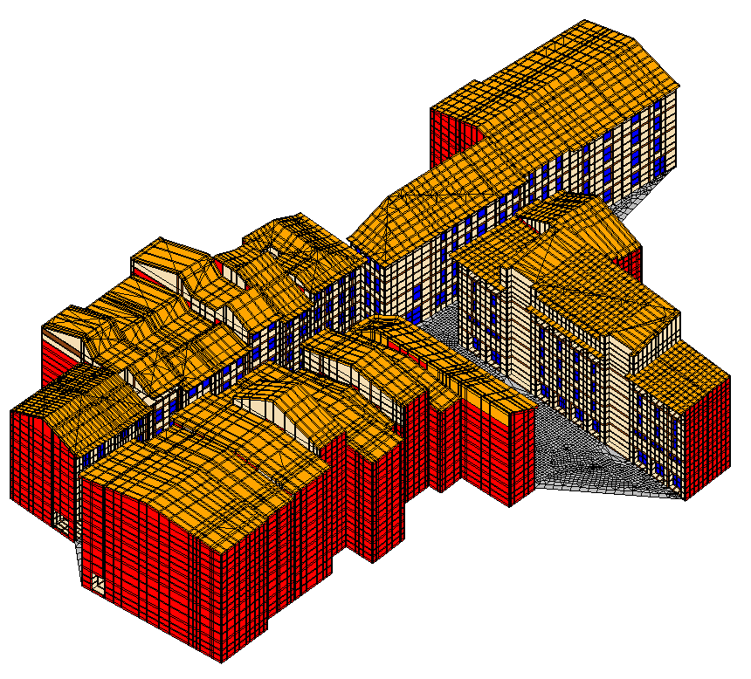
Modèle géométrique
Ouvertures
Enveloppe
Etude thermique
Description géométrique de la peau du modèle de la rue
 |  | Surface (m²) | Nombre | Densité
Peau intérieure |  | 33 823 | 132 241 | 3.9
Peau extérieure | Toit | 3 000 | 15 724 | 5.25
 | Mur | 9412 | 45 338 | 4.8
 | Sol rue | 851 | 7 688 | 9.1
 | Quadrilatères | 13 040 | 66 970 | 5.13
 | Triangles | 224 | 1780 | 7.9
 | Total | 13 264 | 68 750 | -
Peau int + Peau ext |  |  | 200 991
Notes:
An element's Jacobian Matrix relates the quantities wrote in the natural coordinate space and the real space. The bigger the element is distorted in comparison with a ideal shape element, the worse will be the transformation of the quantities from the natural space to the real space. In fact, it means that the distortion on the element shape will introduce error in the mathematical transformation from natural space to the real space.

Slide 13
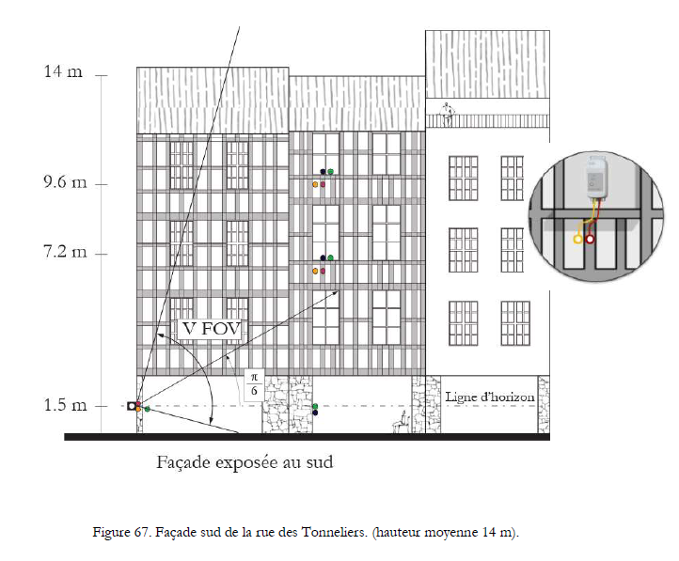
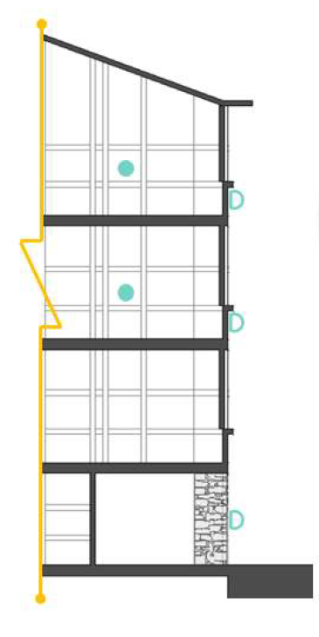
Modèle géométrique
Ouvertures
Enveloppe
Etude thermique
Mesures
Application des méthodes d’imagerie au rayonnement dans les scènes urbaines. Jairo Acuña Paz y Miño
Notes:
An element's Jacobian Matrix relates the quantities wrote in the natural coordinate space and the real space. The bigger the element is distorted in comparison with a ideal shape element, the worse will be the transformation of the quantities from the natural space to the real space. In fact, it means that the distortion on the element shape will introduce error in the mathematical transformation from natural space to the real space.

Slide 14
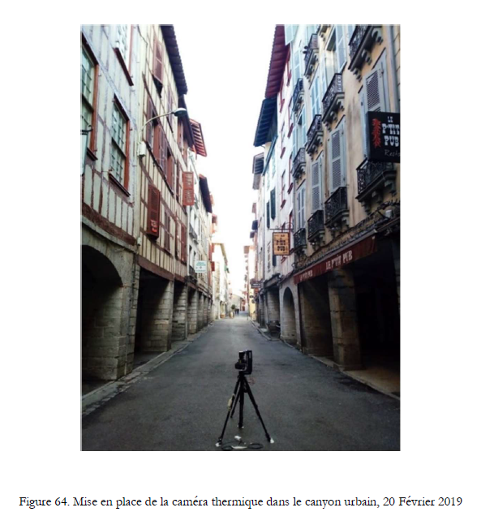
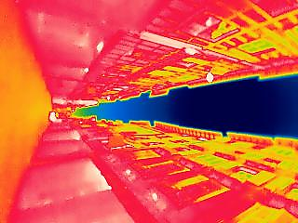
Modèle géométrique
Ouvertures
Enveloppe
Etude thermique
Mesures
Application des méthodes d’imagerie au rayonnement dans les scènes urbaines. Jairo Acuña Paz y Miño
Notes:
An element's Jacobian Matrix relates the quantities wrote in the natural coordinate space and the real space. The bigger the element is distorted in comparison with a ideal shape element, the worse will be the transformation of the quantities from the natural space to the real space. In fact, it means that the distortion on the element shape will introduce error in the mathematical transformation from natural space to the real space.

Slide 15
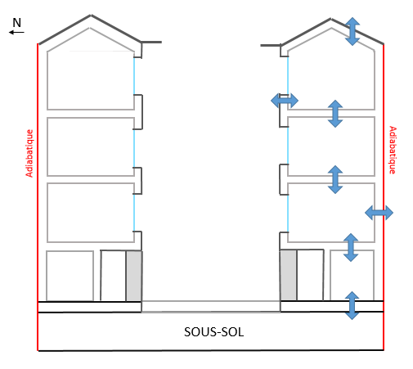
Modèle géométrique
Ouvertures
Enveloppe
Etude thermique
Simulations
Conduction
Hexaèdres et prismes linéaires
Notes:
An element's Jacobian Matrix relates the quantities wrote in the natural coordinate space and the real space. The bigger the element is distorted in comparison with a ideal shape element, the worse will be the transformation of the quantities from the natural space to the real space. In fact, it means that the distortion on the element shape will introduce error in the mathematical transformation from natural space to the real space.

Slide 16
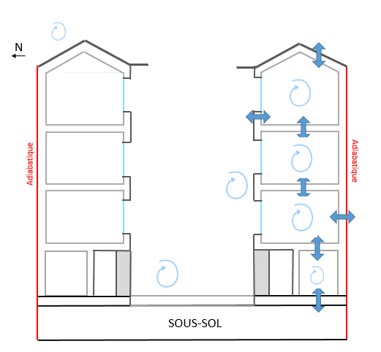
Modèle géométrique
Ouvertures
Enveloppe
Etude thermique
Simulations
Conduction
Hexaèdres et prismes linéaires
Convection
Extérieure (Tair ext), Intérieure (nœuds ‘T’ libre ou fixée)
Notes:
An element's Jacobian Matrix relates the quantities wrote in the natural coordinate space and the real space. The bigger the element is distorted in comparison with a ideal shape element, the worse will be the transformation of the quantities from the natural space to the real space. In fact, it means that the distortion on the element shape will introduce error in the mathematical transformation from natural space to the real space.

Slide 17
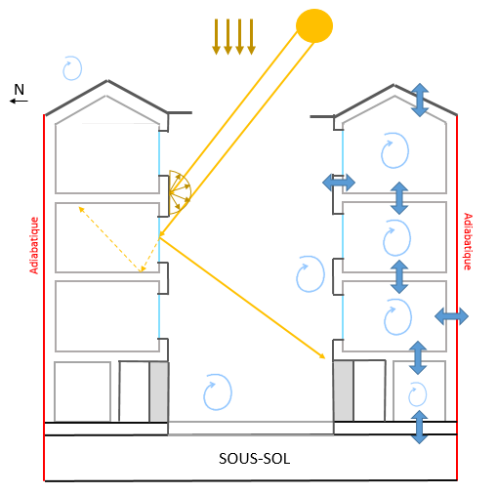
Modèle géométrique
Ouvertures
Enveloppe
Etude thermique
Simulations
Conduction
Hexaèdres et prismes linéaires
Convection
Extérieure (Tair ext), Intérieure (nœuds ‘T’ libre ou fixée)
Rayonnement solaire
Surfaces diffuses, vitrages (transmission directe, réflexion spéculaire)
Notes:
An element's Jacobian Matrix relates the quantities wrote in the natural coordinate space and the real space. The bigger the element is distorted in comparison with a ideal shape element, the worse will be the transformation of the quantities from the natural space to the real space. In fact, it means that the distortion on the element shape will introduce error in the mathematical transformation from natural space to the real space.

Slide 18
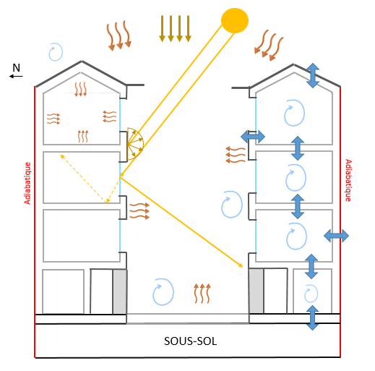
Modèle géométrique
Ouvertures
Enveloppe
Etude thermique
Simulations
Conduction
Hexaèdres et prismes linéaires
Convection
Extérieure (Tair ext), Intérieure (nœuds ‘T’ libre ou fixée)
Rayonnement solaire
Surfaces diffuses, vitrages (transmission directe, réflexion spéculaire)
Rayonnement infrarouge
Corps gris (émission et réflexion diffuse)
Externalisation du calcul des facteurs de vue
Notes:
An element's Jacobian Matrix relates the quantities wrote in the natural coordinate space and the real space. The bigger the element is distorted in comparison with a ideal shape element, the worse will be the transformation of the quantities from the natural space to the real space. In fact, it means that the distortion on the element shape will introduce error in the mathematical transformation from natural space to the real space.

Slide 19
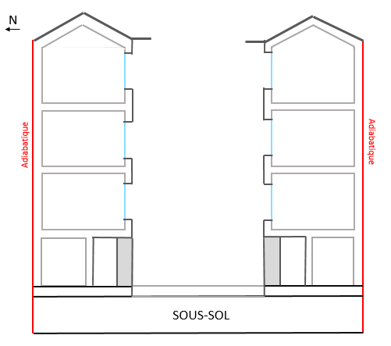
Modèle géométrique
Ouvertures
Enveloppe
Etude thermique
Simulations
Simulation thermique
A3
Durée : 24h
T air ext
Pas de temps : 10min
A2
Bayonne, France, 19 février
Paramètres d’évaluation : Température de l’air et des surfaces
Condition Neumann
- Température de l’air extérieur imposée (mesurée)
Température du sous-sol (2m) imposée
Condition Dirichlet
- Flux atmosphériques
T sous-sol
Temps de calcul : 1h
Notes:
An element's Jacobian Matrix relates the quantities wrote in the natural coordinate space and the real space. The bigger the element is distorted in comparison with a ideal shape element, the worse will be the transformation of the quantities from the natural space to the real space. In fact, it means that the distortion on the element shape will introduce error in the mathematical transformation from natural space to the real space.

Slide 20
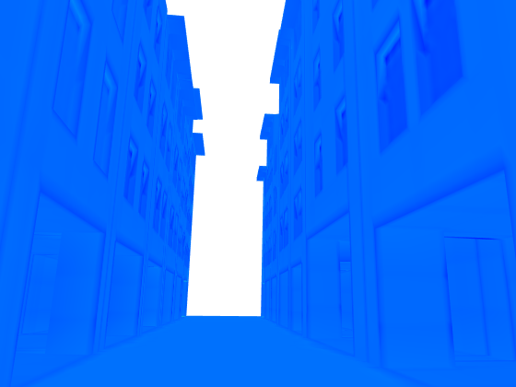
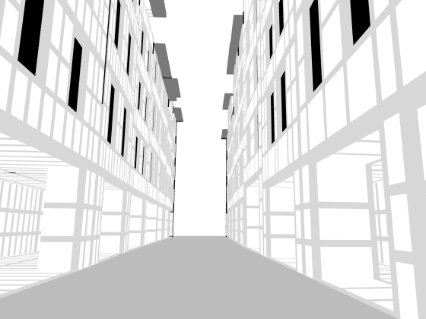
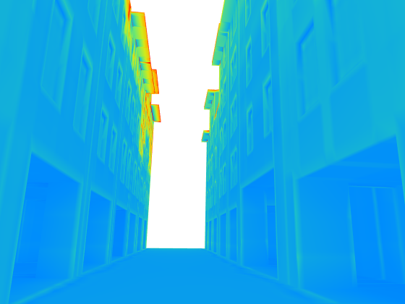
Modèle géométrique
Ouvertures
Enveloppe
Etude thermique
Simulations
8h
T (°C)
12h
22h
Notes:
An element's Jacobian Matrix relates the quantities wrote in the natural coordinate space and the real space. The bigger the element is distorted in comparison with a ideal shape element, the worse will be the transformation of the quantities from the natural space to the real space. In fact, it means that the distortion on the element shape will introduce error in the mathematical transformation from natural space to the real space.

Slide 21
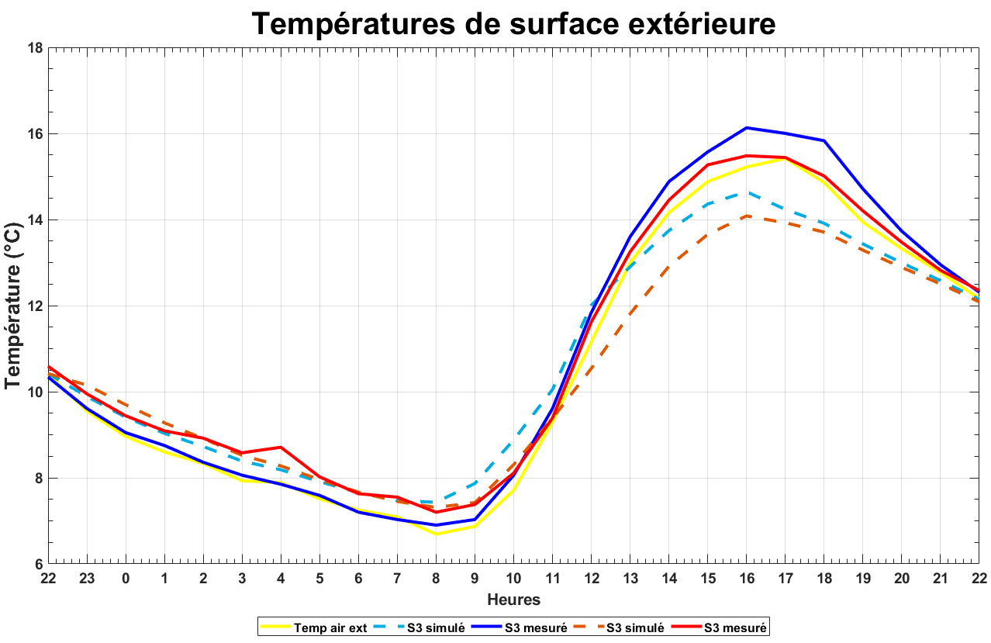
Modèle géométrique
Ouvertures
Enveloppe
Etude thermique
Comparaison
S3
S2
Notes:
An element's Jacobian Matrix relates the quantities wrote in the natural coordinate space and the real space. The bigger the element is distorted in comparison with a ideal shape element, the worse will be the transformation of the quantities from the natural space to the real space. In fact, it means that the distortion on the element shape will introduce error in the mathematical transformation from natural space to the real space.

Slide 22
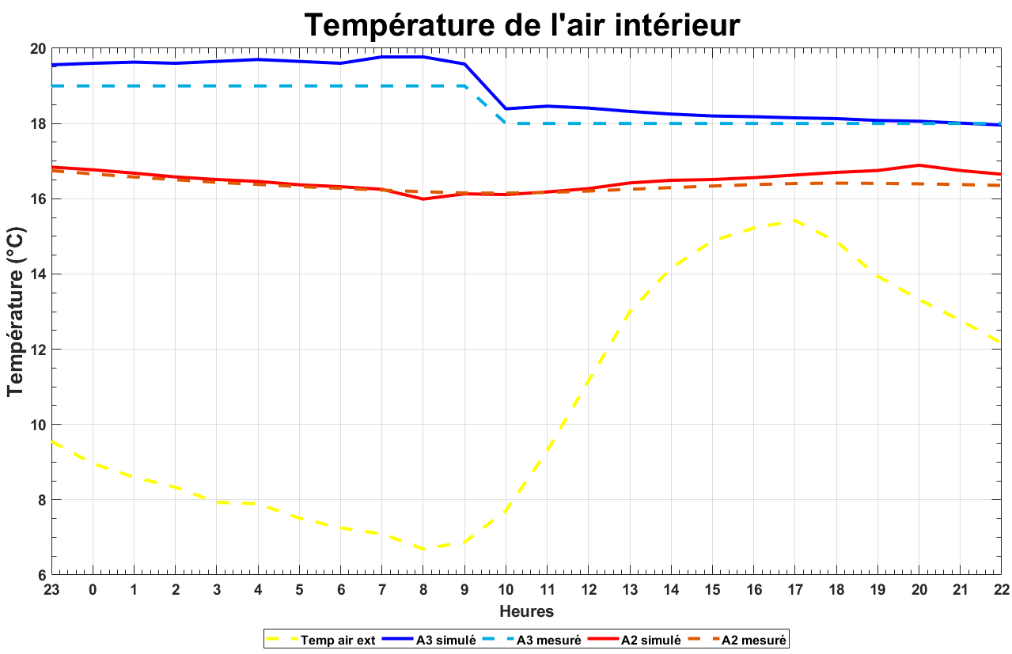
Modèle géométrique
Ouvertures
Enveloppe
Etude thermique
Comparaison
A3
A2
Notes:
An element's Jacobian Matrix relates the quantities wrote in the natural coordinate space and the real space. The bigger the element is distorted in comparison with a ideal shape element, the worse will be the transformation of the quantities from the natural space to the real space. In fact, it means that the distortion on the element shape will introduce error in the mathematical transformation from natural space to the real space.

Slide 23
MERCI !
Description du modèle géométrique d’une rue pour son étude thermique par éléments finis
Nicolas Duport
Chaire Architecture et Physique Urbaine
Benoit BECKERS
UPPA Université de Pau et des Pays de l’Adour – ISA BTP, Anglet, France
Club Cast3M 2020

