Slide 1
Club Cast3M 2017 – Paris, 24 November 2017
A two-compartment hierarchical porous medium system for vascular tumor growth:
theory and implementation in Cast3M
Giuseppe Sciumè
I2M / University of Bordeaux – Esplanade des Arts et Métiers 33405 - Talence France

Slide 2
PHYSICS & CANCER
General introduction
What does physics have to do with cancer?
Franziska Michor et al. – NATURE REVIEWS | CANCER VOLUME 11 | SEPTEMBER 2011 | 657
Transport OncoPhysics: multiscale modelling of cancer growth and multiparameter response to therapy; multiscale imaging; and multiscale probes
Getting physical
Jennie Dushek – NATURE | VOL 491 | 22 NOVEMBER 2012 | S50
Physics, maths and evolutionary biology are among the scientific disciplines providing cancer research with fresh perspective and therapeutic approaches.
“As biology begins to confront the limits of the molecular approach — which has yielded vast amounts of data but not always clear understanding — some scientists have returned to a more biomechanical view of life, and their research is starting to bear fruit.”

Slide 3
MECHANICS & CANCER
General introduction
The forces of cancer
Erica Jonietz - NATURE | VOL 491 | 22 NOVEMBER 2012 | S56
The way cells mechanically interact with each other and their environment could help researchers understand the invasion and metastasis of solid tumors.
The aim is here to exploit porous media mechanics and multiphase flow dynamics to better understand some paradigms of tumor growth mechanobiology

Slide 4
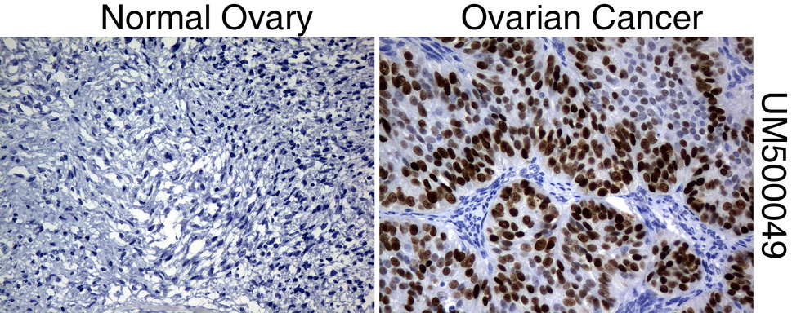
Taken from ORIGENE.com – Immunohistochemical staining of paraffin-embedded Human normal ovary tissue (left) and ovary cancer tissue (rigth)
Multiphase System
TC
5 PHASES ARE CONSIDERED
1 solid scaffold, (s)
Permeated by
4 immiscible fluid phases:
Tumor cells, (t), (tN + tL)
Host cells, (h)
Interstitial fluid, (l)
Blood (b)
HC
ε: Extra-vascular porosity
ε^{b}: vascular porosity

Slide 5
Taken from ORIGENE.com – Immunohistochemical staining of paraffin-embedded Human normal ovary tissue (left) and ovary cancer tissue (rigth)
Multiphase System
TC
5 PHASES ARE CONSIDERED
1 solid scaffold, (s)
Permeated by
4 immiscible fluid phases:
Tumor cells, (t), (tN + tL)
Host cells, (h)
Interstitial fluid, (l)
Blood (b)
HC
REV
IF
TC
HC
IF
ε: Extra-vascular porosity
IF
ε^{b}: vascular porosity
Capillary vessel
HC LTC NTC
ECM fiber

Slide 6
Phases definition & preliminary hypotheses
Vascular porosity
ε: Extra-vascular porosity
Vascular porosity ε^{b} is always saturated by blood;
Saturation degree is defined for extra-vascular porosity only as:
Porosity, and saturation constraint:
Solid scaffold:
ECM fibers (dominant species with structural function);
Vessel walls (they assure immiscibility between blood and other fluid phases).

Slide 7
Mass c. eqs of phases (7 scalar independent eqs)
Definition of porosity and saturation constraint:
Mass conservation eqs of S, TC, HC, IF, B:
(introducing mat. derivatives with respect of the moving solid phase)
TCs growth
ECh production
Vessels formation

Slide 8
Mass c. eqs of species in TC, HC & IF (5 scalar independent eqs)
Mass c. eqs for necrotic TC and ω^{it} constraint (2 scalar independent eqs)
Mass c. eqs of EC species in HC (1 scalar independent eqn)
Derived from the SEI (TCAT: paper 5 – W. G. Gray, C. T. Miller)

Slide 9
Mass c. eqs of species in TC, HC & IF (5 scalar independent eqs)
Mass c. eqs for necrotic TC and ω^{it} constraint (2 scalar independent eqs)
Mass c. eqs of EC species in HC (1 scalar independent eqn)
Mass c. eqs OXY and TAF species in IF (2 scalar independent eqs)

Slide 10
Momentum c. eqs for phases (15 scalar independent eqs)
Mom. c. eqn multiphase system (3 scalar independent eqs)
Summing [mo.α] over all phases gives the momentum equation of the whole multiphase system as:
(Summation allows eliminating momentum transfer terms $\overset{κ→α}{T}$ )
where is the total stress tensor:
Mom. c. eqs for fluid phases (12 scalar independent eqs)
Resistance tensor
with f = t, h, l, b

Slide 11
Model closure
Summary of model conservation eqs
Mass c. eqs of phases ……………………………………………………………………….………………. 7 scalar independent eqs
Mass c. eqs of TC species ………………………………………………………………........................…. 2 scalar independent eqn
Mass c. eqs of HC species ………………………………………………….………………………….…… 1 scalar independent eqn
Mass c. eqs of IF species …………………………………………………….………………………….…… 2 scalar independent eqs
Mom. c. eqs multiphase system ………………...…………………………………………………….…….. 3 scalar independent eqs
Mom. c. eqs for fluid phases ………………………………………………………………....................…. 12 scalar independent eqs
Total : 27 scalar independent eqs
Summary of model independent variables
Phase | Phase indicator | Species | Associated variables | N. equivalent scalar variables
Solid | s | - |  | 12
Tumor cells | t | Lt, Nt |  | 8
Host cells | h | ECh |  | 10
Interstitial fluid | l | OXYl, TAFl |  | 14
Blood vessels | b | - |  | 6
 |  |  | Total of scalar unknowns | 50
23 Constitutive/state eqs are needed for model closure

Slide 12
Model closure / assuming phases incompressibility*
Summary of model conservation eqs
Mass c. eqs of phases ……………………………………………………………………….………………. 7 scalar independent eqs
Mass c. eqs of TC species ………………………………………………………………........................…. 2 scalar independent eqn
Mass c. eqs of HC species ………………………………………………….………………………….…… 1 scalar independent eqn
Mass c. eqs of IF species …………………………………………………….………………………….…… 2 scalar independent eqs
Mom. c. eqs multiphase system ………………...…………………………………………………….…….. 3 scalar independent eqs
Mom. c. eqs for fluid phases ………………………………………………………………....................…. 12 scalar independent eqs
Total : 27 scalar independent eqs
Summary of model independent variables
Phase | Phase indicator | Species | Associated variables | N. equivalent scalar variables
Solid | s | - |  | 12
Tumor cells | t | Lt, Nt |  | 8
Host cells | h | ECh |  | 10
Interstitial fluid | l | OXYl, TAFl |  | 14
Blood vessels | b | - |  | 6
 |  |  | Total of scalar unknowns | 45
18 Constitutive/state eqs are needed for model closure
*this does not mean that the overall ECM scaffold is incompressible because porosity is inside.

Slide 13
Constitutive laws (18 scalar equations)
State equation for ε^{b} 1 eqn
Mechanical constitutive model 6 eqs
Two pressure-saturation eqs 2 eqs
Fick’s law for species diffusion 9 eqs

Slide 14
Effective Stress Tensor
p^{s}
ECM fiber
Capillary vessel
A non-conventional form accounting for hierarchy of porous compartments
Notes:
This is the question that your experiment answers

Slide 15
Effective Stress Tensor: a non-conventional form
Stress tensor solid phase
Stress for fluid phases
effective solid phase stress tensor
solid phase pressure
Pressure in the fluid phase
(positive if the fluid is in compression)
Summing of phase tensors weighed by their own volume fraction gives the total stress tensor as

Slide 16
Effective Stress Tensor: a non-conventional form
Hypothesis 1: blood vessels are mostly surrounded by extra-vascular fluids (TC, HC and IF), hence they have no relevant mechanical interaction with “structural” ECM fibers
Hypothesis 2: the solid pressure, p^{s}, is assumed being related with pressures of extra-vascular fluids (TC, HC and IF) only:
EFFECTIVE STRESS TENSOR (EST)

Slide 17
Effective Stress Tensor: t^{E} = t^{T} + p^{s}1 - ε^{b}(p^{s} - p^{b})1
Material objective time derivative of the effective stress tensor :
EST induces all deformations of ECM scaffold:
Introducing this constitutive relationship in the previous eqn gives:

Slide 18
State eqn for volume fraction of blood vessels
ECM
Ω_{fs}(fs interface)
HC
IF
TC
S^{β} are Bishop’s parameters

Slide 19
State eqn for volume fraction of blood vessels
ECM
Ω_{fs}(fs interface)
p^{s}
S^{β} are Bishop’s parameters
Vascular model ( ε^{b} depends on ( p^{b} - p^{extra-vascular} ) ):
ECM
ECM
ECM
b
IF
IF
HC
IF
HC
HC
b
b
TC
TC
TC
… or ….

Slide 20
State eqn for volume fraction of blood vessels
ECM
Ω_{fs}(fs interface)
b
p^{s}
S^{β} are Bishop’s parameters
Vascular model ( ε^{b} depends on ( p^{b} - p^{extra-vascular} ) ):
ECM
HC
IF
b
TC
Internal variable describing angiogenesis
(no angiogenesis) 0 ≤ Γ ≤ 1 (angiogenesis fully developed)

Slide 21
State eqn for volume fraction of blood vessels
LOAD
“ How does it work ? ”
ECM interacts with blood vessel via extravascular fluids
Comment: This is a reasonable assumption for the considered system and simplifies importantly the mathematical formulation.
b
b
b
b
b
b
b
b
b
b
b
b
b
b
b
b
b
b

Slide 22
1D bio-consolidation with and without vessels
200 Pa
Sinusoidal ramp
Sustained load
A
100 µm
Material data
E | ν | ε | k_{ε} | µ_{f} | ε_{b0} | K_{vess} | k_{vess} | µ_{b}
5000 | 0.2 | 0.5 | 1.10⁻¹⁴ | 1 | 0.1 | 5000 | 1.10⁻¹⁵ | 0.02
Extra-vascular porosity data |  |  |  |  | Vascular porosity data
B

Slide 23
1D bio-consolidation with and without vessels
200 Pa
Point A – Load & vertical displacement with time
A
100 µm
B

Slide 24
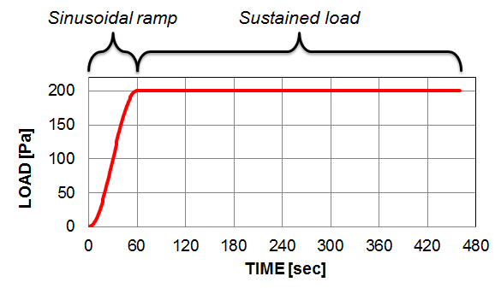
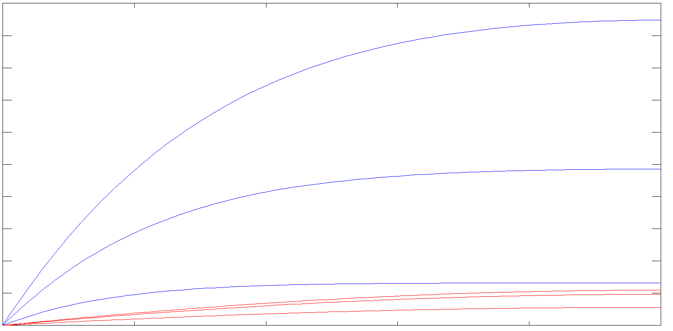
1D bio-consolidation with and without vessels
200 Pa
First 30 seconds
10 20 30 40 50 60 70 80 90 Pa
A
p^{f} p^{b}
10 sec
Coupling:
Flow is induced in the interstitial fluid phase as well as in the blood phase.
Dynamics is however very different; this will be shown in the following slides …
20 sec
30 sec
100 µm
B
10
sec
20
sec
30
sec

Slide 25
1D bio-consolidation with and without vessels
200 Pa
Point B – p^{f} and p^{b} versus Time
A
[ Pa ]
Load
p^{f}
100 µm
p^{b}
B

Slide 26
1D bio-consolidation with and without vessels
200 Pa
Point B – zoom p^{b} versus Time
A
[ Pa ]
p^{b}
100 µm
B

Slide 27
1D bio-consolidation with and without vessels
Point B – Normalized Porosities versus Time
200 Pa
200 Pa
A
Load graph
0 Pa
100 µm
ε^{b}/ε^{b0}
[ - ]
ε/ε⁰
B
TIME [sec]

Slide 28
Mechanical model for the solid scaffold
Hence the stress-strain constitutive law reads
with:
Vascular model with angiogenesis (VMA)

Slide 29
Models hierarchy
VMA
VM
AM (Sciumè et al. 2014)
Reduced models:
Vascular model without angiogenesis (VM):
Avascular model (AM):

Slide 30
Primary variables:
Final system of eqs
Numerical solution
Computational procedure
Mass conservation equation of OXYGEN (species in IF)
Mass conservation equation of TAF (species in IF)
Mass conservation equation of EC (species in HC)
Mass conservation equation of TUMOR CELLS
Mass conservation equation of HOST CELLS
Mass conservation equation of ε-fluids (TC + HC + IF)
Mass conservation equation of BLOOD
MODULE 1
Capillary pressures, interstitial fluid pressure, blood pressure and mass fractions of considered species
MODULE 2
Displacement vector
(solid phase)
Residuals controls
Global convergence check
Staggered procedure
No
Primary variables:
Discretization:
FE in space and FD in time
Mathematical model implemented in Cast3M (FE code of the CEA)
Yes
Linear momentum equation of the multiphase system (rate form)
Next step

Slide 31
Angiogenesis
Modeled phenomena and numerical results
Notes:
This is the question that your experiment answers

Slide 32
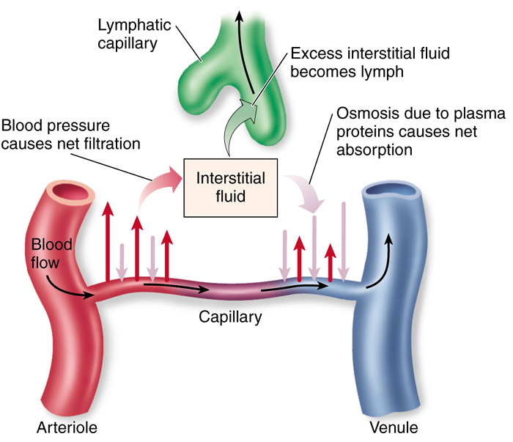
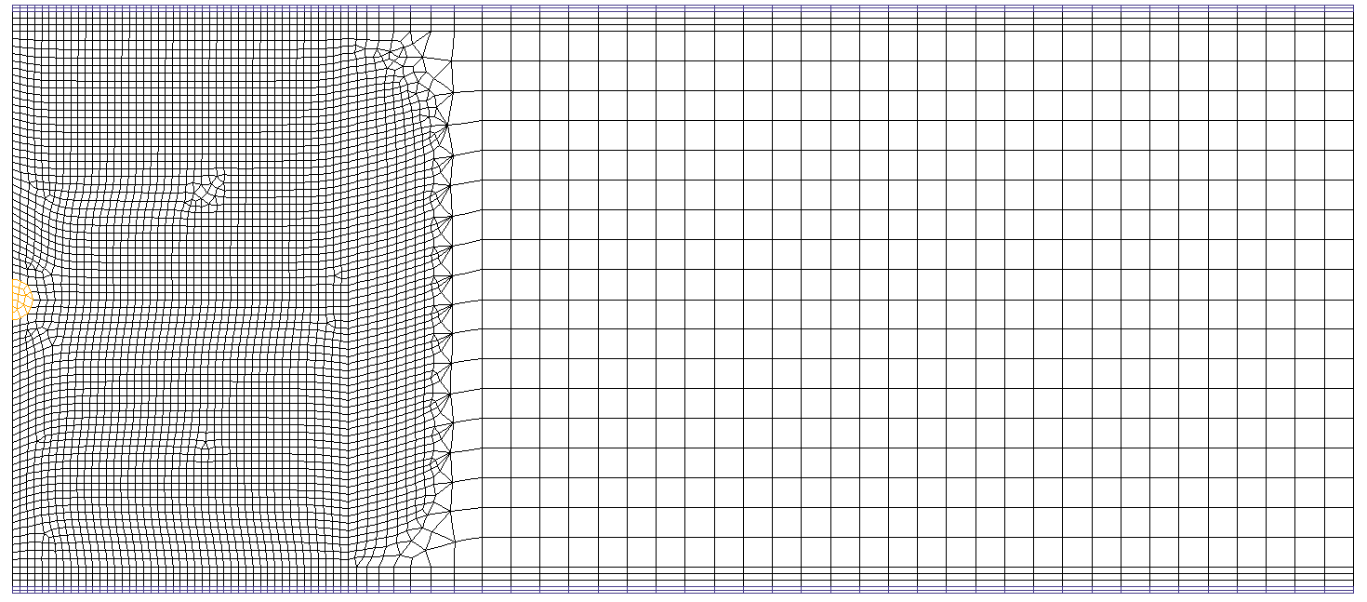
Angiogenesis: TAF release → ECh production → vessel formation dΓ
z (axial symmetry axis)
tumor
Source: www.bio.utexas.edu
Venules bed
Initial spheroid
R_{tum} = 30 µm
h = 800 µm
Blood flow
R_{ext} = 2000 µm
r
Arterioles bed

Slide 33
Angiogenesis: TAF release → ECh production → vessel formation dΓ
TAF release
z
Venules bed
Interfacial area reach of EC
r
Interfacial area reach of EC
Arterioles bed

Slide 34
Angiogenesis: TAF release → ECh production → vessel formation dΓ
TAF release
z
EC production
Venules bed
Interfacial area reach of EC
r
Interfacial area reach of EC
Arterioles bed

Slide 35
Angiogenesis: TAF release → ECh production → vessel formation dΓ
TAF release
z
EC production
Venules bed
Vessel maturation
Interfacial area reach of EC
r
Interfacial area reach of EC
Arterioles bed

Slide 36
Angiogenesis: TAF release → ECh production → vessel formation dΓ

Slide 37
Computational Algorithm
1st level procedure (called in .dgibi)
2nd level procedure (called by pasaps)
$$$$ PASAPAS (ORIGINAL V2016)
'DEBPROC' PASAPAS PRECED*'TABLE';
[…]
Line 132: 'REPETER' BEXTERN; (boucle sur pas de temps)
[…]
Line 197: 'REPETER' BO_BOTH; (boucle couplage)
[…]
# CALCUL THERMIQUE
Line 238: CHTER = TRANSNON PRECED;
Line 269: REEV_THE PRECED 1 ;
[…]
# CALCUL MECANIQUE
Line 310: TT = UNPAS PRECED;
Line 354: REEV_MEC PRECED 1;
[…]
# Test de la convergence méca-thermique !
[…]
Line 411: 'FIN' BO_BOTH ;
[…]
PRECED.'PERSO1_APPEL' = 2 ;
PERSO1 PRECED;
[…]
Line 703: 'FIN' BEXTERN;
[…]
'FINPROC' PRECED ;
$$$$ TRANSNON (ORIGINAL V2016)
CALL @MATETHM (update necrosis, ε, ε^{b}, d_{sw}, K_{ij}, C_{ij} and f_{i})
COMPUTE SOLUTION FOR PRESSURE AND MASS FRACTIONS
$$$$ REEV_THE (PERSONAL PROCEDURE)
CALL @MATETHM (update necrosis, ε, ε^{b}, d_{sw}, K_{ij}, C_{ij} and f_{i})
UPDATE of PRECED . 'ETAT2'
PROVIDES SWELLING STRAIN RATE, d_{sw}, to the mechanical part
$$$$ UNPAS (ORIGINAL V2016)
COMPUTING OF THE DIPLACEMENT VECTOR u^{s}
$$$$ REEV_MEC (PERSONAL PROCEDURE)
COMPUTING OF div(v^{s}), THIS TERM IS NEEDED BY TRANSNON
$$$$ PERSO1 (PERSONAL PROCEDURE)
UPDATE THE STATE VARIABLE VECTOR
PREPARE THE NEXT TIME STEP: PRECED.ETAT1 = PRECED.ETAT2;
Notes:
Summarize your research in three to five points.

Slide 38
Computational Algorithm: @MATETHM
3rd level procedure
2nd level procedure (called by pasaps)
$$$$ @MATETHM (PERSONAL PROCEDURE)
'DEBPROC' @MATETHM MOD_THM*'MMODEL' THPC_W*'CHPOINT';
[…]
'REPETER' BZ_THM nzone; (boucle THM-zones)
[…]
Call of material parameters
Call of primary variables
Computing of dependent variables
[…]
(1) Update of angiogenesis;
(2) Update of porosity;
(3) Update of necrosis;
(4) Update THERMOHYDRIQUE material;
(3.a) computing of swelling strain d_{sw}
(3.b) computing of K_{ij}, C_{ij}, f_{i} for phases’ flow
(5) Update DIFFUSION material;
(4.a) K_{ij}, C_{ij}, f_{i} for oxygen advection-diffusion
(4.b) K_{ij}, C_{ij}, f_{i} for TAF advection-diffusion
(4.c) K_{ij}, C_{ij}, f_{i} for EC advection-diffusion
(4.d) K_{ij}, for the blood flow model
[…]
'FIN' BZ_THM;
[…]
'FINP' MAT1 F0;
$$$$ TRANSNON (ORIGINAL V2016)
CALL @MATETHM (update necrosis, ε, ε^{b}, d_{sw}, K_{ij}, C_{ij} and f_{i})
COMPUTE SOLUTION FOR PRESSURE AND MASS FRACTIONS
$$$$ REEV_THE (PERSONAL PROCEDURE)
CALL @MATETHM (update necrosis, ε, ε^{b}, d_{sw}, K_{ij}, C_{ij} and f_{i})
UPDATE of PRECED . 'ETAT2'
PROVIDES SWELLING STRAIN RATE, d_{sw}, to the mechanical part
Notes:
Summarize your research in three to five points.

Slide 39
Micro- Macro- Description in Averaging Theories
Thermodynamically Constrained Averaging Theory (TCAT)
Microscale entropy inequality,
thermodynamics and equilibrium conditions
Macroscale entropy inequality,
thermodynamics and equilibrium conditions
Averaging theorems
Microscale conservation equations
Larger-scale conservation equations
+
Hierarchy of closed parametrized macroscale models
Closure relations derived from SEI
+
Numerical solution of multiphase flow
at the microscale
for Newtonian and Complex fluids
Additional macroscale closure relations
Pressure-saturation relationships;
Relative permeabilities
Flow of viscoelastic fluids
Etc.
Numerical upscaling
Vincent Le Maout PhD Thesis

Slide 40
Conclusions
A 5-phase model for evolution of tumor and its microenvironment during avascular and vascular growth has been presented;
Blood and blood flow within vascular porosity is explicitly considered;
A special expression of the effective stress tensor has been obtained consistently with the adopted hypotheses;

Slide 41
Conclusions
The correct implementation of the mathematical model in Cast3M (FE code of the CEA) has been verified by solving simple benchmarking cases;
The presented version of the model can be further developed introducing another porous compartment representing the lymphatic system;
Relevant potentialities for simulation of drugs delivery.
Thank you for your attention!

Slide 42
PhD presentation
Aim of the research project
Simulate microscale multiphase flows in porous media in order to provide closure relation to macroscale model or micro-relevant equations for volume-averaging method. The target applications deal with the fields of petroleum engineering and biomechanics area.
Viscoelstic fluid
oil
Pore-scale flow for enhanced oil recovery simulation
Micro model for biological multiphase flow
Source Giuseppe Sciume ALERT Workshop

Slide 43
Multiphasic Flow Simulation
Diffuse interface model
The description of the interface’s motion is taken into account by the Cahn-Hilliard model [1].
The Phase-Field model ensures the continuity of the fluid properties through the interface. The interface thickness is controlled by the parameter
[1] Faruk O. Alpak, Beatrice Riviere and Florian Frank. A phase-field method for direct simulation of two-phase flows in pore-scale media using a non-equilibrium wetting boundary condition. Comput. Geosci 2016
43

Slide 44
Multiphasic Flow Simulation
Flow dynamic model in a single pore
The Cahn-Hilliard system is coupled with the Navier-Stokes equation :
coupling term
$$\overline{f}$$
accounts for the capillarity forces between the phases [1]

Slide 45
Multiphasic Flow Simulation
Dynamic boundary conditions for the interface
No flux conditions do not take into account the wettability of the solid scaffold. On solid walls, conditions are imposed such as it corresponds to realistic interface behavior
Phase 1
Phase 2
Static angle equilibrium condition at common point
45

Slide 46
Multiphasic Flow Simulation
Numerical results
Even if the full-coupled Cahn-Hilliard/Navier-Stokes model is not completely validated yet, some interesting results has been obtained with the Fenics Software:
Initial state
Final state
46

Slide 47
Conclusion
The Cahn-Hilliard model has been successfully implemented, either with no flux or dynamic angle boundary conditions;
The Navier-Stokes/Cahn-Hilliard system is implemented and is being validated;

Slide 48
Next steps
Migrate the code currently under fenics to Castem for compatibility;
Compute and test upscaling methods for macroscale model ;
More complex geometry will be tested in order to study the robustness of the NSCH system;

