Slide 1
Cast3M training on
« Additive Manufacturing Simulation »
S. Pascal version du 12/10/2022

Slide 2
OUTLINES

Slide 3
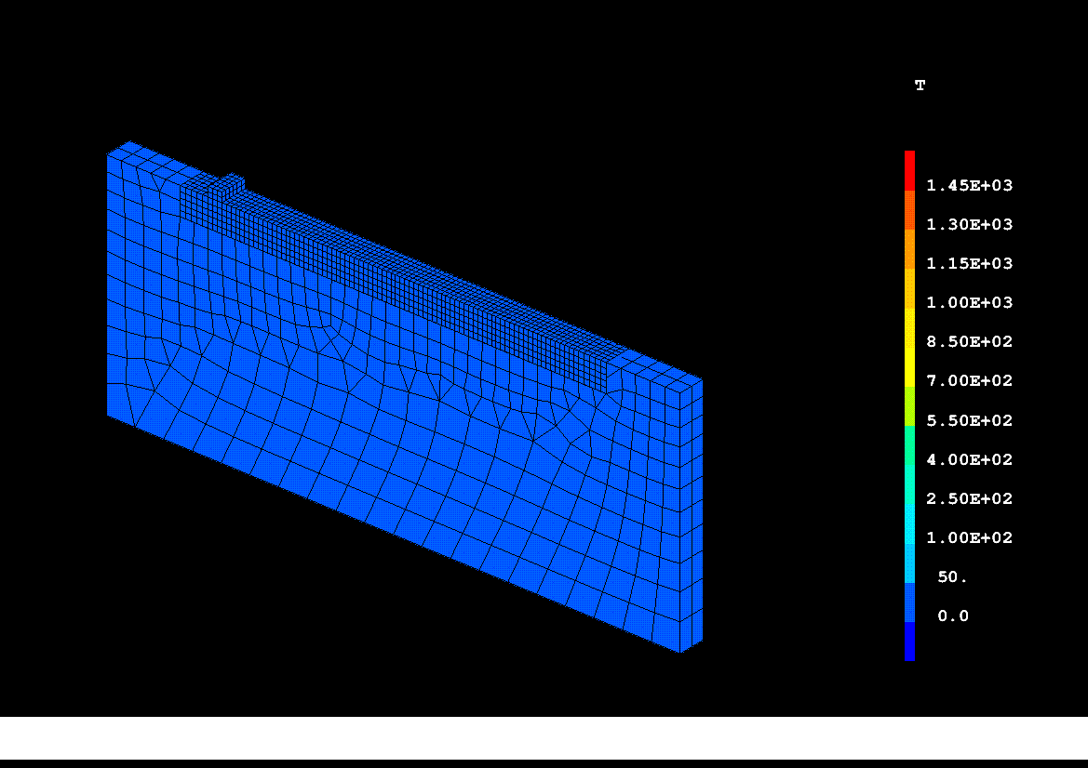
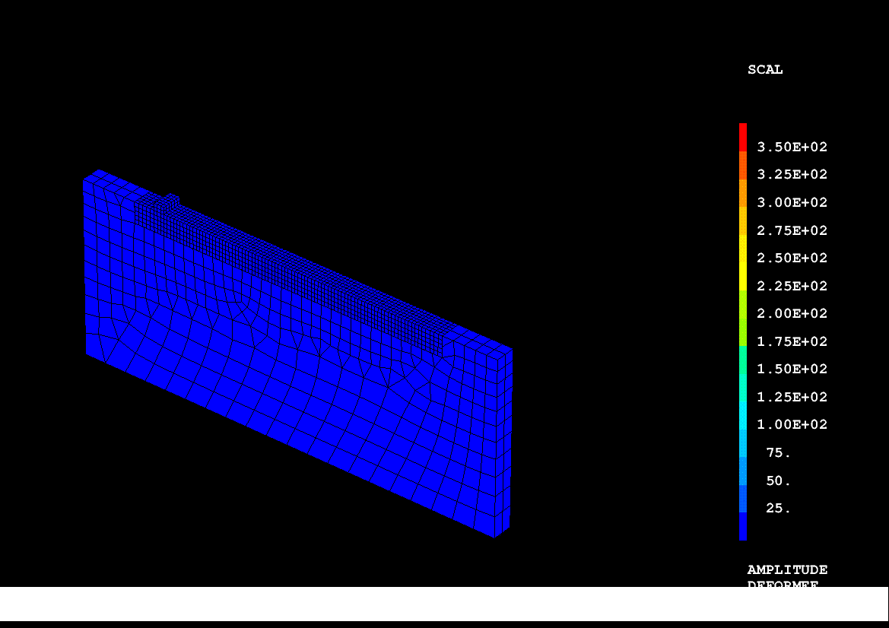
Training program
To rebuild the dgibi example files :
  waam1.dgibi : thermal analysis
  waam2.dgibi : thermomechanical analysis
Both are available in the Cast3M dgibi base since version 2021.
WAAM1
WAAM2

Slide 4
Main functionalities taught
Modelling
  Procedure BIBLIO : how to get material data
  Procedure SOUDAGE : how to define a manufacturing sequence
  Procedure WAAM : how to mesh a manufacturing sequence
  How to define time evolutive Cast3M models (MODE) as CHARGEMENT type objects,
  and their characteristics (MATE)
  How to define a heat source model as a mobile, Gaussian distribution
  How to reset plastic hardening after material fusion : FUSION model option
Solver
  Procedure PASAPAS
Post-treatment
  Procedure EXPLORER
  PASAPAS results table analysis

Slide 5
A few reminders about GIBIANE
In GIBIANE, 2 types of instructions
  Directives, that do not return any result:
  OPTI DIME 3 ELEM CUB8 TRAC X ;
  Operators, that return result object, freely named by the user:
  LIGN1 = DROI 5 P1 P2 ;
Enables to check the result of each instruction
  Directive LIST, option RESU :
  LIST LIGN1 ;
  LIST (VALE DIME) ; LIST RESU CHPO1 ;
All functionalities are documented in manual pages, available on the command line
  Directive INFO :
  INFO OPTI ; INFO DROI ;
Dynamic data typing according to predefined object types
  ENTIER, FLOTTANT, MOT… POINT, MAILLAGE, CHPOINT, MCHAML… MMODEL, EVOLUTION…

Slide 6
WAAM1.DGIBI

Slide 7
Example WAAM1.DGIBI
Additive manufacturing study case¹
0.30
120
/100
15
(1) Camille Cambon, Issam Bendaoud, Sébastien Rouquette, Fabien Soulié.
“Influence of the first weld bead on strain and stress states in wire+arc additive manufacturing”.
The 12th International Seminar ”Numerical Analysis of Weldability”, Institute for Materials Science, Joining and Forming (IMAT),
Sep 2018, Seggau, Austria. ‌hal-01954354
https://hal.archives-ouvertes.fr/hal-01954354

Slide 8
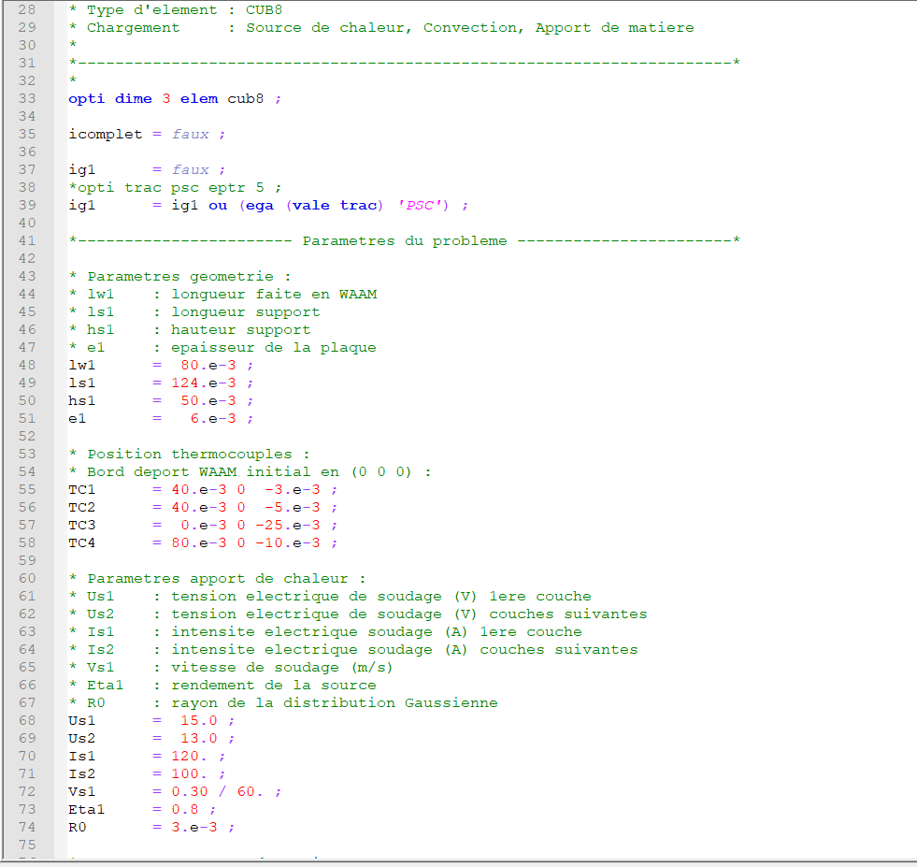
Example WAAM1.DGIBI
Head of the file waam1_formation.dgibi
0.30
120
/100
15

Slide 9
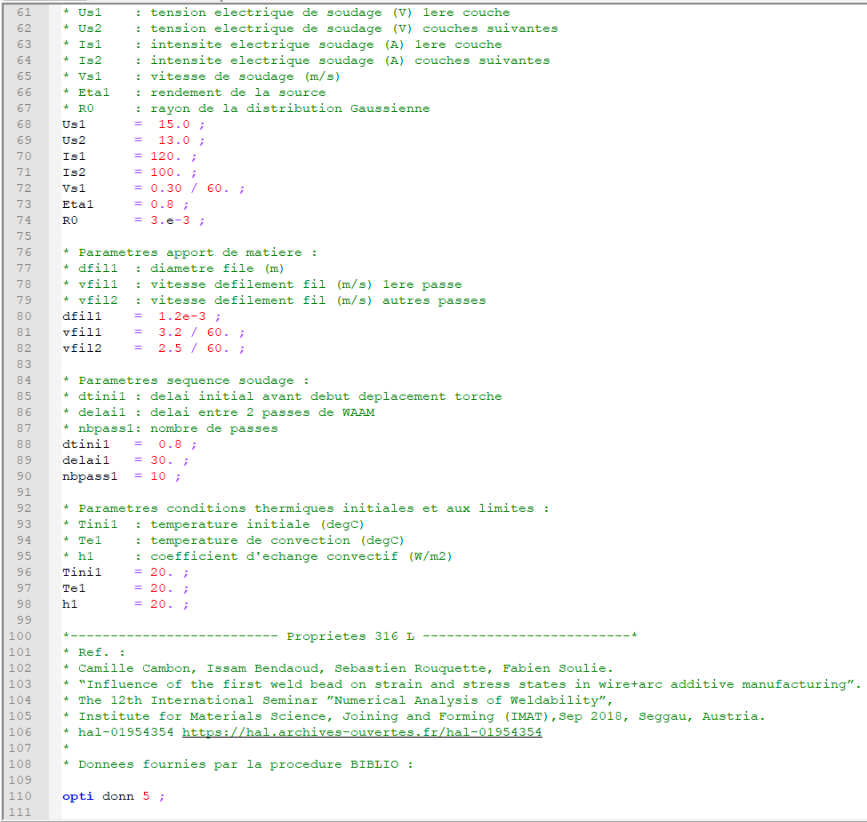
Example WAAM1.DGIBI
Head of the file waam1_formation.dgibi
0.30
120
/100
15

Slide 10
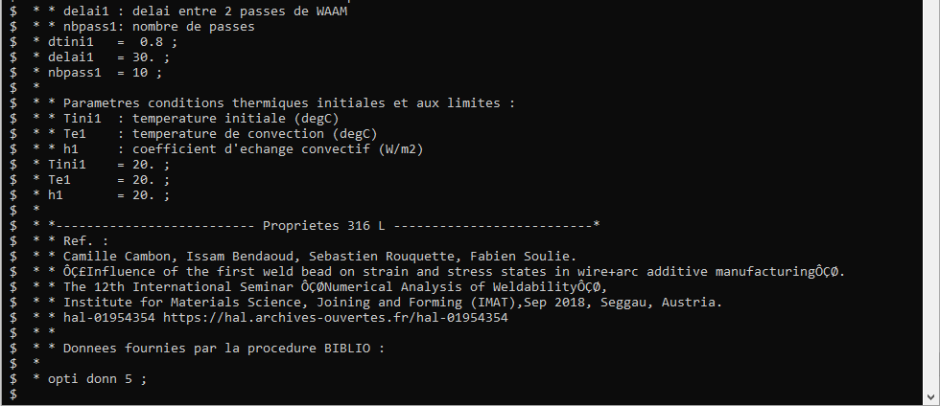
Example WAAM1.DGIBI
Head of the file waam1_formation.dgibi
  Run the dgibi file by typing:
  castem22 waam1_formation
  The program stops on the instruction:
  OPTI DONN 5 ;

Slide 11
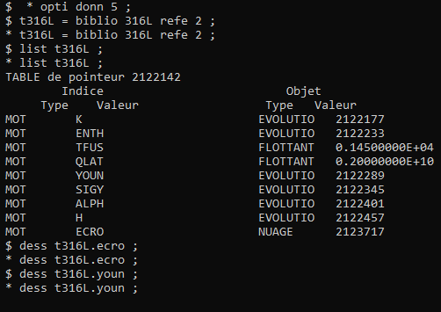
Example WAAM1.DGIBI
Procedure BIBLIO
  To load bibliographic data in a TABLE, as for example material data.
  Syntax :
  TAB1 = BIBLIO MOT1 (REFE ENT1) ;
  To get more information about BIBLIO, type:
  info biblio ;
  To load 316L material data, type:
  t316L = biblio 316L Refe 2 ;
  You can list the table T316L:
  LisT T316L ;
  You can plot some material data:
  dess T316L . ‘YOUN’ ;

Slide 12
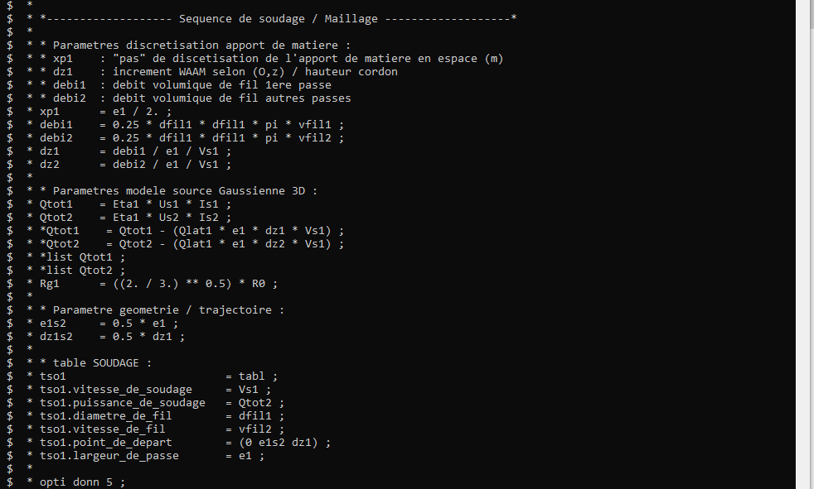
Example WAAM1.DGIBI
Continuation of waam1_formation.dgibi
  Type :
  opti donn 3 ;
  The program continues, then stops again on the instruction:
  OPTI DONN 5 ;

Slide 13
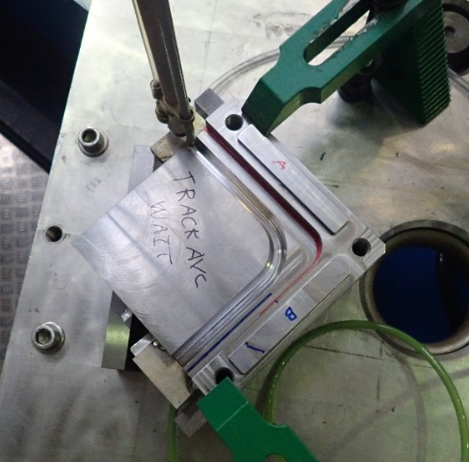
Example WAAM1.DGIBI
Procedure SOUDAGE
  To define a manufacturing sequence (or a welding sequence).
Crédit photo : L. Forest, SEMT/LTA

Slide 14
Example WAAM1.DGIBI
Procedure SOUDAGE
  What is a manufacturing sequence?
  Manufacturing tool kinematic (stops and starts along its trajectory)
  Manufacturing actions (weld points, weld beads, layer “lasing”, etc.)
  Process parameters:
    Manufacturing tool speed
    Wire feed / material deposition rate
    Energy deposition rate
    Manufacturing technology (WAAM, WLAM, DED…)
    Inerting
    Etc.

Slide 15
Example WAAM1.DGIBI
Procedure SOUDAGE
  Syntax:
  SOUDAGE TAB1 options… ;
  The options define manufacturing actions (welding point or bead, tool displacement).
  Principle of use:
  Call the procedure for each manufacturing action
  Actions are recorded in TAB1 at each call
  Example :
  SOUDAGE TAB1 DEPLA P1 ;
  SOUDAGE TAB1 POINT FLOT1 ;
  SOUDAGE TAB1 DEPLA P2 ;
  ….

Slide 16
Example WAAM1.DGIBI
Procedure SOUDAGE
  TAB1 contains input data, default values of manufacturing parameters:
  TAB1 . VITESSE_DE_SOUDAGE : FLOTTANT type object, welding (manufacturing) speed
  TAB1 . PUISSANCE_DE_SOUDAGE : FLOTTANT type object, welding (manufacturing) thermal power
  TAB1 . DIAMETRE_DE_FIL : FLOTTANT type object, filler wire diameter
  TAB1 . VITESSE_DE_FIL : FLOTTANT type object, wire feed rate
  TAB1 . DEBIT_DE_FIL : FLOTTANT type object, material volume flow
  TAB1 . POINT_DE_DEPART : POINT type object, beginning point of manufacturing ((0 0 0) by default)
  TAB1 . VITESSE_DE_DEPLACEMENT : FLOTTANT type object, displacement speed (without manufacturing)
  TAB1 . LARGEUR_DE_PASSE : FLOTTANT type object, weld bead width
  TAB1 . TEMPS_DE_COUPURE : FLOTTANT type object, time delay to switch on/off the heat source and/or the material deposition (0,1s by default)

Slide 17
Example WAAM1.DGIBI
Procedure SOUDAGE
  TAB1 outputs:
  TAB1 . TRAJECTOIRE : MAILLAGE type object, welding tool trajectory.
  Red lines represent welding pass, green lines, displacements.
  TAB1 . EVOLUTION_DEPLACEMENT : EVOLUTION type object, time evolution of the manufacturing tool motion.
  TAB1 . EVOLUTION_PUISSANCE : EVOLUTION type object, time evolution of the thermal power.
  TAB1 . EVOLUTION_DEBIT : EVOLUTION type object, time evolution of the filler material volume flow.

Slide 18
Example WAAM1.DGIBI
Procedure SOUDAGE
  Option POINT : to define a weld point.
  Syntax :
  SOUDAGE TAB1 POINT FLOT1 ('PUIS' FLOT2) ('DEBI' FLOT3) ;
  With:
  FLOT1 : FLOTTANT type object, time to achieve that welding point.
  FLOT2 : FLOTTANT type object, thermal power used to achieve the welding point.
  Do not modify default value TAB1.'PUISSANCE_DE_SOUDAGE‘.
  FLOT3 : FLOTTANT type object, wire volume flow used to achieve that welding point.
  Do not modify default value TAB1.'DEBIT_DE_FIL‘.

Slide 19
Example WAAM1.DGIBI
Procedure SOUDAGE
  Option PASSE : to define a welding pass (or a “lasing line”).
  Syntax :
SOUDAGE TAB1 PASSE | 'DROI' P1 | ('RELA') | ('VITE' FLOT1) ('PUIS' FLOT2) ('DEBI' FLOT3) ;
| 'CERC' P1 P2 (N1)| 'ABSO‘ |
| 'MAIL' LIGN1 ;
  With :
  P1 : POINT type object, final point of the pass (line).
  P2 : POINT type object, circle center.
  N1 : ENTIER type object, number of line segments along the circle arc.
  (by default, this number is computed to get an angle of 5 degrees between 2 consecutive segments).
  LIGN1 : MAILLAGE type object, oriented line representing the pass trajectory.
  'RELA‘ : MOT type object, specify that point coordinates are defined according to the current point as point origin.
  'ABSO‘ : MOT type object, specify that point coordinates are defined in the general reference basis.
  FLOT1 : FLOTTANT type object, welding speed of that welding pass.
  Do not modify default value TAB1. VITESSE_DE_SOUDAGE‘.
  FLOT2, FLOT3 : idem option POINT.

Slide 20
Example WAAM1.DGIBI
Procedure SOUDAGE
  Option DEPLA : to define a displacement of the tool.
  Syntax :
SOUDAGE TAB1 DEPLA | 'DROI' P1 | ('RELA') | ('VITE' FLOT1) ;
| 'CERC' P1 P2 (N1)| 'ABSO‘ |
| 'MAIL' LIGN1 ;
| 'COUCHE' ('PAUSE' FLOT2) ;
  With :
  P1 : objet POINT, final point of the displacement.
  P2 : objet POINT, circle center.
  N1 : objet ENTIER, number of line segments along the circle arc(idem pass option).
  LIGN1 : objet MAILLAGE, oriented line representing the pass trajectory.
  'RELA‘ : objet MOT, specify that point coordinates are defined according to the current point as point origin.
  'ABSO‘ : objet MOT, specify that point coordinates are defined in the general reference basis.
  FLOT1 : objet FLOTTANT, welding speed of that welding pass.
  Do not modify default value TAB1. VITESSE_DE_SOUDAGE‘.
  FLOT4 : objet FLOTTANT, time delay between 2 layers.

Slide 21
Example WAAM1.DGIBI
Back to waam1_formation.dgibi
  Program stopped here:
+

Slide 22
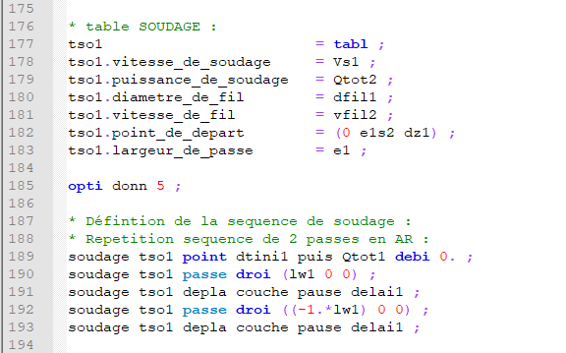
Example WAAM1.DGIBI
File waam1_formation.dgibi :
Definition of the manufacturing sequence – call to SOUDAGE procedure

Slide 23
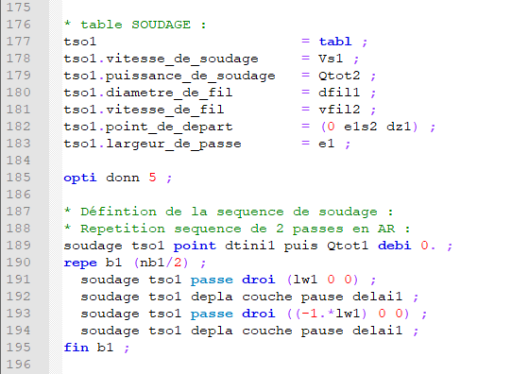
Example WAAM1.DGIBI
File waam1_formation.dgibi :
Definition of the manufacturing sequence – call to SOUDAGE procedure

Slide 24
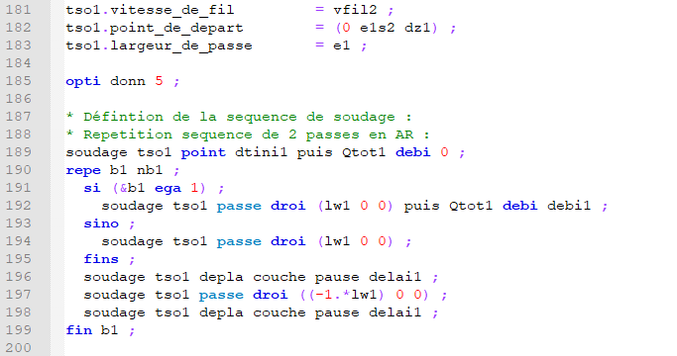
Example WAAM1.DGIBI
File waam1_formation.dgibi :
Definition of the manufacturing sequence – call to SOUDAGE procedure

Slide 25
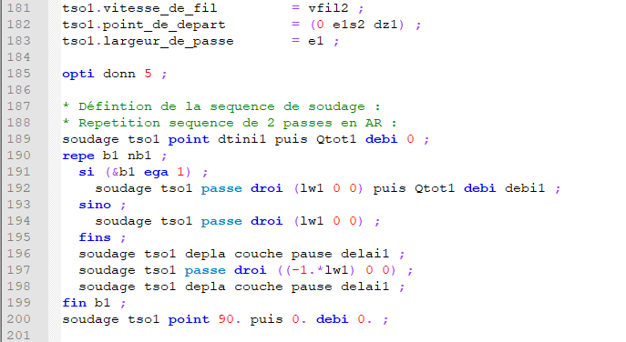
Example WAAM1.DGIBI
File waam1_formation.dgibi :
Definition of the manufacturing sequence – Call SOUDAGE procedure

Slide 26
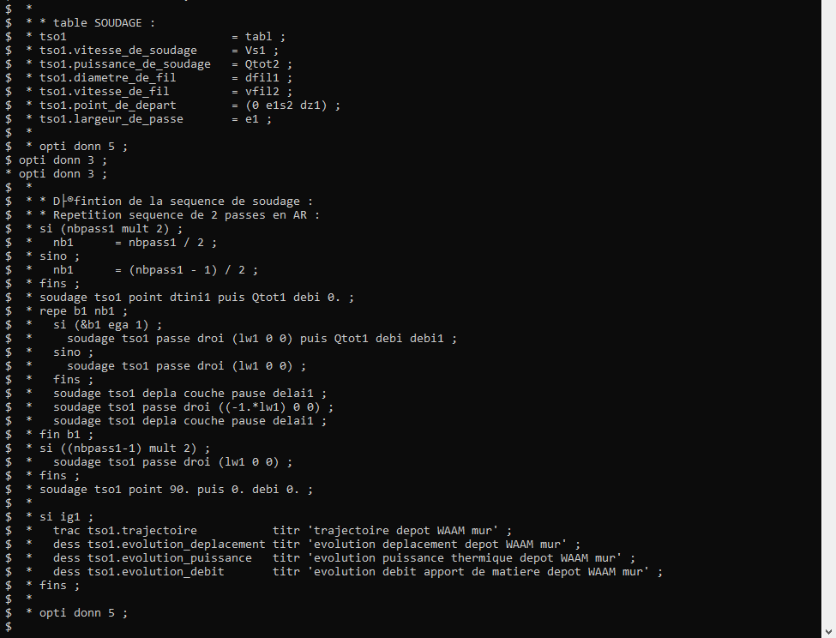
Example WAAM1.DGIBI
Continuation of waam1_formation.dgibi
  Type :
  opti donn 3 ;
  Program continues,
  then stops again on:
  OPTI DONN 5 ;

Slide 27
Example WAAM1.DGIBI
Procedure WAAM
  To mesh a manufacturing sequence defined with the SOUDAGE procedure.
  Syntax, option ‘MAIL’:
  TAB2 = WAAM TAB1 'MAIL' 'PAS' | FLOT1 | ('LARG' FLOT2) | ('DENS FLOT3) | (‘TEMP’ (FLOT4));
  | LRE1 | | (N1) |
  Inputs:
  TAB1 : TABLE type object, manufacturing sequence defined with the SOUDAGE procedure
  FLOT1 : FLOTTANT type object, space discretization step of material deposition.
  FLOT2 : FLOTTANT type object, welding pass width (if TAB1.LARGEUR_DE_PASSE not defined)
  FLOT3 : FLOTTANT type object, mesh density (~finite element side length)
  N1 : ENTIER type object, number of finite element by space discretization step (1 by default)
  FLOT4 : FLOTTANT type object, time discretization step for transient thermal analysis.
  By default, (1/π) of travel time of the first step of material deposition.

Slide 28
Example WAAM1.DGIBI
Procedure WAAM
  To mesh a manufacturing sequence defined with the SOUDAGE procedure.
  Syntax, option ‘MAIL’:
  TAB2 = WAAM TAB1 'MAIL' 'PAS' | FLOT1 | ('LARG' FLOT2) | ('DENS FLOT3) | (‘TEMP’ (FLOT4));
  | LRE1 | | (N1) |
  Outputs:
  TAB2 . MAILLAGE : MAILLAGE type object, mesh of the manufacturing
  TAB2 . EVOLUTION_MAILLAGE : TABLE type object, it has 2 sub-index:
  . TEMPS : TABLE type object, contains the instants of “mesh deposition”
  (FLOTTANT type objects), indexed by integers ranging from 0 to N.
  . MAILLAGE : TABLE type object, contains the meshes of the manufacturing
  (MAILLAGE type objects) at the corresponding instants and indices (0 to N).
  TAB2 . TEMPS_CALCULES : LISTREEL type object, list of time steps given by TEMP option.

Slide 29
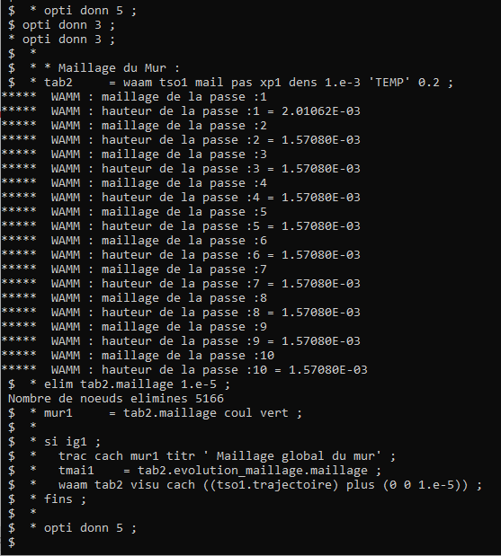
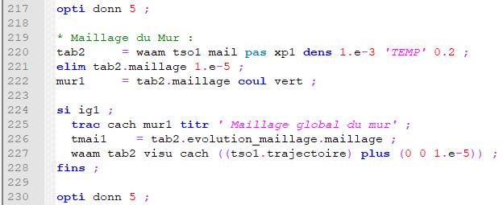
Example WAAM1.DGIBI
File waam1_formation.dgibi :
Meshing the manufacturing sequence –
Call WAAM procedure
  Type:
  opti donn 3 ;
  Program continues,
  then stops again on:
  OPTI DONN 5 ;

Slide 30
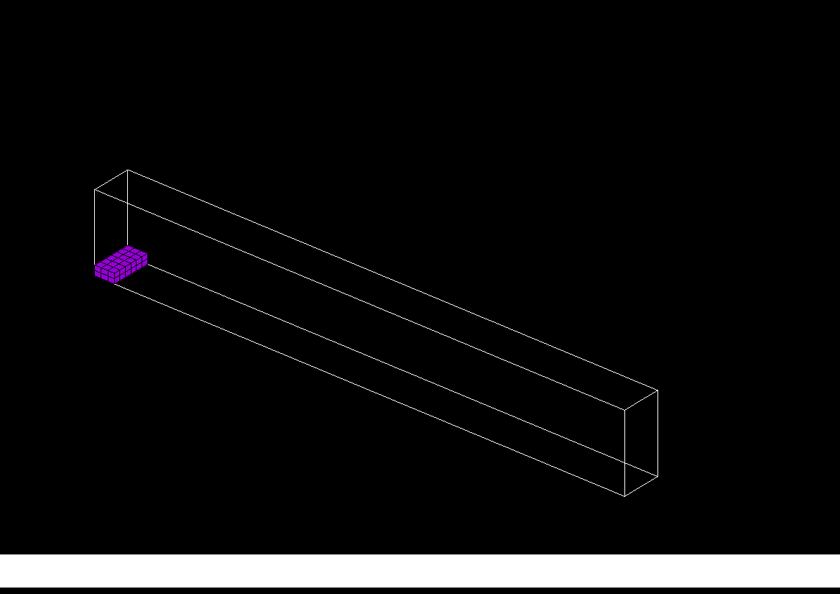
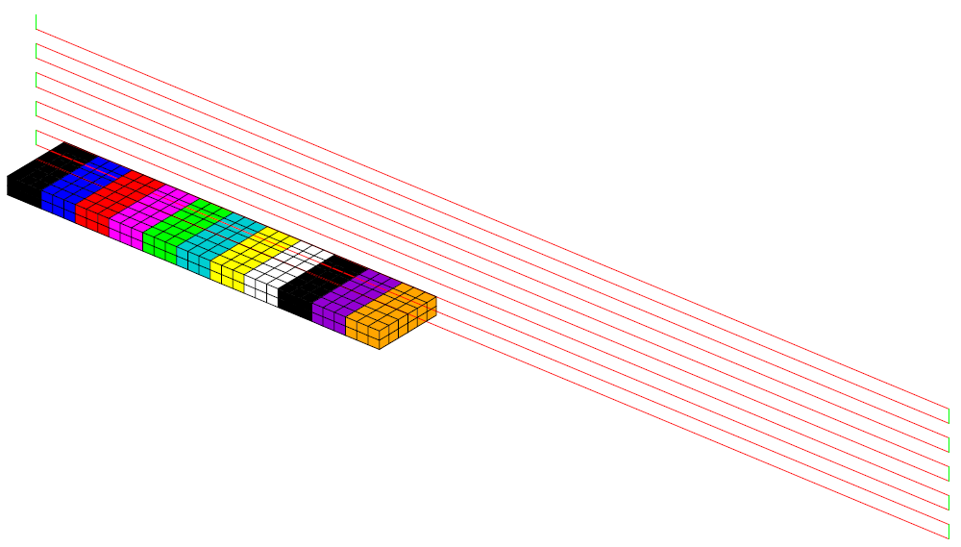
Example WAAM1.DGIBI
File waam1_formation.dgibi :
Meshing the manufacturing sequence – Call WAAM procedure
Material deposition mesh sequencing
Material deposition discretization step~ 3 mm

Slide 31
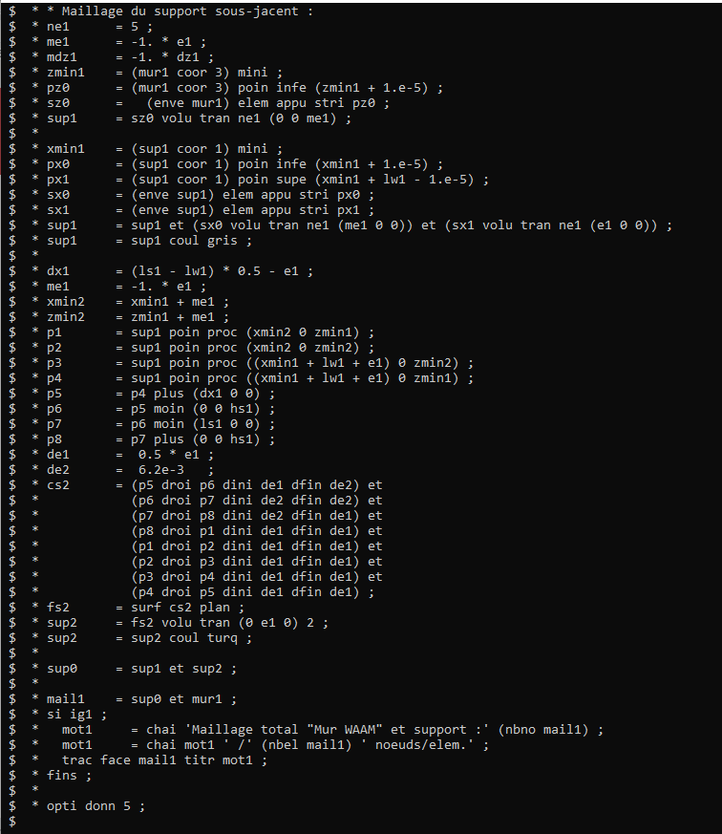
Example WAAM1.DGIBI
Continuation of waam1_formation.dgibi
  Type:
  opti donn 3 ;
  Program continues,
  then stops again on:
  OPTI DONN 5 ;

Slide 32
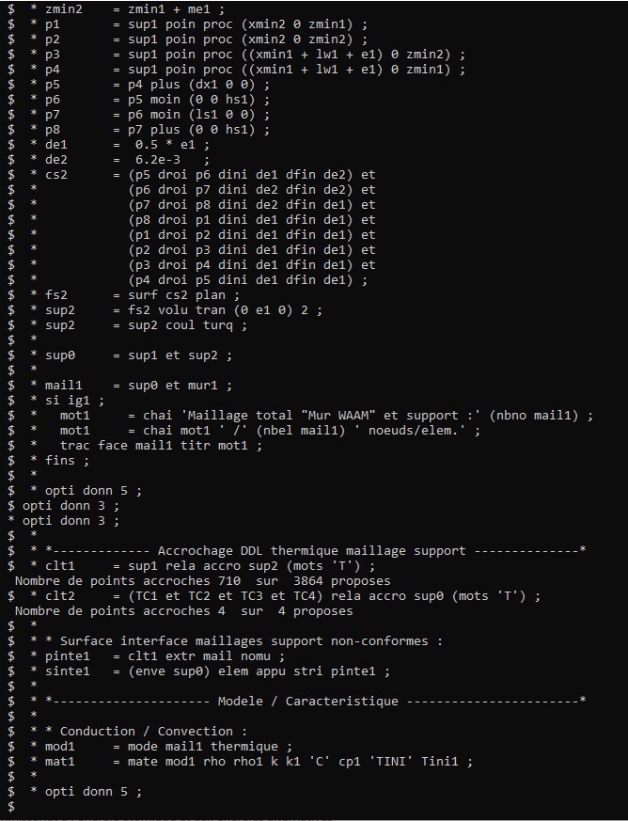
Example WAAM1.DGIBI
Continuation of waam1_formation.dgibi
  Type:
  opti donn 3 ;
  Program continues,
  then stops again on:
  OPTI DONN 5 ;

Slide 33
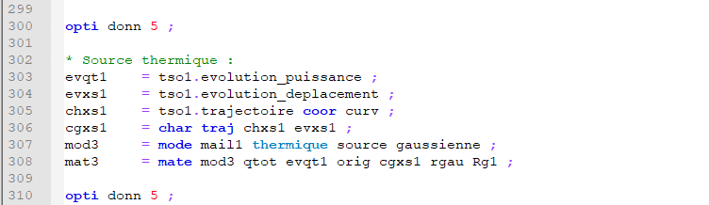
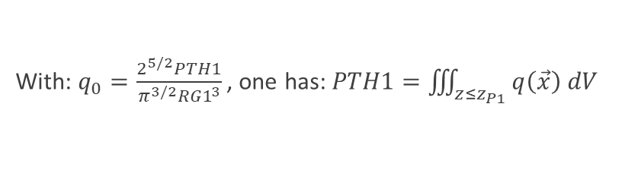

Example WAAM1.DGIBI
Gaussian heat source model
  Syntax :
  MOD1 = MODE GEO1 THERMIQUE SOURCE GAUSSIENNE ISOTROPE ;
  MAT1 = MATE MOD1 ‘QTOT’ PTH1 ‘ORIG’ P1 ‘RGAU’ RG1 ;
  Heat source volume distribution :
Heat source time displacement
Point P1 moves along the trajectory➔ time evolution of its curvilinear abscissa along the trajectory
PTH1 varies also over time (welding stops and starts) ➔ time evolution of the thermal power
$$q(\vec{x})=q_{0}e^{\left(−2\frac{{(x−x_{P1})}^{2}+{(y−y_{P1})}^{2}+{(z−z_{P1})}^{2}}{{RG1}^{2}}\right)}$$
With: $q_{0}=\frac{2^{5/2}PTH1}{π^{3/2}{RG1}^{3}}$, one has: $PTH1=\iiint_{z≤z_{P1}}{q\left(\vec{x}\right) dV}$

Slide 34
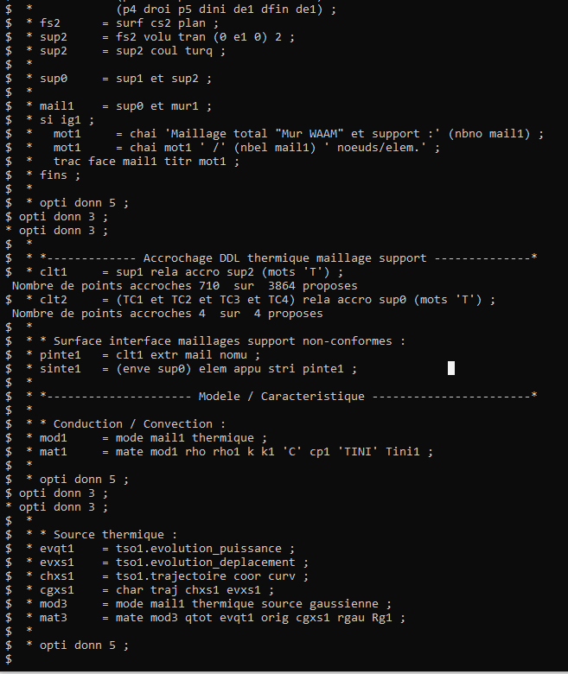
Example WAAM1.DGIBI
Continuation of waam1_formation.dgibi
  Type:
  opti donn 3 ;
  Program continues,
  then stops again on:
  OPTI DONN 5 ;

Slide 35
Example WAAM1.DGIBI
Material deposition modeling – Definition of CHARGEMENT of models and materials
  Reminder : concepts of MODELE et MATERIAL in Cast3M
  MOD1 = MODE GEO1 THERMIQUE CONDUCTION CONS ‘316L’ ; ➔ defines a thermal model over GEO1
  MAT1 = MATE MOD1 RHO RHO1 K K1 C CP1 ; ➔ defines the material characteristics of MOD1
  Material deposition
  GEO1 evolves over time➔ MOD1 is discretized as GEO1 (mesh sequence)
  TTPS1 = TAB2.EVOLUTION_MAILLAGE.TEMPS ;
  TMAI1 = TAB2.EVOLUTION_MAILLAGE.MAILLAGE ;
  NB1 = DIME TMAI1 ;
  TMOD1 = TABLE ;
  TMAT1 = TABLE ;
  I1 = 0 ;
  REPE B1 NB1 ;
  TMOD1 . I1 = REDU MOD1 (TMAI1 . I1) ;
  TMAT1 . I1 = REDU MAT1 (TMOD1 . I1) ;
  I1 = I1 + 1 ;
  FIN B1 ;
  Definition de CHARGEMENT of MODE and MATE
  CGMOD1 = CHAR MODE TTPS1 TMOD1 ; ➔ defines a MODE CHARGEMENT that describes the time evolution of the model
  CGMAT1 = CHAR MATE TTPS1 TMAT1 ; ➔ idem for material characteristics
  MOD(t1) = TIRE CGMOD1 MODE t1 ; ➔ supplies the model MOD(t1) to use at time t1 (idem with CGMAT1)
with MOD1 et MAT1 defined on the final geometry

Slide 36
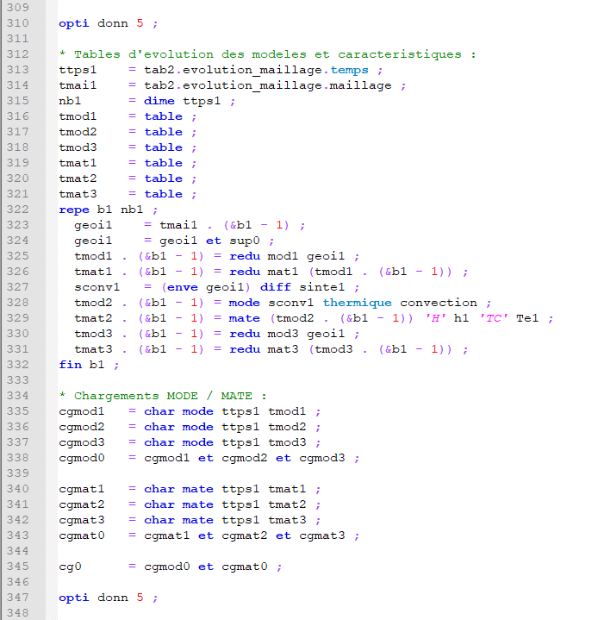
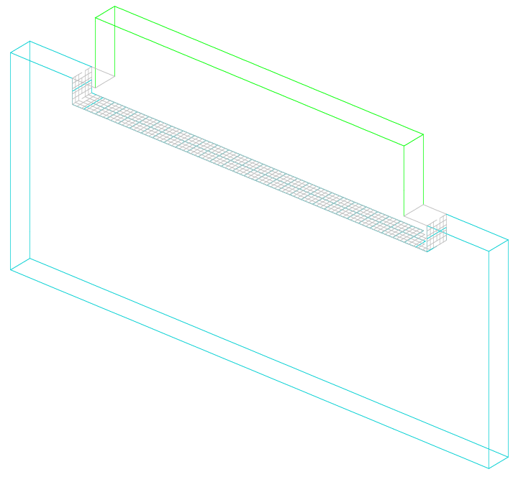
Example WAAM1.DGIBI
File waam1_formation.dgibi : model and material characteristics sequencing
sinte1

Slide 37
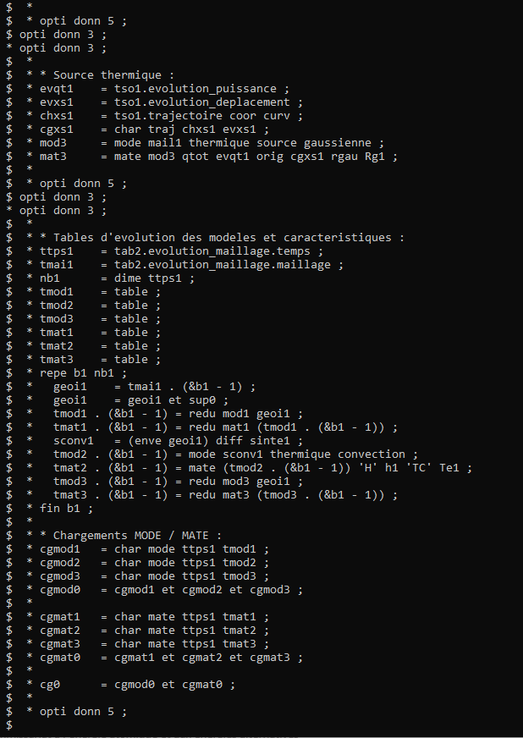
Example WAAM1.DGIBI
Continuation of waam1_formation.dgibi
  Type:
  opti donn 3 ;
  Program continues,
  then stops again on:
  OPTI DONN 5 ;

Slide 38
Example WAAM1.DGIBI
CHARGEMENT of type MODE et MATE : how to use with PASAPAS?
  In input: add the CHARGEMENT MODE and MATE to PASAPAS table
  TPAS1 = TABLE ;
  TPAS1 . CHARGEMENT = CGMOD1 ET CGMAT1 ET …
  TPAS1 . MODELE = TIRE CGMOD1 MODE t0 ;
  TPAS1 . CARACTERISTIQUES = TIRE CGMAT1 MATE t0 ;
  …
  In outputs: new output index TAB1.MODELES = models used at the corresponding time steps.
  MODi1 = TPAS1 . MODELES . i1 ;
  SIGi1 = TPAS1 . CONTRAINTES . i1 ;
  TRAC SIGi1 MODi1 ;
  To get the mesh belonging on the model:
  GEOi1 = EXTR MODi1 MAIL ;
  DEPi1 = TPAS1 . DEPLACEMENTS . i1 ;
  TRAC DEPi1 GEOi1
  Remark:
  With a thermal model concatenating conduction + convection + … ➔ GEOi1 does not contains only solid elements
  GEOi1 = (EXTR MODi1 MATE CONDUCTION) EXTR MAIL ;

Slide 39
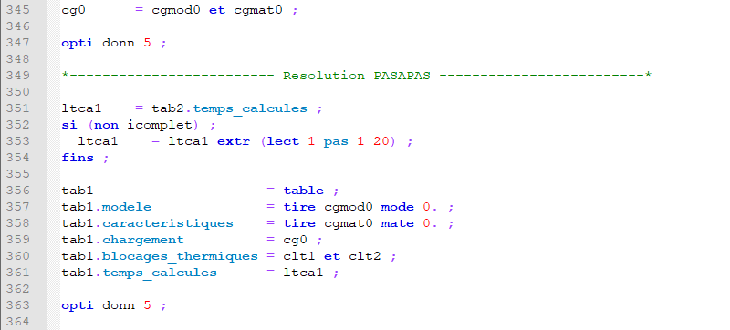
Example WAAM1.DGIBI
File waam1_formation.dgibi : PASAPAS table

Slide 40
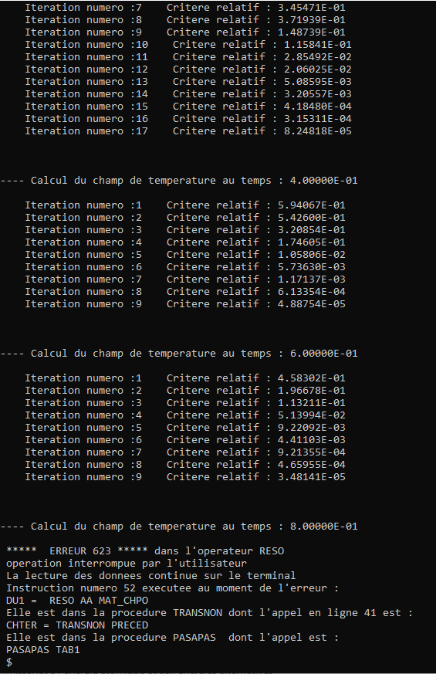
Example WAAM1.DGIBI
Continuation of the file waam1_formation.dgibi :
RESOLUTION with PASAPAS procedure
  Type:
  opti donn 3 ;
  The program continues and resolution starts.
  Stop it by pressing: CTRL + C

Slide 41
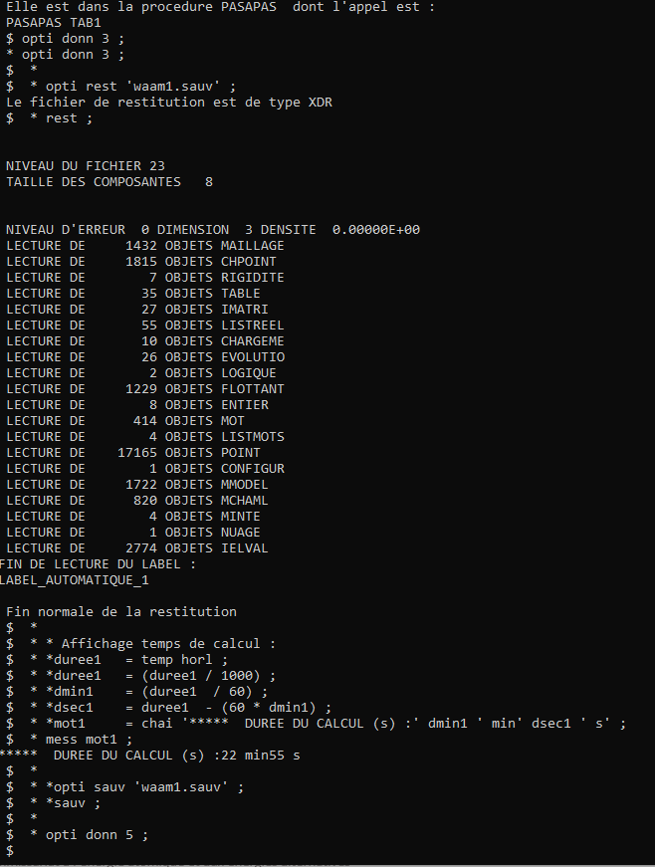
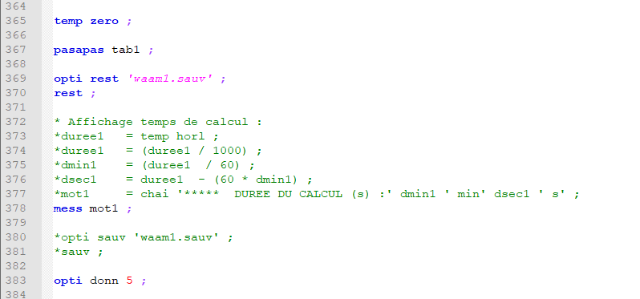
Example WAAM1.DGIBI
Continuation of the file waam1_formation.dgibi :
  Type:
  opti donn 3 ;
  The program restore the saved results from
  the saved file.

Slide 42
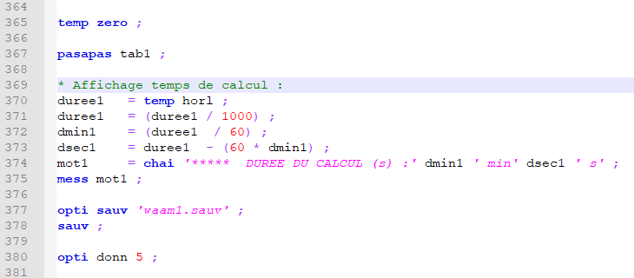
Example WAAM1.DGIBI
Continuation of the file waam1_formation.dgibi :
  Remarks on the executed code (save / restore).
waam1_formation.dgibi
waam1.dgibi
CTRL + C, then: “opti donn 3 ;”

Slide 43
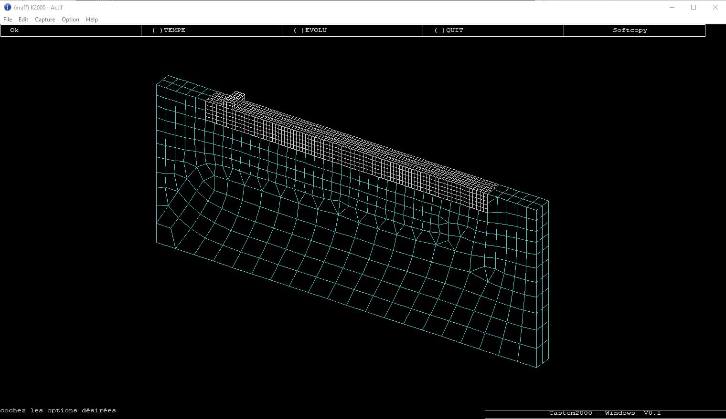
Example WAAM1.DGIBI
Procedure EXPLORER : post-treatment of the PASAPAS result table
  Type:
  explorer TAB1 ;
  (temperature visualization)
  Quit EXPLORER and type:
  Trac sup0 cach qual ;
  Then:
  Lx1 = (aret sup0) elem comp P1 P4 ;
  Then, once again:
  Explorer tab1 ;
  (space evolution of T along LX1)
  (time evolution of T in P1)

Slide 44
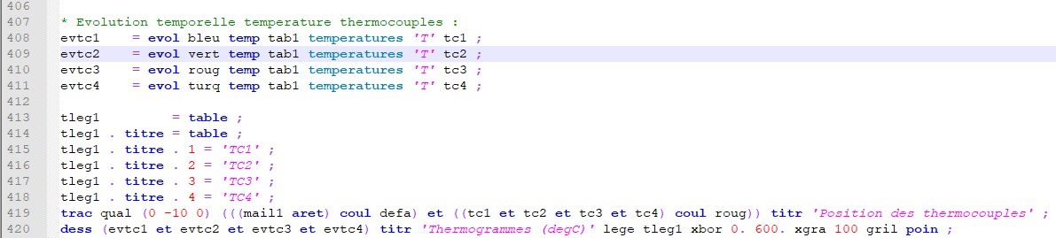
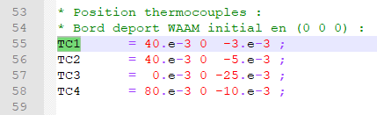
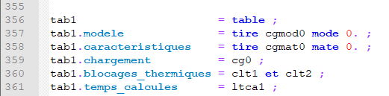
Example WAAM1.DGIBI
Continuation of the file waam1_formation.dgibi : temperature measurements post-processing
  Time:
  opti donn 3 ;

Slide 45
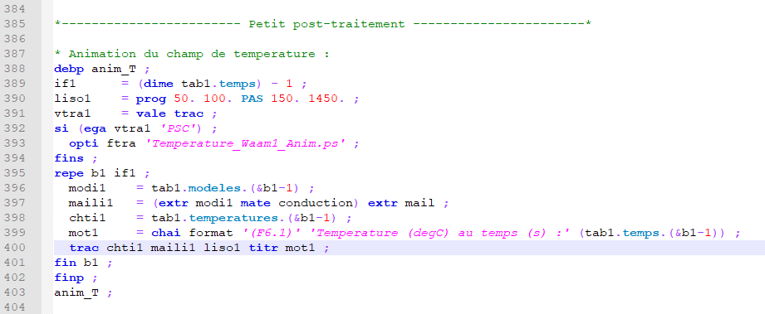
Example WAAM1.DGIBI
Continuation of the file waam1_formation.dgibi : temperature field charts animation
  Type:
  opti donn 3 ;
  Click on « Fin trace »:
  ➔ A new temperature field is displayed.
  After a few clicks, press:
  CTRL+C
  Then, « Fin trace » to regain control.
  Type:
  opti trac PSC ;
  ANIM_T ;
  Type:
  FIN ;

Slide 46
Example WAAM1.DGIBI
How to realize an animated GIF file
  In the current directory, you should find the file (type « ls » on the command line) :
  Temperature_Waam1_Anim.ps
  To convert this file in an animated GIF file, type:
  ps2gif –d 10 Temperature_Waam1_Anim.ps
  After 1 or 2 minutes, you get:
  Temperature_Waam1_Anim.gif
  To display it with Firefox, type:
  firefox Temperature_Waam1_Anim.gif

Slide 47
WAAM2.DGIBI

Slide 48
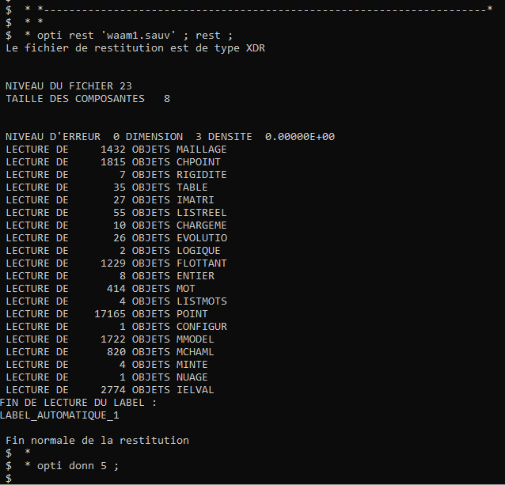
Example WAAM2.DGIBI
Start of the file waam2_formation.dgibi
  For this training, we only compute the “mechanical part” of waam2.dgibi.
  So, let us restore the thermal analysis (waam1.dgibi) and pursue.
  Type:
  castem22 waam2_formation.dgibi

Slide 49
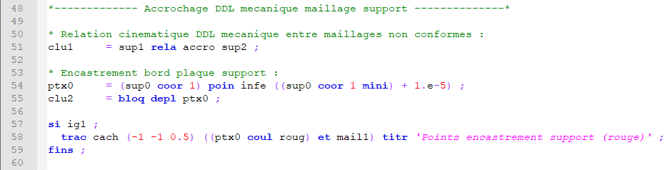
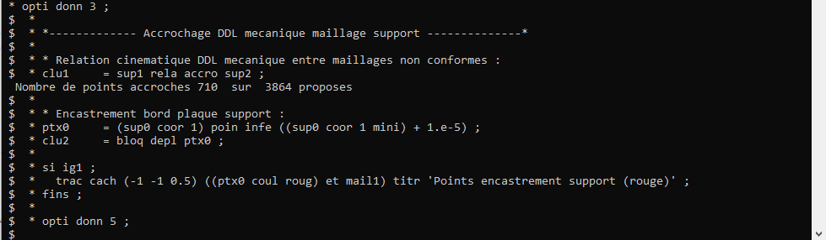
Example WAAM2.DGIBI
Continuation of the file waam2_formation.dgibi : Boundary conditions
  Type:
  Opti donn 3 ;

Slide 50
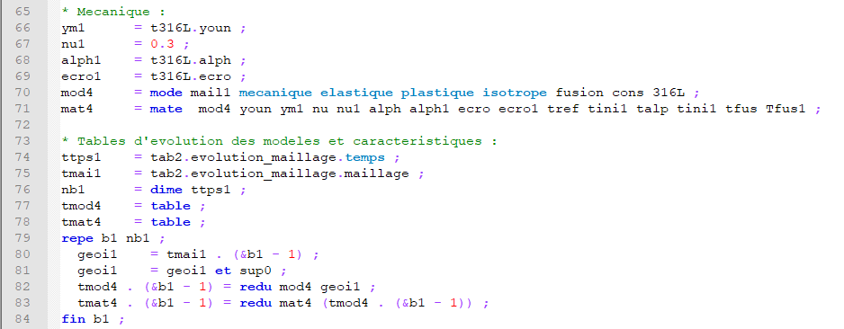
Example WAAM2.DGIBI
Mechanical model – Option FUSION
  Basic model to account for plastic hardening annealing at high temperature
  ➔ reset to zero hardening internal variables of the mechanical behavior law if T > T_{fusion}
  Syntax
  MOD1 = MODE GEO1 MECANIQUE ELASTIQUE PLASTIQUE… FUSION ; ➔ model with FUSION option
  MAT1 = MATE MOD1 YOUN ... TFUS TFUS1 ; ➔ value of TFUS
  Material deposition modelling
  As the thermal model, the time evolution of the mechanical model is sequenced into a table

Slide 51
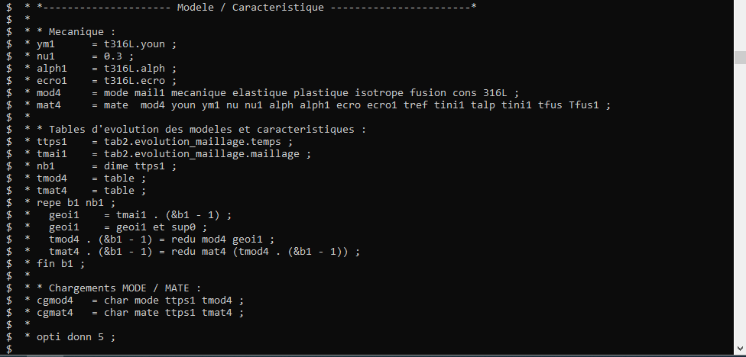
Example WAAM2.DGIBI
Continuation of the file waam2_formation.dgibi : mechanical model definition and sequencing
  Type:
  Opti donn 3 ;

Slide 52
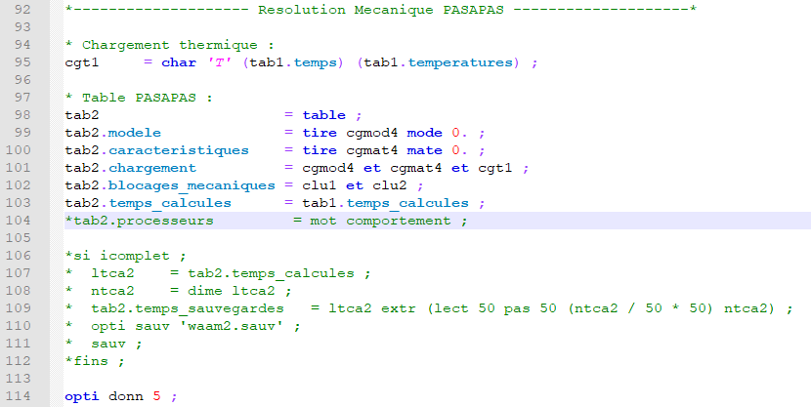
Example WAAM2.DGIBI
Thermal loading and PASAPAS input table definition

Slide 53
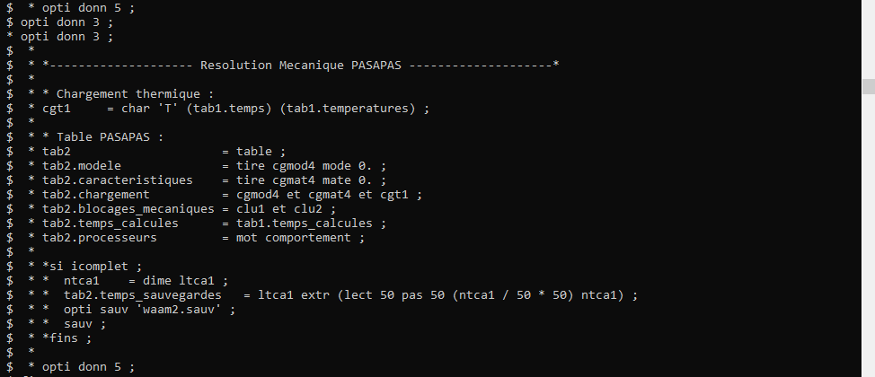
Example WAAM2.DGIBI
Continuation of the file waam2_formation.dgibi : PASAPAS input table definition
  Type:
  Opti donn 3 ;

Slide 54
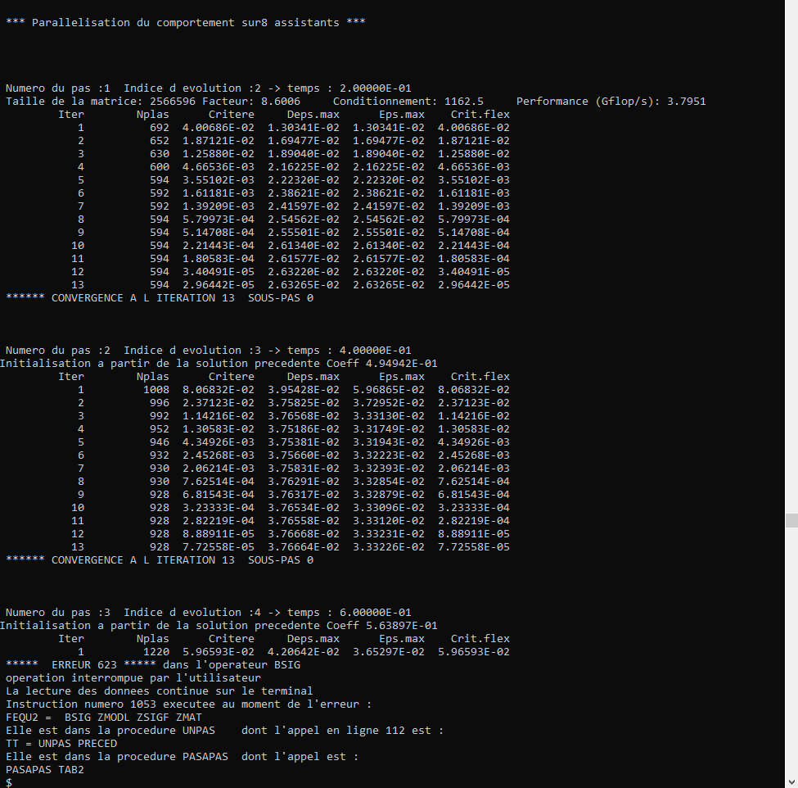
Example WAAM2.DGIBI
Continuation of the file waam2_formation.dgibi
RESOLUTION with PASAPAS procedure
  Type:
  Opti donn 3 ;
  The program continues,
  the resolution starts.
  Stop it by pressing: CTRL + C

Slide 55
Example WAAM2.DGIBI
Continuation of the file waam2_formation.dgibi
  Type:
  Opti donn 3 ;
  The program restores the mechanical results from the saved file.

Slide 56
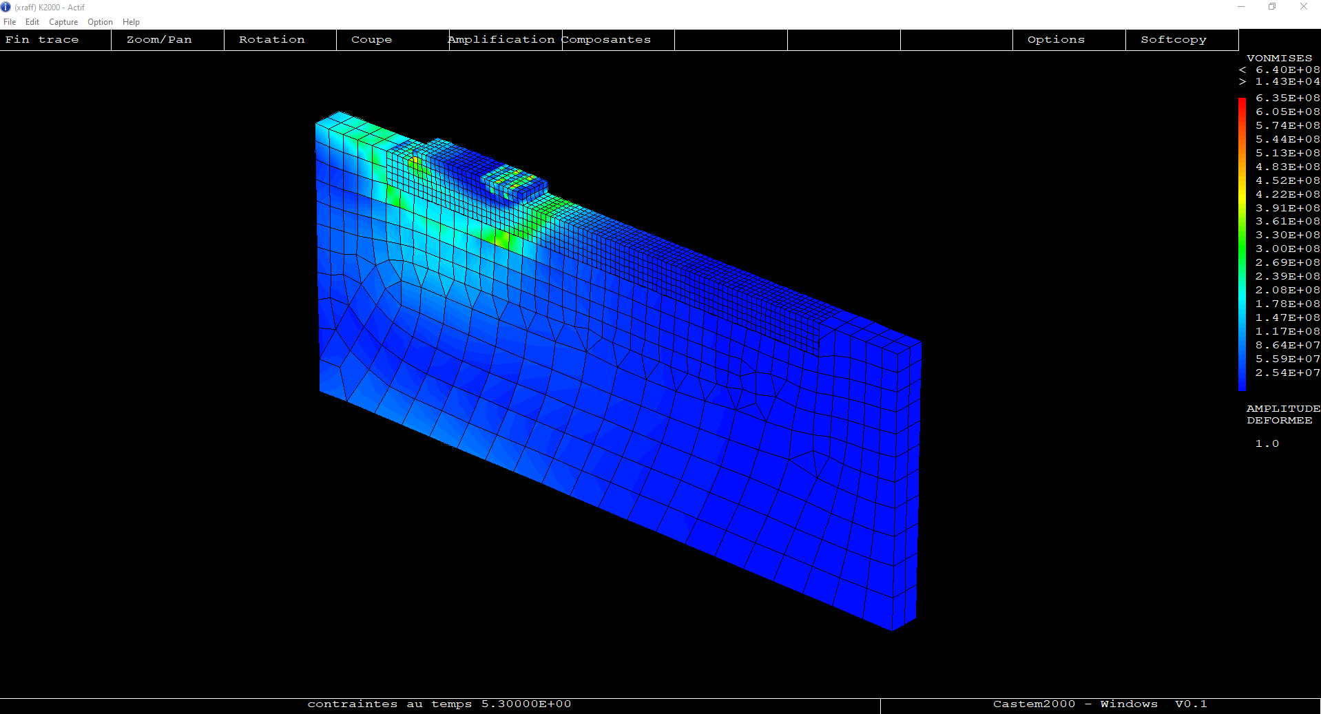
Example WAAM2.DGIBI
Procedure EXPLORER : post-processing of the PASAPAS result table
  Type:
  explorer TAB2 ;
  (stress field visualization)
  trac cach sup0 qual ;
  (time evolution of Uz at point P5)
  (time evolution of Rx at point P8)
  Quit EXPLORER procedure.

Slide 57
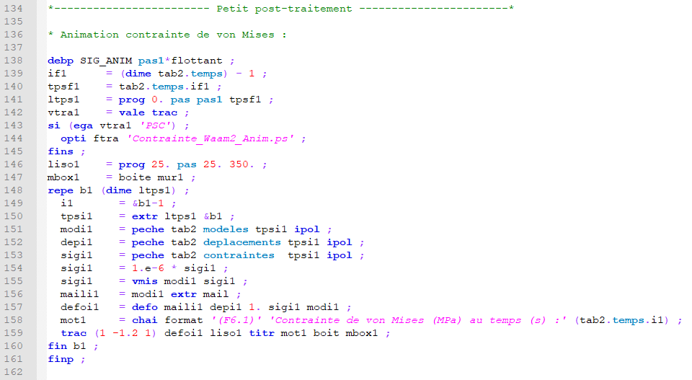
Example WAAM2.DGIBI
Continuation of the file waam2_formation.dgibi : stress field charts animation
  Type:
  opti donn 3 ;
  SIG_ANIM ;
  Click on « Fin trace » :
  ➔ A new frame is displayed.
  After a few clicks, press:
  CTRL+C
  Then, « Fin trace » to regain control.
  Type:
  opti trac PSC ;
  SIG_ANIM 0.5 ;
  Type:
  FIN ;

Slide 58
Example WAAM2.DGIBI
To get an animated GIF file
  In the current directory, you should find the file (type « ls ») :
  Contrainte_Waam2_Anim.ps
  To convert this file in an animated GIF file, type:
  ps2gif –d 10 Contrainte_Waam2_Anim.ps
  After 1 or 2 minutes, you should get the file:
  Contrainte_Waam2_Anim.gif
  To display it with Firefox, type:
  firefox Contrainte_Waam2_Anim.gif

Slide 59
ONGOING DEVELOPMENTS IN CAST3M

Slide 60
Ongoing developments
Reminders about Cast3M web site
  Cast3M source and documentation files showed on the web site (manual pages, examples, Gibiane procedures, Esope files…) are those of the version in development.
  Source and documentation files of annual version are supplied with the version.
  Cast3M web site is a window on the version in development.
  It gives an access to upgrade functionalities of annual versions.
  To get manual pages of your annual version, see the embedded documentation.
  If you face a bug in an operator or a procedure of your Cast3M version…
  Check if a correction exists in the development version, section anomalies (then search by key-words).
  Demo. : Anomalies | Cast3M (cea.fr)

Slide 61
Ongoing developments
Sequencing models and material characteristics… : LISTOBJE type object
  New object LISTOBJE : defines a list of objects of the same type.
  Syntax :
  LOBJ1 = ENUM OBJ1 OBJ2 … ;
  With :
  OBJ1, OBJ2… : objects of the same type
  LOBJ1 : result, LISTOBJ object
  Works with ET operator:
  LOBJ3 = LOBJ1 ET LOBJ2 ;
  LOBJ1 et LOBJ2 list of objects of all the same type.
  Or:
  LOBJ2 = LOBJ1 ET OBJ1 ;
  OBJ1, object of the same type as those contained in LOBJ1.

Slide 62
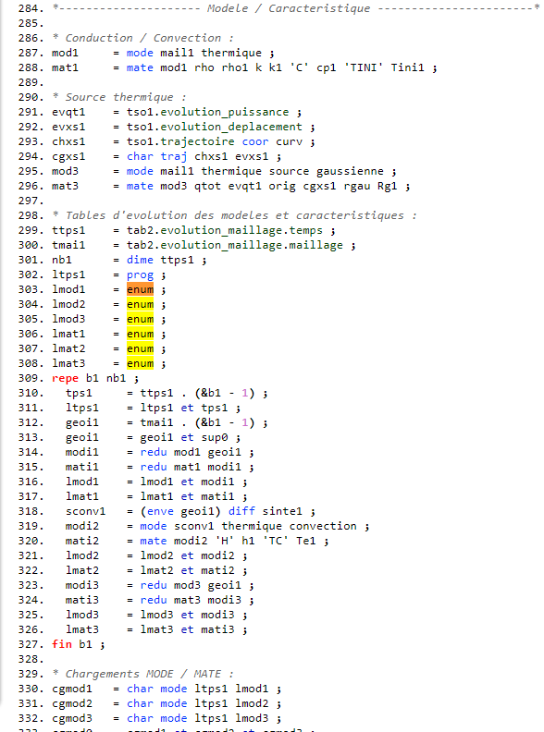
Ongoing developments
WAAM1.DGIBI
Sequencing models and material characteristics…
LISTOBJE type object
  Replace the use of tables.
  Also use to define CHARGEMENT:
  CGMOD1 = CHAR MODE LTPS1 LMOD1 ;
  With : LMOD1, LISTOBJ type object (list of models)
  Now used in “WAAM examples” (waam1.dgibi, waam2.dgibi…)

Slide 63
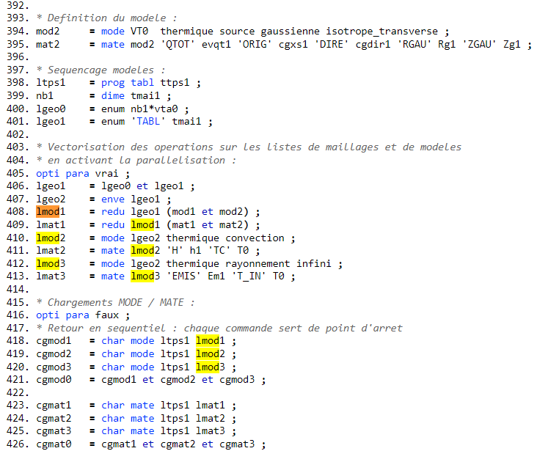
Ongoing developments
Sequencing models and material characteristics… : LISTOBJE type object
  LISTOBJE enables operator vectorization.
  Used in waam4.dgibi.
WAAM4.DGIBI
Vectorization on
Vectorization off

Slide 64
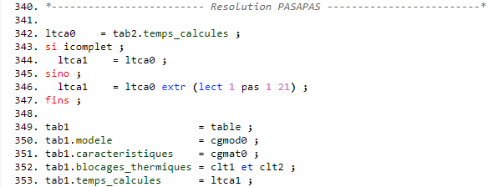
Ongoing developments
CHARGEMENT of MODE and MATE in PASAPAS input table
  CHARGEMENT of MODE and MATE are now input as model and characteristics in PASAPAS table:
  TAB1 . MODELE = CGMOD1 ;
  TAB1 . CARACTERISTIQUES = CGMAT1 ;
  TAB1 . BLOCAGES_... = CGBLO1 ;
  CHARGEMENT objects are used to describe models and material characteristics with geometrical support that evolves with time,
  But they are not mechanical or thermal loading, really models and material characteristics.
  Now used in “WAAM examples”.

Slide 65
Bug corrections and improvements
Corrections et modifications of SOUDAGE and WAAM procedures
  Procedure SOUDAGE: modification of DEPLA COUCHE option:
  SOUDAGE TAB1 DEPLA 'COUCHE' (‘VITE' FLOT2) (‘DEBI' FLOT3) ('PAUSE' FLOT4) ;
  Miscellaneous bug fixes in SOUDAGE and WAAM procedures (see fiches anomalies).
Corrections and improvements in PASAPAS procedure according to material deposition modelling

Slide 66
Exercises

Slide 67
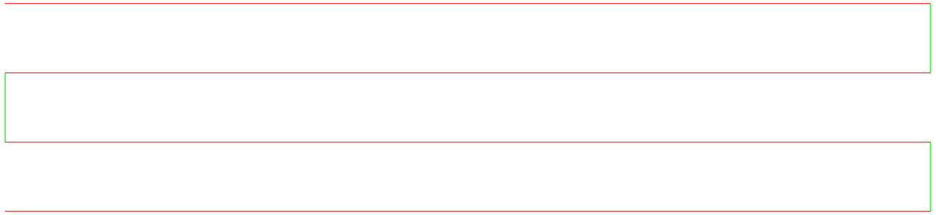
Exercises
Exo1.dgibi: manufacturing a wall
  Run the file exo1.dgibi and use the procedure SOUDAGE to define this manufacturing trajectory:
  Visualize the trajectory and the time-evolution of the tool displacement, heat supply and material flow.
  Mesh this trajectory with the procedure WAAM. Discretize the material addition with a step of 2mm and a mesh size (density) of 1mm.
  Visualize the final mesh in output of the procedure WAAM. Merge the nodes in double (ELIM).
  Visualize the material deposition by programming a loop that displays the time evolution of this mesh.
  The previous trajectory represents the deposition of 1 layer.
  Modify your script to model the deposition of 4 layers. At the end of each layer, the tool goes back to the starting point, one layer height up, and waits 2 min before restarting manufacturing (time to displace to the upper layer can be neglected). Visualize your results.
  Modify your script to have an offset of 1.5mm in the “Lw1” direction at the beginning of every new layer (the pass length is reduced by this offset) . Check the merging of the nodes at the offset. Find a solution to get a conforming mesh.
Lw1
e1

Slide 68
Exercises
Exo2.dgibi: manufacturing a tube
  Run the file exo2.dgibi and use the procedure SOUDAGE to define a pass along a circle of radius Rw1 centered at the origin (check if the “starting point” of the procedure is well defined). Build the circle by quarters. You can define extra points to use with the CERC option of the procedure SOUDAGE.
  Repeat it nbpass1 times to define the manufacturing of a tube. Do not use the COUCHE option to go to the upper layer (calculate the pass height). The starting point of each pass must be rotated 90° from the previous one.
  Define a CHARGEMENT of trajectory (CHAR TRAJ) and use it to display the evolution of a point on the trajectory with a time step of 5 s (make a loop, press CTRL+C to stop).
  Use the WAAM procedure to mesh the manufacturing sequence with a material deposition step of 5 mm and a mesh size of 2.5mm.
  Visualize the global mesh before and after merging the nodes.
  We want to mesh the base plate of the tube manufacturing:
  Mesh the border of a square of side 4Rw1 with a mesh density of 10mm, centered with the tube. Z coordinate of the square must be the same as the base surface of the tube (get it from the tube mesh).
  Catch the base surface of the tube (use the POINT operator to get the points at minimal z coordinate and the ELEM operator to get the surface mesh that belongs on these points). Then, get its edges (CONTour operator).
  Separate the inner and outer lines of the tube base edges with the PART operator, CONNex option. Then, mesh the surface between the square outline (LSQ1) and the outer tube edge (LTO1) (use SURF PLAN (LSQ1 et LTO1)).
  Mesh the part of the base plate surface inside the tube. Give a node field to specify a mesh density of 5 mm.
  Concatenate the inner and outer surfaces of the base plate and the base surface of the tube and mesh the volume of the plate (VOLU TRAN). Its thickness is 20mm. Visualize the plate mesh alone, then together with the tube.

Slide 69
Exercises
Download the procedure SOUDAGE on the Cast3M website.
Exo3.dgibi: manufacturing a branching tap on a pipe
  Run the file exo3.dgibi and display the meshes VTA0 and VTB0. Use the BOIT option of TRAC to focus the display on VTB0 using a box build by the procedure BOITE.
  The display shows the beginning of the branching (VTB0) and a part of the main tube (VTA0). The mesh of the branching is made of 5 layers of different colors. The goal of this exercise is to define the time sequence of the deposition of each layer.
  The trajectory of each layer is define in table ttrj1. Display the 1st layer trajectory (ttrj1.1) together with the mesh of the 1st layer (LIST the VTB0 mesh colors with ELEM operator, then get the mesh of the 1st color name of the list).
  Define the 1st manufacturing pass with the procedure SOUDAGE using the MAIL option and the trajectory given in table ttrj1 (fabrication table name is tfab1) . Before starting manufacturing, define a heating delay of dtini1 at the thermal power Qs1.
  Define a displacement of the tool to the starting point of the next pass (ttrj1.2). Use the POINT operator to get this point (pay attention to the system of coordinates of the point). This displacement must last dtpasse1 s.
  Repeat this sequence to define the manufacturing of the other layers.
  Now, we want to define the time evolution of the mesh deposition of this manufacturing sequence.
  Use the MAIL option of the procedure SOUDAGE to define the time evolution of the mesh deposition (use a space step of 10.e-3 for the mesh sequencing).
  Visualize the mesh deposition with time.

Slide 70
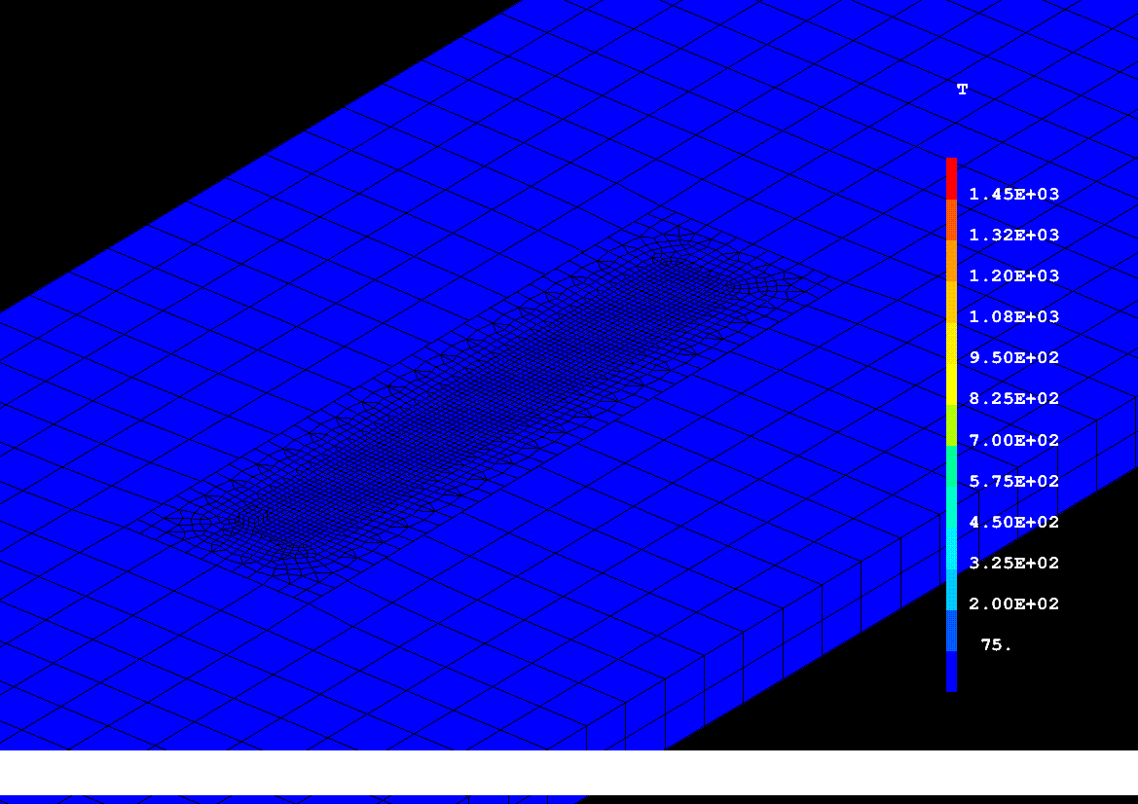
Merci de votre attention
S. Pascal

