Slide 1
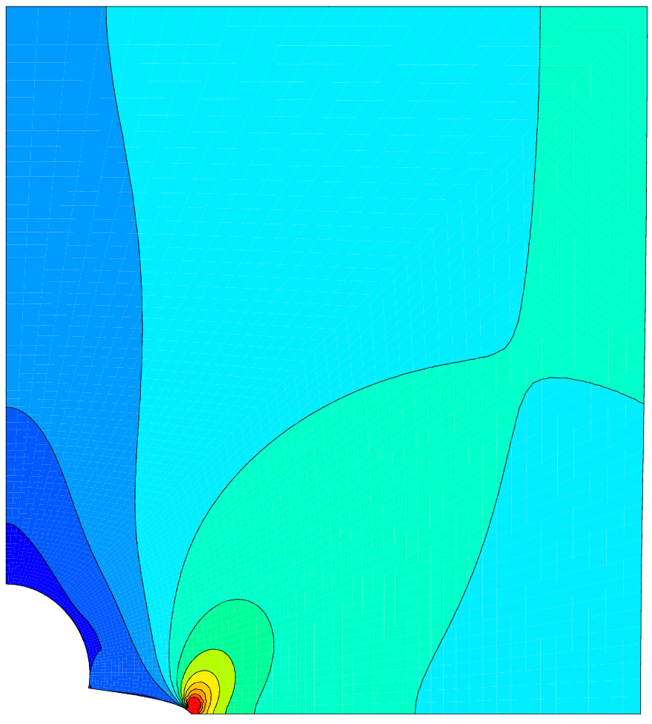
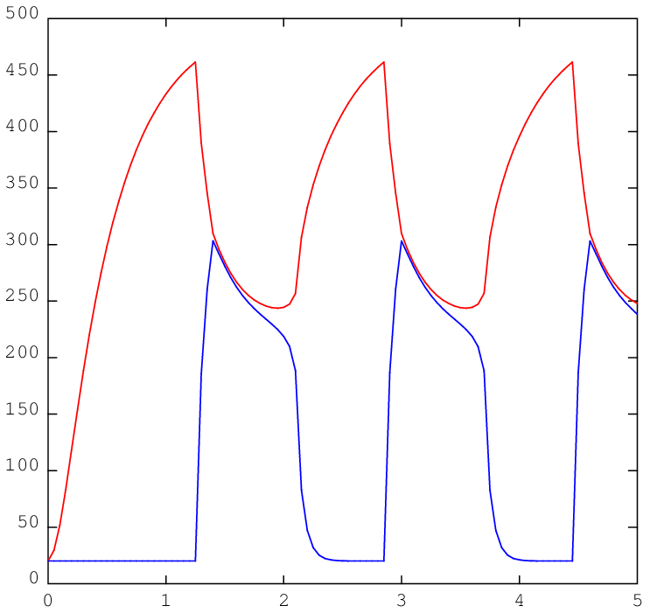
The PASAPAS procedure and the users procedures available on : http://www-cast3m.cea.fr/index.php?xml=formations
François DI PAOLA, Caroline GUERIN
Last changes: November 30 2022

Slide 2
Summary
Introduction to Cast3M and reminders on PASAPAS
PASAPAS operation
Finding the mechanical equilibrium: UNPAS
Exercise 1: following load
Exercise 2: failure by elements removal
Finding the thermal equilibrium: TRANSNON
Exercise 3: variable heat source
Exercise 4: thermo-mechanical contact

Slide 3
Introduction to Cast3M reminders on PASAPAS

Slide 4
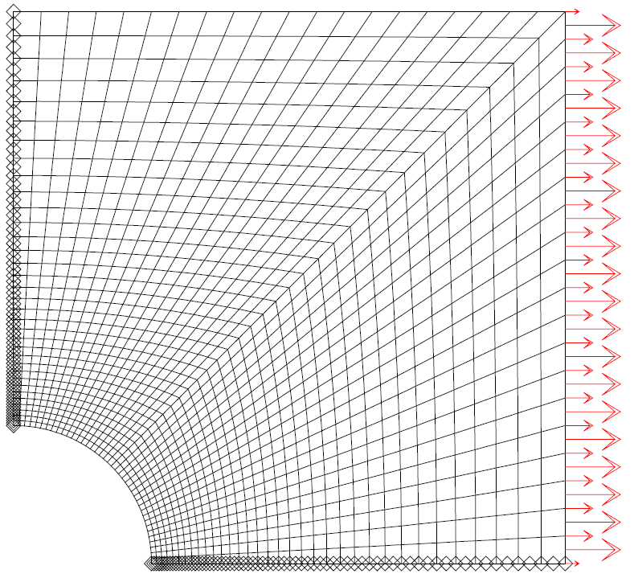
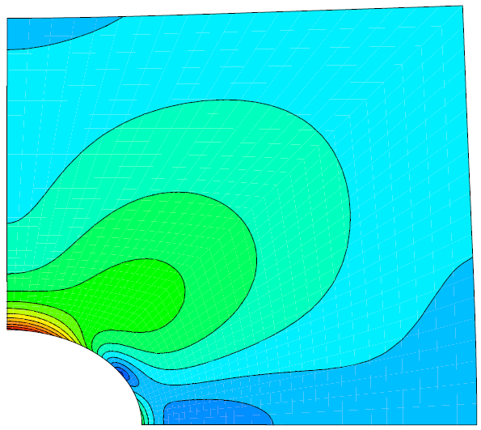
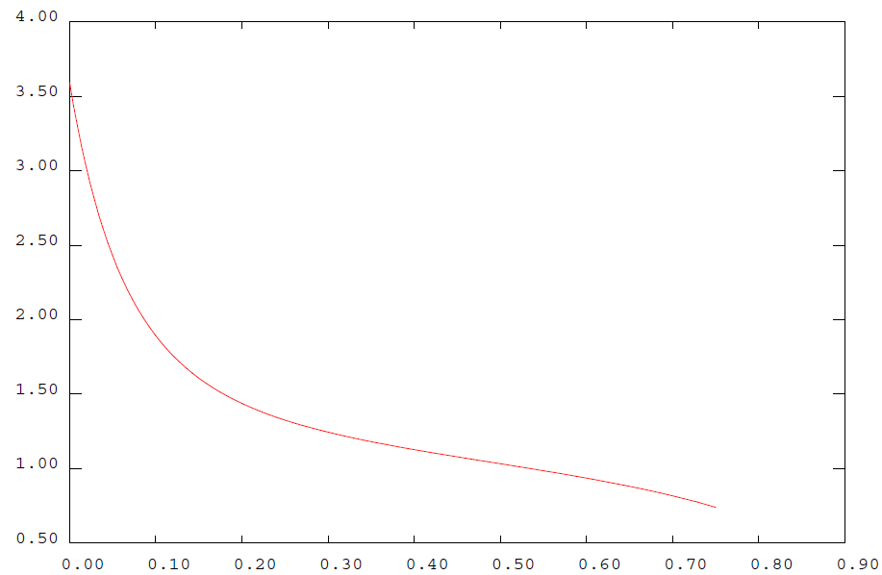
Cast3M, quid ?
A finite element software
for structural and fluid mechanics
Partial differential equations solved with the finite element method
Complete software: solver, pre-processing and post-processing, visualization
Based on an objet-oriented programming language: Gibiane

Slide 5
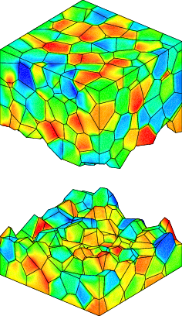
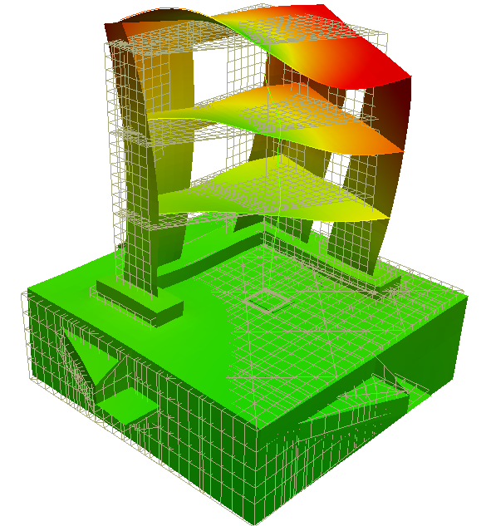
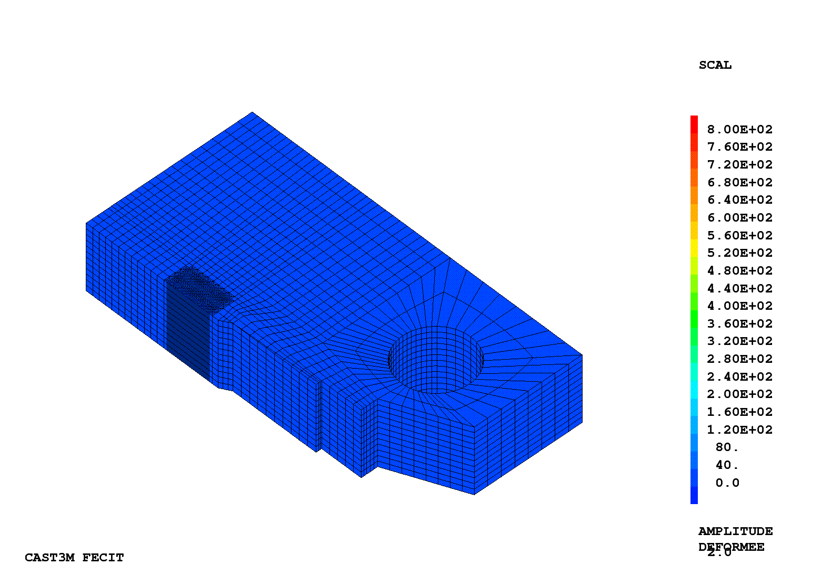
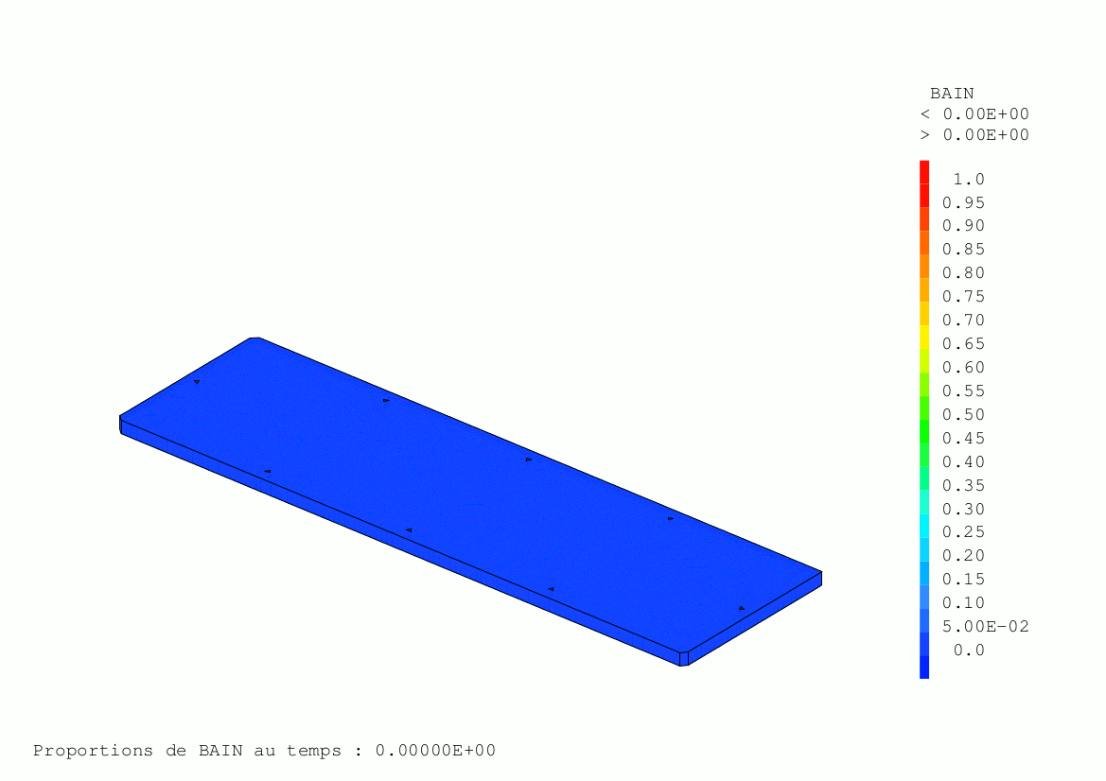
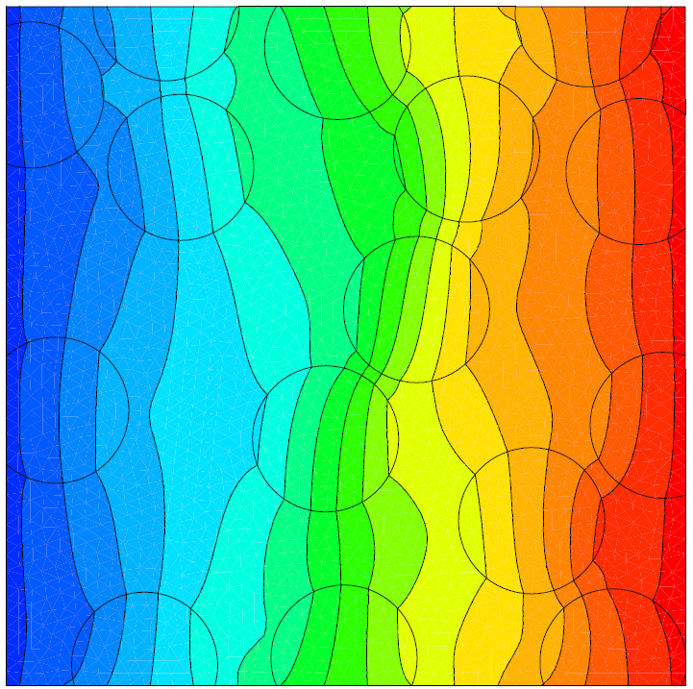
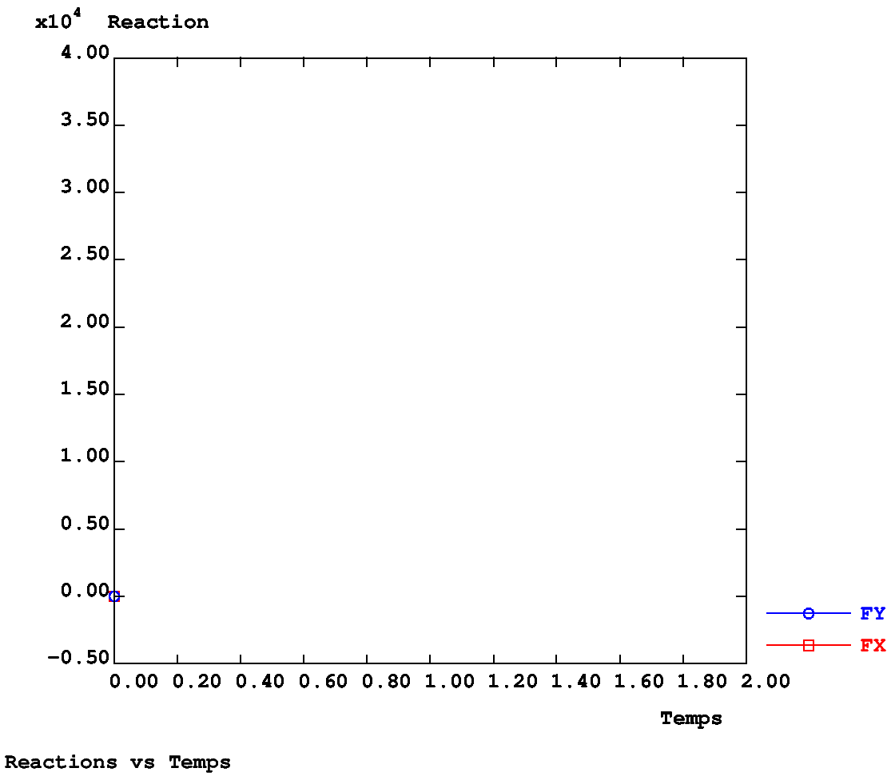
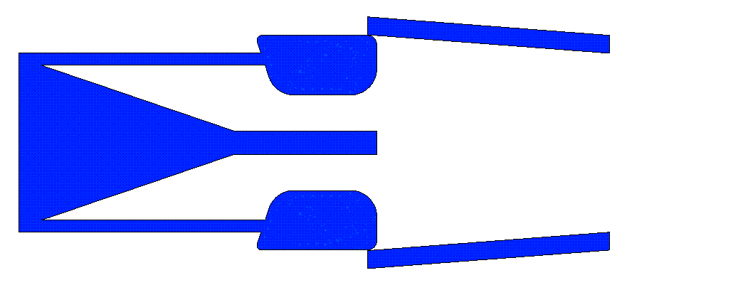
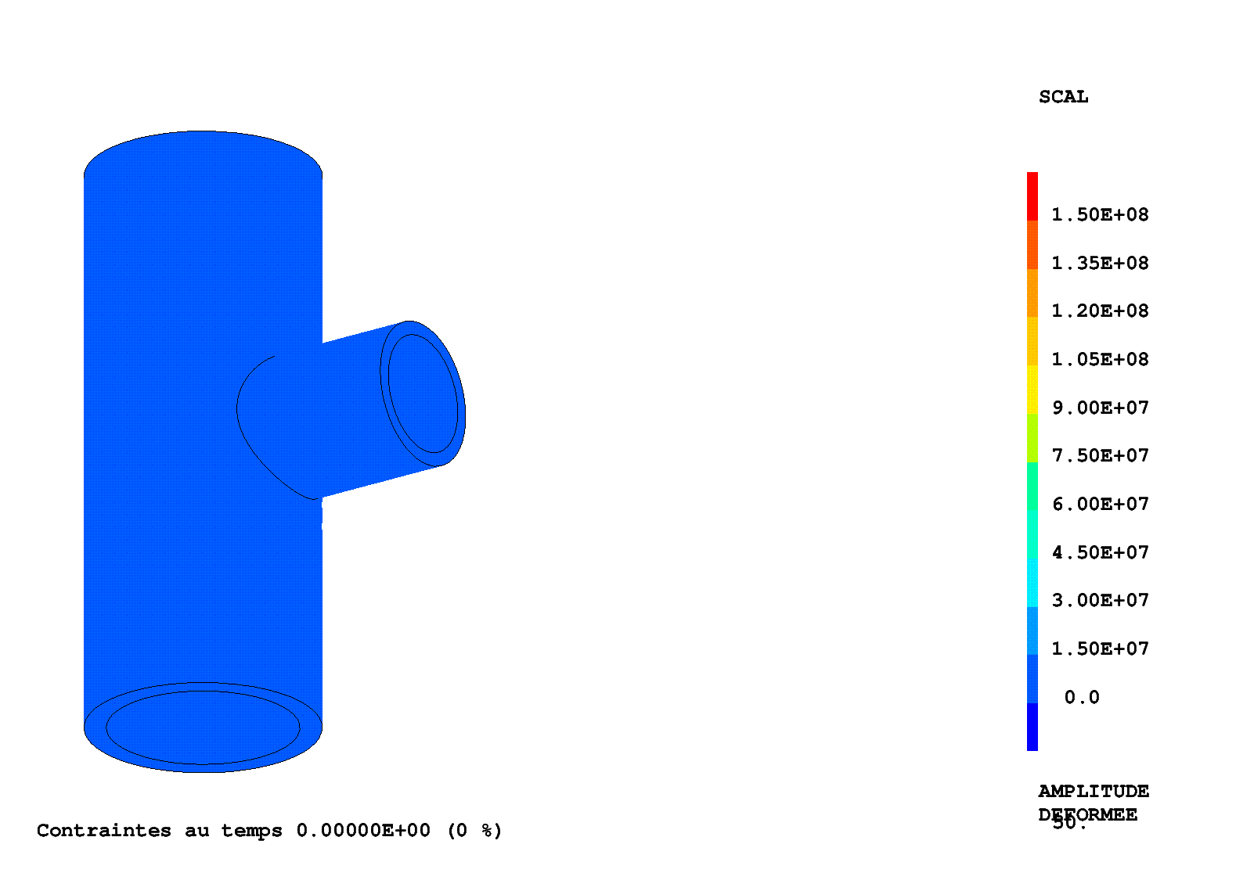
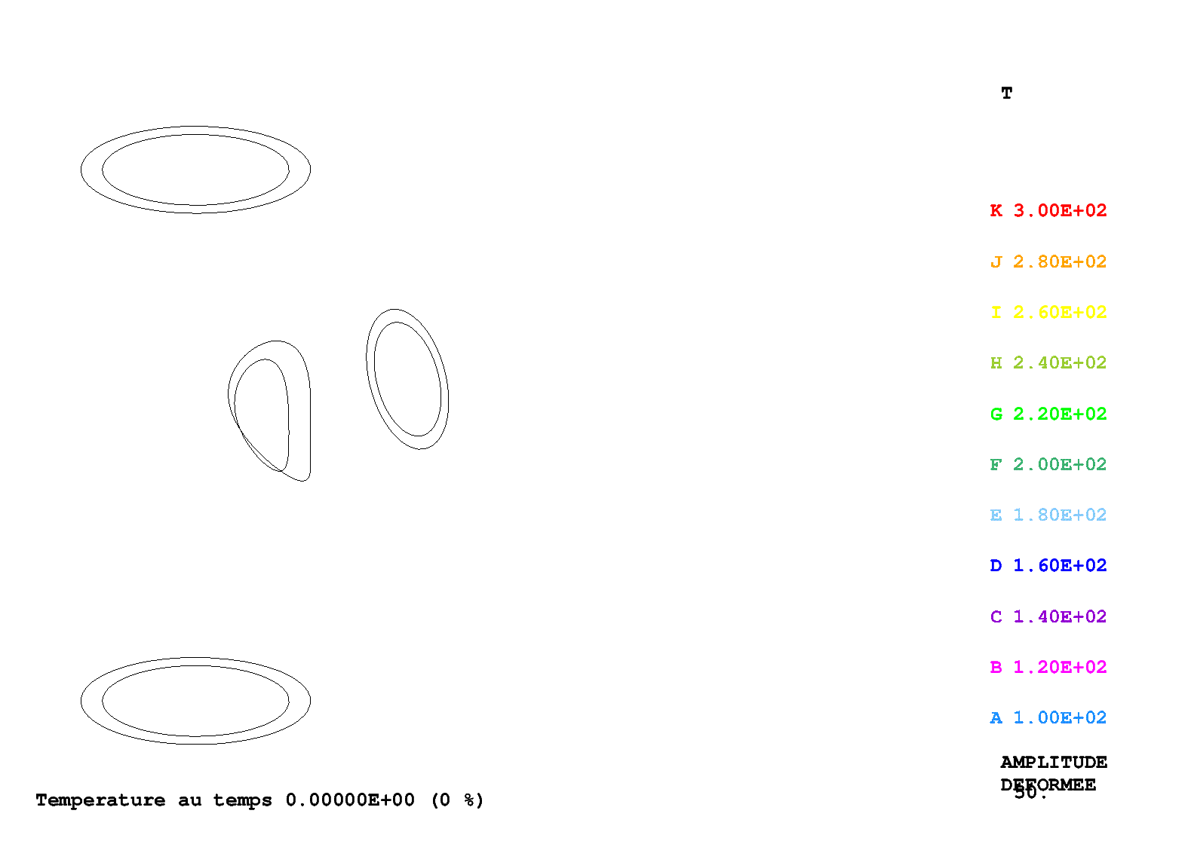
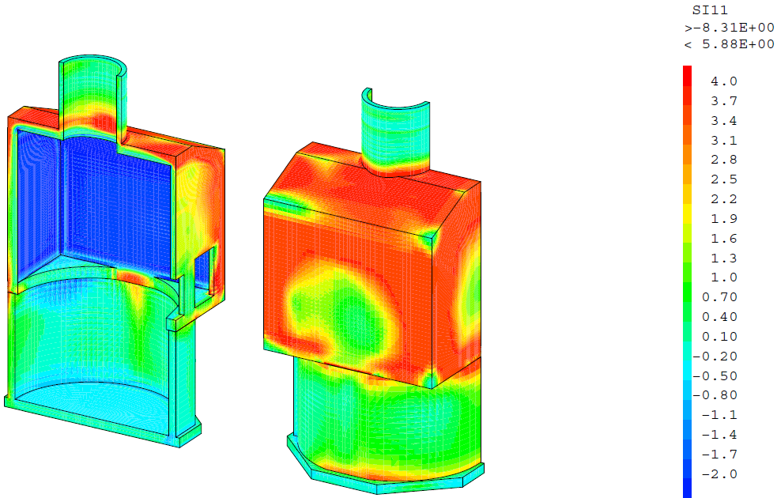
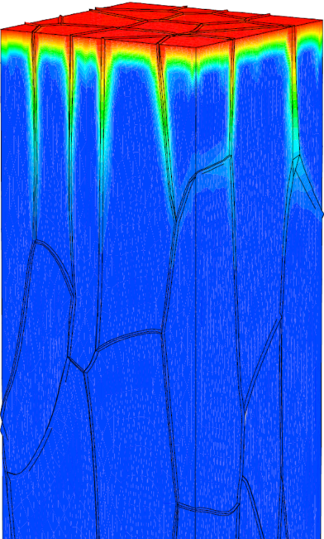
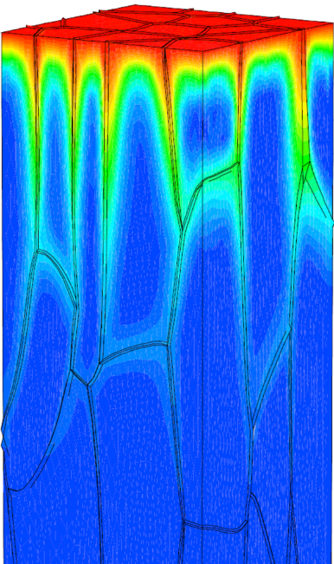
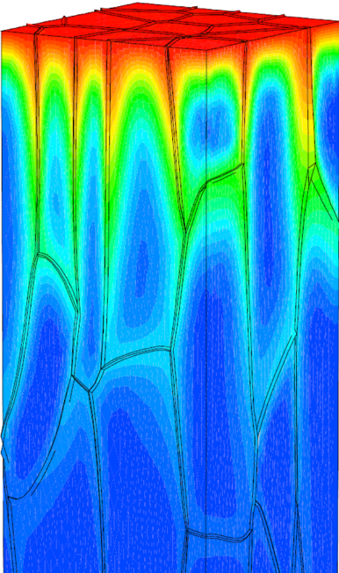
Modeling in Numerous AREAS
Structural mechanics (historical field)
Quasi-static (non linear materials, geometry, boundary conditions)
Contact/friction, Buckling
Dynamics (temporal, modal, fluid structure interaction)
Fracture mechnics (XFEM, dynamic propagation, cohesive zone model)
Thermal analysis
Conduction, convection, radiation, phase transition
Fluid mechanics
Metallurgy
Magnetostatics
Multi spieces diffusion (Fick’s law)
Thermo-hydro-mechanical coupling

Slide 6
The PASAPAS Procedure
Objective
incremental solving of non linear progressive thermal and mechanical problems
time can be physical (e.g. thermal transients) or not (e.g. plasticity with progressive loading)
➔ time or pseudo-time is called the evolution parameter
Non linear phenomena considered
behavior (plasticity, damage, variable material properties, …)
geometry (large displacements)
strains (large rotations)
boundary conditions (radiation, friction, following pressure, …)

Slide 7
PASAPAS use
Create a table containing all the data:
TAB1 = TABL ;
TAB1 . MODELE = MOD1 ET MOD2 ;
TAB1 . CARACTERISTIQUES = MAT1 ET MAT2 ;
TAB1 . BLOCAGES_MECANIQUES = BLO1 ;
TAB1 . CHARGEMENT = CHA1 ET CHA2 ET CHA3 ;
TAB1 . TEMPS_CALCULES = PROG 0.1 'PAS' 0.1 50. ;
TAB1 . TEMPS_SAUVES = PROG 4. 8. 15. 16. 23. 42. ;
TAB1 . PRECISION = 1.E-6 ;
TAB1 . GRANDS_DEPLACEMENTS = VRAI ;
…
Procedure call: PASAPAS TAB1 ;
Results post-processing
some indexes are required
other are optional

Slide 8
Overview of input parameters
General
MODELE (MMODEL) Equations to solve, F. E. formulation (MODE)
CARACTERISTIQUES (MCHAML) Material and/or geometrical parameters (MATE)
CHARGEMENT (CHARGEME) Boundary conditions and loading variation during calculation (CHAR)
Thermal analysis
BLOCAGES_THERMIQUES (RIGIDITE) Stiffness matrix associated to the imposed values of the unknowns (DIRICHLET boundary conditions) (BLOQ)
CELSIUS (LOGIQUE) =VRAI (true) if temperature unit is CELSIUS
TEMPERATURES . 0 (CHPOINT) Initial conditions
Mechanics
BLOCAGES_MECANIQUES (RIGIDITE) Stiffness matrix associated to the imposed values of the unknowns (DIRICHLET boundary conditions) (BLOQ)
GRANDS_DEPLACEMENTS (LOGIQUE) Equilibrium checked on the deformed mesh
DEPLACEMENTS . 0 (CHPOINT)
CONTRAINTES . 0 (MCHAML)
VARIABLES_INTERNES . 0 (MCHAML)
DEFORMATIONS_INELASTIQUES . 0 (MCHAML)
Initial conditions

Slide 9
Overview of input parameters
Mechanics (dynamics)
DYNAMIQUE (LOGIQUE) =VRAI (true) for dynamics calculations
AMORTISSEMENT (RIGIDITE) Damping matrix
VITESSES . 0 (CHPOINT)
ACCELERATIONS . 0 (CHPOINT)
List of the values of evolution parameter
TEMPS_CALCULES (LISTREEL) List of the values of the evolution parameter (or time) for which results are requested
TEMPS_SAUVES (LISTREEL) List of times for which results are saved
OPTI 'SAUV' 'my_file' ;
TEMPS_SAUVEGARDES (LISTREEL) List of times for which SAUV operator is called
MES_SAUVEGARDES (TABLE) Results to be stored in addition to those automatically stored (total strains, …)
Initial conditions

Slide 10
Overview of output parameters
Results are stored in the table
TEMPS (TABLE) Times values, corresponding to « TEMPS_SAUVES »
TEMPERATURES (TABLE)
PROPORTIONS_PHASE (TABLE)
DEPLACEMENTS (TABLE)
CONTRAINTES (TABLE)
DEFORMATIONS_INELASTIQUES (TABLE)
VARIABLES_INTERNES (TABLE)
REACTIONS (TABLE)
VITESSES (TABLE)
ACCELERATIONS (TABLE)
Fields (solution) calculated for each stored time « TEMPS_SAUVES »

Slide 11
Post processing (examples)
Solution fields extraction:
from the table index
SIG1 = TAB1 . CONTRAINTES . 5 ;
or from the calculation time
SIG1 = PECHE TAB1 'CONTRAINTES' 28.3 ;
Graphical mode, interactive plot (limited):
EXPLORER TAB1 ;
Evolution of calculated field with time:
EV1 = EVOL 'TEMP' TAB1 'DEPLACEMENTS' 'UX' P1 ;

Slide 12
PASAPAS operation

Slide 13
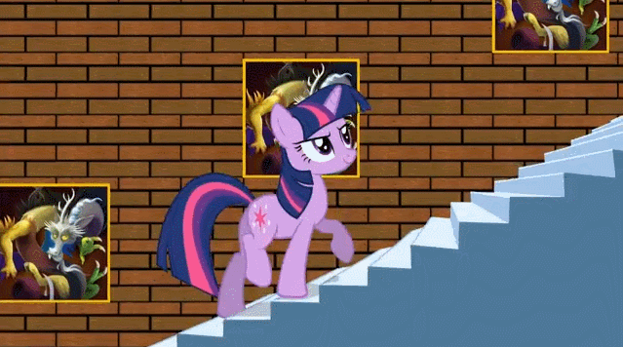
PASAPAS operation
Main algorithm
Initializations
Loop on time steps (BEXTERN)
Loop for thermo-mechanical convergence (BO_BOTH)
Thermal solving [for the step]
Mechanical solving [for the step]
Thermo-mechanical convergence?
Results recording
End
+ User procedures calls (optional, user have to ask it)
PERSO1 PERSO2 REEV_MEC REEV_THE CHARMECA CHARTHER PARATHER
procedures to be defined by the user!

Slide 14
PASAPAS operation
Initializations, PERSO1, REEV_MEC, REEV_THE
Options reading, initializations (materials, unknowns, temporary variables, indicators…), calculation times WTABLE, …
Time step initialization
Call of the procedure for thermal calculation: TRANSNON, TRANSLIN or DUPONT2
(in the case of large displacements, solving on the last deformed shape)
Results are stored in ESTIMATION
Thermal solving
REEV_THE
User procedure (if asked)
Mechanics solving
Call to the procedure for mechanical calculation UNPAS
Results are stored in ESTIMATION
BO_BOTH
REEV_MEC
User procedure (if asked)
BEXTERN
no
Convergence?
Test of convergence for thermo-mechanics, to activate with:
TAB1 . CONVERGENCE_MEC_THE = VRAI ;
[MAXI ABS (T_{i}–T_{i-1})] / [MAXI ABS T_{i}] < CRITERE_COHERENCE (10E-2)
yes
Next time step Initialization
Recording of the new state as the initial time step state in WTABLE
PERSO1
User procedure (if asked)
PAS_RESU: writing in CONTINUATION quantities of ESTIMATION
PAS_SAUV: writing in TAB1 if the time step belongs to TEMPS_SAUVE,
call to SAUV if the time step belongs to TEMPS_SAUVEGARDE
Results storage
no
Time steps end?
yes
End

Slide 15
Access to PASAPAS data
TAB1 . 'ESTIMATION' contains all results calculated/converged by TRANSNON and UNPAS but not converged for BO_BOTH loop
TAB1 . 'ESTIMATION' . 'TEMPS'
TAB1 . 'ESTIMATION' . 'DEPLACEMENTS'
TAB1 . 'ESTIMATION' . 'CONTRAINTES'
TAB1 . 'ESTIMATION' . 'TEMPERATURES'
…
…
TAB1 . 'CONTINUATION' contains converged results (for BO_BOTH loop) this index is updated at the end of the time-step!!! ➔ useful for PASAPAS restart
TAB1 . 'CONTINUATION' . 'TEMPS'
TAB1 . 'CONTINUATION' . 'DEPLACEMENTS'
TAB1 . 'CONTINUATION' . 'CONTRAINTES'
TAB1 . 'CONTINUATION' . 'TEMPERATURES'
…
…

Slide 16
Access to PASAPAS data
TAB1 . 'WTABLE'
Contains all useful variables for PASAPAS (chosen options, models, materials and instant loading, intermediate results …)
Some indexes:
WTABLE . 'CHARGEMENT' Loading on the time step
WTABLE . 'THER_COURANT' Value of temperature at last iteration (during a time step)
WTABLE . 'BLOCAGES_MECANIQUES' Mechanical constraint matrix WTABLE . 'BLOCAGES_THERMIQUES' Thermal constraint matrix
WTABLE . 'FOR' Configuration at the time step beginning WTABLE . 'FOR0' Initial Configuration
WTABLE . 'MODELE' Models WTABLE . 'CARACTERISTIQUES' Material properties
…
For more information, see:
→ Comments in procedure PAS_DEFA (http://www-cast3m.cea.fr/index.php?page=procedures&procedure=pas_defa)
→ The PASAPAS documentation (http://www-cast3m.cea.fr/html/Documentation_Cast3M/Pasapas.pdf)

Slide 17
Finding the mechanical equilibrium the UNPAS procedure

Slide 18
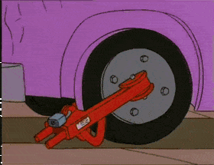
Reminder on equations
Local equations of the static equilibrium
equilibrium $div\left(σ\right)+f=0$ on $V$
prescribed surface forces $σ. n=t$ on $∂V^{t}$
prescribed displacements $u=d$ on $∂V^{d}$
Weak form + FE discretization
$$\left\{F\right\} −\int_{V}{{\left[B\right]}^{T}\left\{σ\right\}dV}=\left\{0\right\}$$
$$\underset{{\left\{F\right\}}^{S}}{\underbrace{\int_{∂V^{t}}{{\left[N\right]}^{T}\left\{t\right\} dS}}} + \underset{{\left\{F\right\}}^{R}}{\underbrace{\int_{∂V^{d}}{{\left[N\right]}^{T}\left\{σ.n\right\}dS}}} + \underset{{\left\{F\right\}}^{V}}{\underbrace{\int_{V}{{\left[N\right]}^{T}\left\{f\right\} dV}}}−\underset{\left[B\right]\left\{σ\right\}}{\underbrace{\int_{V}{{\left[B\right]}^{T}\left\{σ\right\}dV}}}=\left\{0\right\}$$
Vectors of Equivalent nodal forces (N)
${\left\{F\right\}}^{S}$ to the prescribed surface forces $t$ (Pa) (PRES, FSUR, FORC, …)
${\left\{F\right\}}^{R}$ to the surface forces in reaction to the prescribed displacements $d$ (m) (REAC)
${\left\{F\right\}}^{V}$ to the prescribed volume forces $f$ (N.m⁻³) (CNEQ)
$\left[B\right]\left\{σ\right\}$ to the internal volume forces (BSIG)
Matrices
$\left[N\right]$ matrix of shape (interpolation) functions
$\left[B\right]$ matrix of derivatives of shape functions

Slide 19
Imbalance
Imbalance = measure of deviation of equilibrium
$$\left\{R\right\}=\underset{{\left\{F\right\}}^{ext}}{\underbrace{{\left\{F\right\}}^{S}+{\left\{F\right\}}^{R}+{\left\{F\right\}}^{V}}}−\underset{{\left\{F\right\}}^{int}}{\underbrace{\left[B\right]\left\{σ\right\}}}$$
The balance is obtained when
$$\left\|R\right\|<ε.F^{ref}$$
$\left\|R\right\|$ norm of the imbalance vector, for instance infinity norm
$ε$ computational precision (given by user)
$F^{ref}$ reference force for the studied problem

Slide 20
Non linear behavior
Introduction of the linear elastic stiffness matrix
$σ=𝔼:ε^{lin}+σ^{nl}$ with $ε^{lin}=\frac{1}{2}\left(∇u+∇^{T}u\right)$
${\left\{ε\right\}}^{lin}=\left[B\right]\left\{U\right\}$
Equilibrium can be re written
$$\left[B\right]\left\{σ\right\}={\left\{F\right\}}^{S}+{\left\{F\right\}}^{R}+{\left\{F\right\}}^{V}$$
$$\left[B\right]\left[E\right]{\left\{ε\right\}}^{lin}={\left\{F\right\}}^{S}+{\left\{F\right\}}^{R}+{\left\{F\right\}}^{V}−\left[B\right]{\left\{σ\right\}}^{nl}$$
$$\underset{\left[K\right]}{\underbrace{\int_{V}{{\left[B\right]}^{T}\left[E\right]\left[B\right]dV}}} \left\{U\right\}={\left\{F\right\}}^{S}+{\left\{F\right\}}^{R}+{\left\{F\right\}}^{V}−\left[B\right]{\left\{σ\right\}}^{nl}$$
$$\left[K\right]\left\{U\right\}={\left\{F\right\}}^{S}+{\left\{F\right\}}^{R}+{\left\{F\right\}}^{V}−\left[B\right]{\left\{σ\right\}}^{nl}$$
$\left\{U\right\}$ nodal displacements $u(x)=\left[N\left(x\right)\right]\left\{U\right\}$
${\left\{ε\right\}}^{lin}$ linear strains (« small » strains) ${\left\{ε\right\}}^{lin}=\left[B\right]\left\{U\right\}$ (EPSI)
${\left\{σ\right\}}^{nl}$ complementary non linear stresses
$\left[E\right]$ Hooke matrix (ELAS)
$\left[K\right]$ elastic stiffness matrix (RIGI)

Slide 21
Introducing the prescribed displacements
Boundary condition matrix
$u=d$ on $∂V^{d}$
$$\left[A\right]\left\{U\right\}=\left\{d\right\}$$
Lagrange Multipliers
For a lin. system without prescribed displacements: $\left[K\right]\left\{U\right\}={\left\{F\right\}}^{S}+{\left\{F\right\}}^{V}−\left[B\right]{\left\{σ\right\}}^{nl}$
We add new unknowns $\left\{λ\right\}$
$\left[K\right]\left\{U\right\}+\underset{−{\left\{F\right\}}^{R}}{\underbrace{{\left[A\right]}^{T}\left\{λ\right\}}}={\left\{F\right\}}^{S}+{\left\{F\right\}}^{V}−\left[B\right]{\left\{σ\right\}}^{nl}$ with $\left[A\right].\left\{U\right\}=\left\{d\right\}$
Equilibrium is now written:
$$\underset{\left[\hat{K}\right]}{\underbrace{\left[\begin{matrix}K & A^{T} \\ A & 0\end{matrix}\right]}}\left\{\begin{matrix}U \\ λ\end{matrix}\right\}=\left\{\begin{matrix}F^{S}+F^{V}−\left[B\right]{\left\{σ\right\}}^{nl} \\ d\end{matrix}\right\}$$
$\left[A\right]$ boundary condition matrix (BLOQ, RELA)
$\left\{d\right\}$ prescribed nodal displacements (DEPI)
$\left\{λ\right\}$ Lagrange multipliers
depends on $\left\{U\right\}$ !!
non linear behavior,
large displacements,
following forces,
…

Slide 22
Incremental decomposition (1/2)
Computation on a time step between $t_{0}$ and $t_{1}$
$\left[t_{0},{\left\{U\right\}}_{0},{\left\{λ\right\}}_{0},{\left\{σ\right\}}_{0}\right]$ known state beginning of time step
$\left[t_{1},{\left\{U\right\}}_{1},{\left\{λ\right\}}_{1},{\left\{σ\right\}}_{1}\right]$ unknown state end of time step
Incremental decomposition of nodal displacements
${\left\{U\right\}}_{1}^{i}={\left\{U\right\}}_{0}+Δ{\left\{U\right\}}_{1}^{i}$ and $Δ{\left\{U\right\}}_{1}^{i+1}=Δ{\left\{U\right\}}_{1}^{i}+δ{\left\{U\right\}}_{1}^{i+1}$
and so
$${\left\{U\right\}}_{1}^{i+1}={\left\{U\right\}}_{1}^{i}+δ{\left\{U\right\}}_{1}^{i+1}$$
${\left\{U\right\}}_{1}^{i}$ estimation of displacement ${\left\{U\right\}}_{1}$ at iteration $i$
$Δ{\left\{U\right\}}_{1}^{i}$ estimation of displacement increment at iteration $i$
$δ{\left\{U\right\}}_{1}^{i+1}$ correction of displacement increment at iteration $i$
Incremental decomposition of boundary conditions
$$\left[A\right]{\left\{U\right\}}_{1}^{i+1}={\left\{d\right\}}_{1}$$
$$\left[A\right]δ{\left\{U\right\}}_{1}^{i+1}={\left\{d\right\}}_{1}−\left[A\right]{\left\{U\right\}}_{1}^{i}$$

Slide 23
Incremental decomposition (2/2)
Incremental decomposition of equilibrium
$$\left[K\right]{\left\{U\right\}}_{1}^{i+1}+{\left[A\right]}^{T}{\left\{λ\right\}}_{1}^{i+1}={\left\{F\right\}}_{1}^{S}+{\left\{F\right\}}_{1}^{V}−\left[B\right]{\left\{σ\right\}}_{1}^{nl,i}$$
$$\left[K\right]δ{\left\{U\right\}}_{1}^{i+1}={\left\{F\right\}}_{1}^{S}+{\left\{F\right\}}_{1}^{V}−{\left[A\right]}^{T}{\left\{λ\right\}}_{1}^{i+1}−\underset{\left[B\right]{\left\{σ\right\}}_{1}^{i}}{\underbrace{\left(\left[K\right]{\left\{U\right\}}_{1}^{i}+\left[B\right]{\left\{σ\right\}}_{1}^{nl,i}\right)}}$$
$$\left[K\right]δ{\left\{U\right\}}_{1}^{i+1}=\underset{{\left\{R\right\}}_{1}^{i}}{\underbrace{{\left\{F\right\}}_{1}^{S}+{\left\{F\right\}}_{1}^{V}−{\left[A\right]}^{T}{\left\{λ\right\}}_{1}^{i+1}−\left[B\right]{\left\{σ\right\}}_{1}^{i}}}$$
Equilibrium is finally written
$$\underset{\left[\hat{K}\right]}{\underbrace{\left[\begin{matrix}K & A^{T} \\ A & 0\end{matrix}\right]}}\left\{\begin{matrix}δU_{1}^{i+1} \\ λ_{1}^{i+1}\end{matrix}\right\}=\left\{\begin{matrix}F_{1}^{S}+F_{1}^{V}−\left[B\right]{\left\{σ\right\}}_{1}^{i} \\ {\left\{d\right\}}_{1}−\left[A\right]{\left\{U\right\}}_{1}^{i}\end{matrix}\right\}$$

Slide 24
Imbalance minimization algorithm
Simple algorithm
$\left[{\left\{U\right\}}_{1}^{i=0},{\left\{λ\right\}}_{1}^{i=0},{\left\{σ\right\}}_{1}^{i=0}\right]=\left[{\left\{U\right\}}_{0},{\left\{λ\right\}}_{0},{\left\{σ\right\}}_{0}\right]$ initializations
${\left\{F\right\}}_{1}^{R,i=0}=−{\left[A\right]}^{T}{\left\{λ\right\}}_{1}^{i=0}$ reaction forces (REAC)
$F^{ref}=\left\|{\left\{F\right\}}_{1}^{S}+{\left\{F\right\}}_{1}^{V}+{\left\{F\right\}}_{1}^{R,i=0}\right\|$ convergence norm (MAXI 'ABS')
${\left\{R\right\}}_{1}^{i=0}={\left\{F\right\}}_{1}^{S}+{\left\{F\right\}}_{1}^{V}+{\left\{F\right\}}_{1}^{R,i=0}−\left[B\right]{\left\{σ\right\}}_{1}^{i=0}$ first imbalance (residual) (BSIG)
While: $\left\|{\left\{R\right\}}_{1}^{i}\right\|/F^{ref}≥ε$
$\left[δ{\left\{U\right\}}_{1}^{i+1},{\left\{λ\right\}}_{1}^{i+1} \right]={\left[\hat{K}\right]}^{−1}{\left\{R\right\}}_{1}^{i}$ resolution (RESO)
${\left\{U\right\}}_{1}^{i+1}={\left\{U\right\}}_{1}^{i}+δ{\left\{U\right\}}_{1}^{i+1}$ estim. displacements
${\left\{ε\right\}}_{1}^{i+1}=𝒟\left({\left\{U\right\}}_{1}^{i+1}\right)$ estim. strains (EPSI)
${\left\{σ\right\}}_{1}^{i+1}=𝒞\left(Δ{\left\{ε\right\}}_{1}^{i+1}\right)$ estim. stresses (COMP)
${\left\{F\right\}}_{1}^{R,i+1}=−{\left[A\right]}^{T}{\left\{λ\right\}}_{1}^{i+1}$ estim. reaction forces (REAC)
${\left\{R\right\}}_{1}^{i+1}={\left\{F\right\}}_{1}^{S}+{\left\{F\right\}}_{1}^{V}+{\left\{F\right\}}_{1}^{R,i+1}−\left[B\right]{\left\{σ\right\}}_{1}^{i+1}$ new imbalance (residual) (BSIG)
$i=i+1$
End

Slide 25
UNPAS operation
Initializations, CHARMECA
Acquisition of options, materials updating, WTABLE, …
Stiffness matrix calculation $\left[K\right]$, external prescribed forces ${\left\{F\right\}}^{ext}$
1st imbalance evaluation
Iteration engine, computes the imbalance between the internal and external forces ${\left\{R\right\}}_{1}^{i=0}={\left\{F\right\}}_{1}^{S}+{\left\{F\right\}}_{1}^{V}+{\left\{F\right\}}_{0}^{R}−\left[B\right]{\left\{σ\right\}}_{0}$ (BSIG operator)
1st RESO and magnitude of convergence
Displacement increment on the step $Δ{\left\{U\right\}}_{1}^{i=0}=δ{\left\{U\right\}}_{1}^{i=0}$
$δ{\left\{U\right\}}_{1}^{i=0}={\left[K\right]}^{−1}{\left\{R\right\}}_{1}^{i=0}$ (RESO operator)
Convergence norm: $F^{ref}$ measure the step, along ${\left\{R\right\}}_{1}^{i=0}$ and $Δ{\left\{U\right\}}_{1}^{i=0}$
Convergence acceleration
Imbalance correction from the 3 previous imbalances (ACT3 operator)
$δ{\left\{U\right\}}_{1}^{i+1} and {\left\{λ\right\}}_{1}^{i+1}={\left[K\right]}^{−1}{\left\{R\right\}}_{1}^{i}$ correction of the displ. increment on the step (RESO operator)
$Δ{\left\{U\right\}}_{1}^{i+1}=Δ{\left\{U\right\}}_{1}^{i}+δ{\left\{U\right\}}_{1}^{i+1}$ displacement increment on the step (ZDEPT)
RESO
Forced Convergence:
Restart from the out of unbalanced state
Integration of the behavioral law CHARMECA
Strains increment calculation on the step${∆\left\{ε\right\}}_{1}^{i+1}$ (EPSI operator)
Stresses ${\left\{σ\right\}}_{1}^{i+1}$, internal variables ${\left\{V\right\}}_{1}^{i+1}$ calculation, end of the step (COMP op.)
New imbalance evaluation
${\left\{F\right\}}_{1}^{R,i+1}=−{\left[A\right]}^{T}{\left\{λ\right\}}_{1}^{i+1}$ reaction forces (REAC operator)
${\left\{R\right\}}_{1}^{i+1}={\left\{F\right\}}_{1}^{S}+{\left\{F\right\}}_{1}^{V}+{\left\{F\right\}}_{1}^{R,i+1}−\left[B\right]{\left\{σ\right\}}_{1}^{i+1}$ new imbalance (BSIG operator)
Equilibrium reached?
yes
Magnitude of the imbalance < criterion (PRECISION, FTOL, MTOL) ??
Variation of the strains increment between 2 iterations < criterion ??
no
Non convergence detection:
maximum number of iterations reached
significant increase of the imbalance over several iterations
Forced convergence process
« Non convergence » detected ?
no
yes
Results recording
no
Convergence ?
yes
End

Slide 26
Users procedures in PASAPAS PERSO1 REEV_MEC CHARMECA PERSO2 REEV_THE CHARTHER PARATHER

Slide 27
Users procedures: instructions for use
There exists 7 users procedures called at different stages of PASAPAS algorithm
PERSO1 PERSO2 REEV_MEC REEV_THE CHARMECA CHARTHER PARATHER
1) According to the desired action, choose the procedure to be used as a function of its location on the algorithm
for instance: since PERSO1 is called after computing a time step it is dedicated to update the next time step data e.g. boundary conditions, material parameters, …
2) Analyze the procedure syntax - in the PASAPAS manual pages - In the PASAPAS, UNPAS or TRANSNON procedures
the following table recalls the procedures syntaxes

Slide 28
PERSO1 Procedure example
3) Define the desired procedure
DEBP PERSO1 T1*'TABLE' ;
MESS 'Hello! The PERSO1 procedure is talking to you.' ;
FINP ;
4) Indicate in the PASAPAS table that this procedure should be called
TAB1 . 'MODELE' = MOD1 ;
TAB1 . 'CARACTERISTIQUES' = MAT1 ;
TAB1 . 'TEMPS_CALCULES' = PROG 1. 2. 3. 4. ;
TAB1 . 'PROCEDURE_PERSO1' = VRAI ;
...
...
PASAPAS TAB1 ;

Slide 29
Users procedures LIST
Name | Index to be activated in PASAPAS table | Syntax | Function
PERSO1 | TAB1 . 'PROCEDURE_PERSO1' = VRAI ; | PERSO1 T1 ; | Updates the problem after the mechanical calculation step
REEV_MEC | TAB1 . 'PROCEDURE_REEV_MEC' = VRAI ; | REEV_MEC T1 N1 ; | Ditto (but in BO_BOTH) ➔ the step can be started again
CHARMECA | TAB1 . 'PROCEDURE_CHARMECA' = VRAI ; | T2 = CHARMECA T1 TPS1 ; | Mechanical loads addition during UNPAS iterations
PERSO2 | TAB1 . 'PROCEDURE_PERSO2' = VRAI ; | PERSO2 T1 ; | Updates the problem after the thermal calculation step
REEV_THE | TAB1 . 'PROCEDURE_REEV_THE' = VRAI ; | REEV_THE T1 N1 ; | Ditto (but in PASAPAS) ➔ the step can be started again
CHARTHER | TAB1 . 'PROCEDURE_CHARTHER' = VRAI ; | T2 = CHARTHER T1 TPS1 ; | Thermal loads addition during TRANSNON iterations
PARATHER | TAB1 . 'PROCEDURE_PARATHER' = VRAI ; | PARATHER T1 TPS1 ; | Updating of the external variables of thermal parameters
With
T1 : the PASAPAS table
TPS1 : the current calculated time
N1 : the call number of the procedure (0 or 1) → see the PASAPAS procedure
T2 : the output table (only for the CHARMECA and CHARTHER procedures)

Slide 30
A few remarks
Instructions inside these procedures are free !!!
CHARMECA and CHARTHER output is a table with 2 possible indexes:
- 'ADDI_MATRICE' contains the stiffness matrices (RIGIDITE type object) to be added to the 1st member
- 'ADDI_SECOND' contains the CHPOINT to be added to the 2nd member (nodal forces)
For large displacements ('GRANDS_DEPLACEMENTS' option), CHARMECA is called on the deformed shape

Slide 31
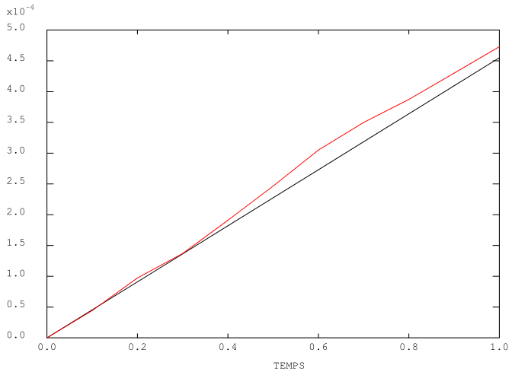
A simple example
Random variation of Young’s modulus map at each time step
OPTI 'DIME' 2 'ELEM' 'QUA4' ;
P0 = 0. 0. ; P1 = 1. 0. ;
L1 = DROI 1 P0 (0. 0.1) ;
S1 = L1 TRAN 10 (1. 0.) ;
L2 = S1 COTE 3 ; P2 = L2 POIN 'PROC' (1. 0.) ;
MO = MODE S1 'MECANIQUE' ;
MA = MATE MO 'YOUN' 200.E9 'NU' 0.3 ;
BL = (BLOQ 'UX' L1) ET (BLOQ 'UY' P0) ;
F = PRES 'MASS' MO L2 -1.E8 ;
EV = EVOL 'MANU' (PROG 0. 1.) (PROG 0. 1.) ;
CHA = CHAR 'MECA' F EV ;
TAB1 = TABL ;
TAB1 . 'MODELE' = MO ;
TAB1 . 'CARACTERISTIQUES' = MA ;
TAB1 . 'BLOCAGES_MECANIQUES' = BL ;
TAB1 . 'CHARGEMENT' = CHA ;
TAB1 . 'TEMPS_CALCULES' = PROG 0.1 'PAS' 0.1 1. ;
TAB1 . 'PROCEDURE_PERSO1' = VRAI ;
PASAPAS TAB1 ;
EVU = EVOL 'TEMP' TAB1 'DEPLACEMENTS' 'UX' P2 ;
DESS EVU ;
DEBP PERSO1 T1*'TABLE' ;
MOD = T1 . 'WTABLE' . 'MO_TOT' ;
MAIL = EXTR MOD 'MAIL' ;
CHPYO = BRUI 'BLAN' 'UNIF' 200.E9 150.E9 MAIL ;
CHMYO = CHAN 'CHAM' CHPYO MOD 'RIGIDITE' ;
MAT = MATE MOD 'YOUN' CHMYO 'NU' 0.3 ;
T1 . 'WTABLE' . 'CARACTERISTIQUES' = MAT ;
FINP ;

Slide 32
Exercise 1: beam with following force Download the starting file on the website: http://www-cast3m.cea.fr/index.php?page=exemples&exemple=formation_pasapas_1_initial

Slide 33
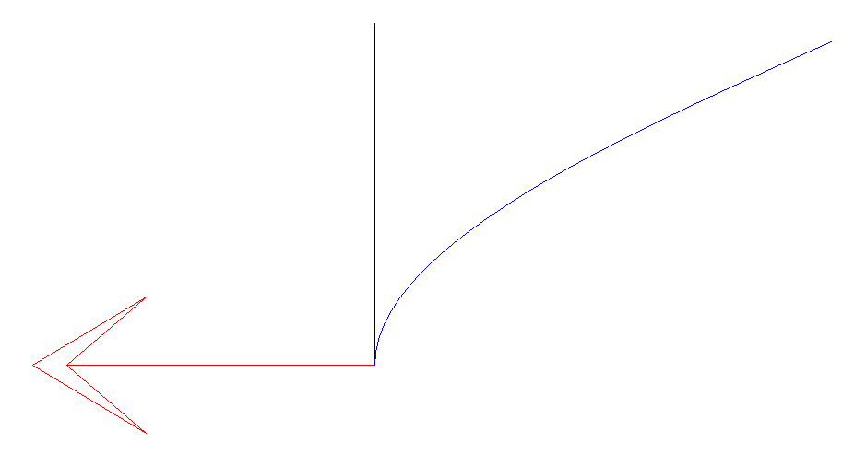
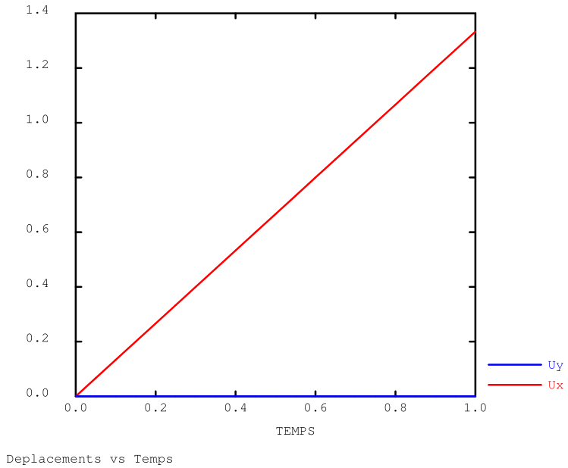
Exercise 1: beam with Following force
Beam bending
base is clamped
point shear force at the top of the beam (perpendicular to the beam)
large displacement at the top of the beam
Problem: the force is calculated on the initial shape and not updated
Purpose: to correctly apply the force during the calculation
It’s up to you!
F
Deformed shape + reaction

Slide 34
Exercise 1: beam with Following force
A few indications …
Useful objects
P2 : point at the top of the beam, where the force is prescribed
EV1 : force magnitude to be applied as a function of time
Useful operators
EXTR, COS, SIN
IPOL : to interpolate the force magnitude as a function of the calculated step
FORC : to apply a point force

Slide 35
Exercise 1: beam with Following force
Solution
- use option 'GRANDS_DEPLACEMENTS' (equilibrium verified on the deformed shape)
use procedure PERSO1 (1 call / time step) to re-calculate the force on deformed shape (at beginning of time step)
create a “load” with it (CHARGEMEnt type object)
overwrite the load in WTABLE
DEBP PERSO1 T1*'TABLE' ;
* donnees utiles
TAM = T1 . 'MY_DATA' ;
PF = TAM . 'POINT' ;
EV = TAM . 'EVOL' ;
* angle de rotation de la section droite
U1 = T1 . 'ESTIMATION' . 'DEPLACEMENTS' ;
RS = EXTR U1 'RZ' PF ;
RSD = RS * 180. / PI ;
* direction de l'effort
DIR1 = (COS RSD) (SIN RSD) ;
* creation du second membre
F1 = FORC DIR1 PF ;
CHAR2 = CHAR 'MECA' F1 EV ;
T1 . 'WTABLE' . 'CHARGEMENT' = CHAR2 ;
FINP ;
TAB1 . 'GRANDS_DEPLACEMENTS' = VRAI ;
TAB1 . 'PREDICTEUR' = 'HPP' ;
TAB1 . 'PROCEDURE_PERSO1' = VRAI ;
TAB1 . 'MY_DATA' = TABL ;
TAB1 . 'MY_DATA' . 'EVOL' = EV1 ;
TAB1 . 'MY_DATA' . 'POINT' = P2 ;
PERSO1 procedure Main program

Slide 36
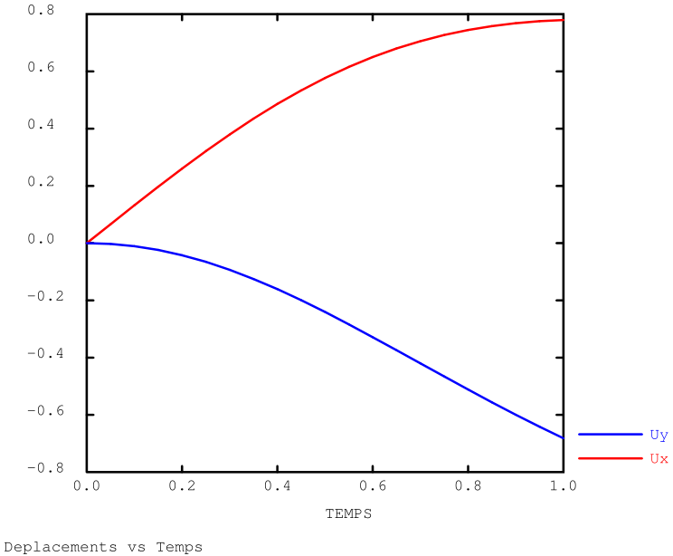
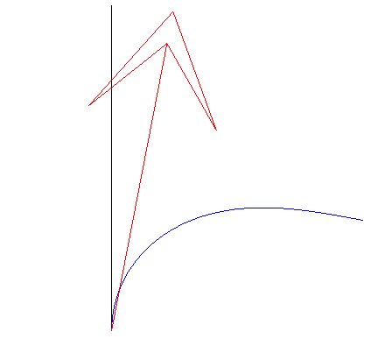
Exercise 1: beam with Following force
Results
Deformed shape + reaction
Displacements Ux and Uy as a function of time

Slide 37
Exercise 1: beam with Following force
Solution (bis)
idem but with the CHARMECA procedure
suppress initial mechanical loading
no need of CHARGEMEnt type object
longer: 1 call / each iteration / time step
results are identical
DEBP CHARMECA T1*'TABLE' TPS1*'FLOTTANT' ;
* donnees utiles
TAM = T1 . 'MY_DATA' ;
PF = TAM . 'POINT' ;
EV = TAM . 'EVOL' ;
* angle de rotation de la section droite
U1 = T1 . 'ESTIMATION' . 'DEPLACEMENTS' ;
RS = EXTR U1 'RZ' PF ;
RSD = RS * 180. / PI ;
* direction de l'effort
DIR1 = (COS RSD) (SIN RSD) ;
* creation du second membre
VAL1 = IPOL TPS1 EV ;
F1 = FORC (VAL1 * DIR1) PF ;
T2 = TABLE ;
T2 . 'ADDI_SECOND' = F1 ;
FINP T2 ;
***TAB1 . 'CHARGEMENT' = CHAR1 ;
TAB1 . 'GRANDS_DEPLACEMENTS' = VRAI ;
TAB1 . 'PREDICTEUR' = 'HPP' ;
TAB1 . 'PROCEDURE_CHARMECA' = VRAI ;
TAB1 . 'MY_DATA' = TABL ;
TAB1 . 'MY_DATA' . 'EVOL' = EV1 ;
TAB1 . 'MY_DATA' . 'POINT' = P2 ;
CHARMECA procedure Main program

Slide 38
Exercise 1: beam with Following force
Solution (ter)
idem, but the force is updated on the deformed shape at the end of time step!
more precise: when converged, the deformed geometry is exactly perpendicular to applied force
- watch out: can become unstable !
DEBP CHARMECA T1*'TABLE' TPS1*'FLOTTANT' ;
* donnees utiles
TAM = T1 . 'MY_DATA' ;
PF = TAM . 'POINT' ;
EV = TAM . 'EVOL' ;
* angle de rotation de la section droite
DRS = 0. ;
SI (EGA (TYPE ZDEPT) 'CHPOINT') ;
DRS = EXTR ZDEPT 'RZ' PF ;
FINSI ;
U0 = T1 . 'CONTINUATION' . 'DEPLACEMENTS' ;
RS = (EXTR U0 'RZ' PF) + DRS ;
RSD = RS * 180. / PI ;
* direction de l'effort
DIR1 = (COS RSD) (SIN RSD) ;
* creation du second membre
VAL1 = IPOL TPS1 EV ;
F1 = FORC (VAL1 * DIR1) PF ;
T2 = TABLE ;
T2 . 'ADDI_SECOND' = F1 ;
FINP T2 ;
***TAB1 . 'CHARGEMENT' = CHAR1 ;
TAB1 . 'GRANDS_DEPLACEMENTS' = VRAI ;
TAB1 . 'PREDICTEUR' = 'HPP' ;
TAB1 . 'PROCEDURE_CHARMECA' = VRAI ;
TAB1 . 'MY_DATA' = TABL ;
TAB1 . 'MY_DATA' . 'EVOL' = EV1 ;
TAB1 . 'MY_DATA' . 'POINT' = P2 ;
CHARMECA procedure Main program

Slide 39
Exercise 2: rupture by elements removal Download the starting file on the website: http://www-cast3m.cea.fr/index.php?page=exemples&exemple=formation_PASAPAS_2_INITIAL

Slide 40
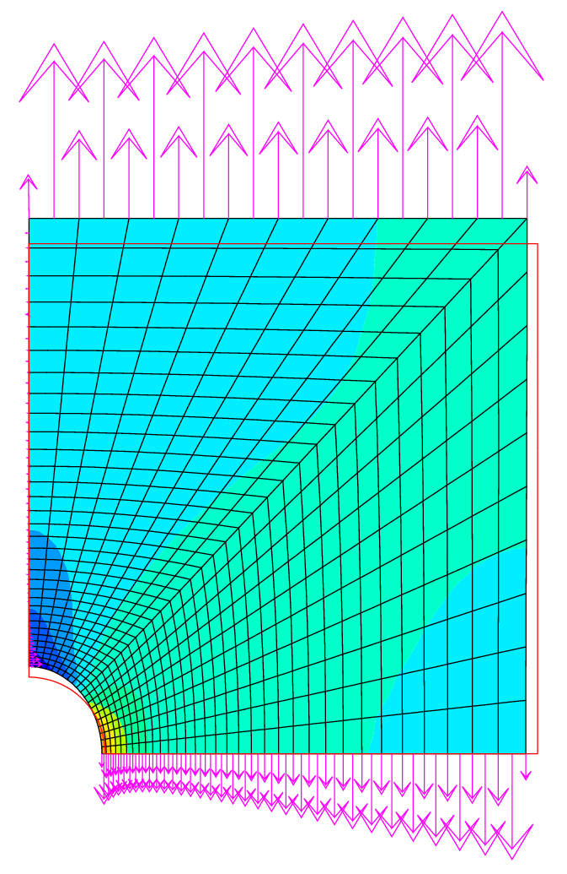
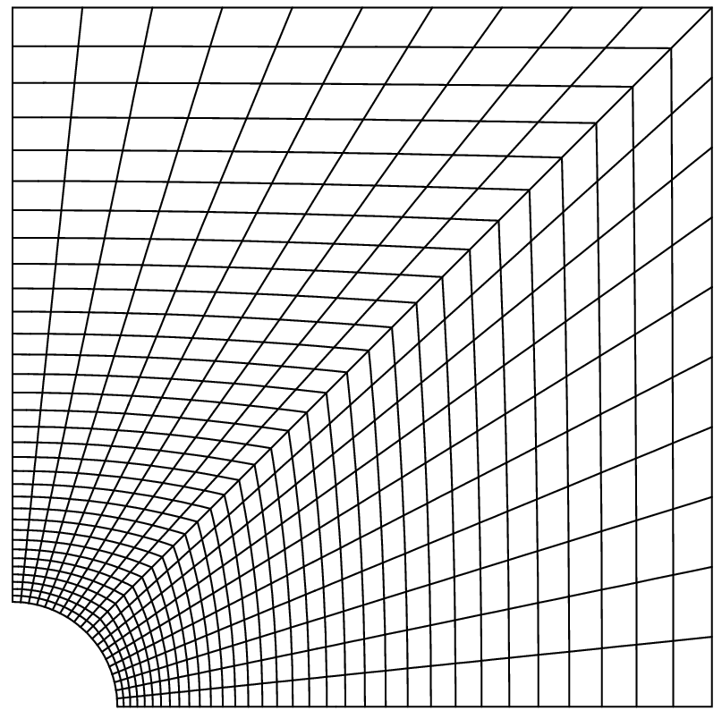
Exercise 2: rupture by elements removal
Traction of a perforated plate
elastic behavior, large displacements
Purpose: to model fracture by removing elements during calculations We will use a simple criterion based on the 1st principal stress:
fracture if σ_{I} ≥ 22 GPa
It’s up to you!
Imposed
displacement
σ_{I} stress and
reaction forces
on the deformed shape
Boundary conditions

Slide 41
Exercise 2: rupture by elements removal
A few indications …
Useful objects
PRIN: principal stress field calculations
CHAN: change the support points of a field by elements
ELEM: select the elements of a field that meets a criteria
REDU: reduction of a model on a sub-mesh
Useful information
Modify the temporary objects for computation in TAB1 . WTABLE

Slide 42
Exercise 2: rupture by elements removal
Solution
- reduce time steps
- use the PERSO1 procedure
extract the model and the calculated stresses (T1 . ESTIMATION)
calculate the principal stresses
determine the mesh of “intact elements”
- reduce the model on this mesh
- overwrite the model in the working table WTABLE
DEBP PERSO1 T1*'TABLE' ;
MO1 = T1 . 'WTABLE' . 'MODELE' ;
SG1 = T1 . 'ESTIMATION' . 'CONTRAINTES' ;
SGP1 = PRIN SG1 MO1 ;
SG11 = CHAN 'GRAVITE' (EXCO 'SI11' SGP1) MO1 ;
MAIL2 = SG11 ELEM 'INFERIEUR' 2.2E10 ;
MO2 = REDU MO1 MAIL2 ;
T1 . 'WTABLE' . 'MODELE' = MO2 ;
FINP ;
TAB1 . 'PROCEDURE_PERSO1' = VRAI ;
TAB1 . 'TEMPS_CALCULES' = PROG 0.1 'PAS' 0.1 0.6
'PAS' 0.01 1. ;
PERSO1 procedure Main program

Slide 43
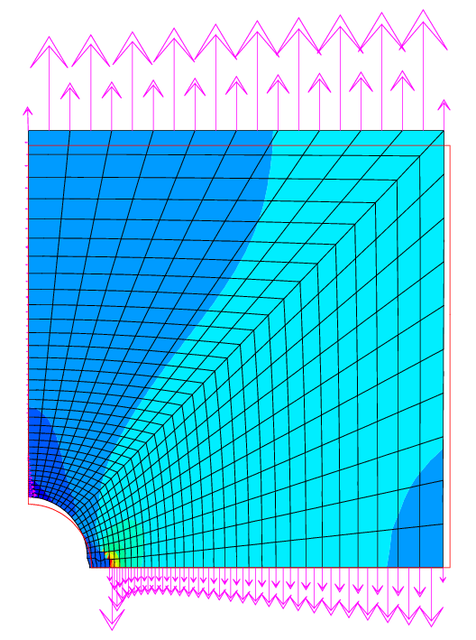
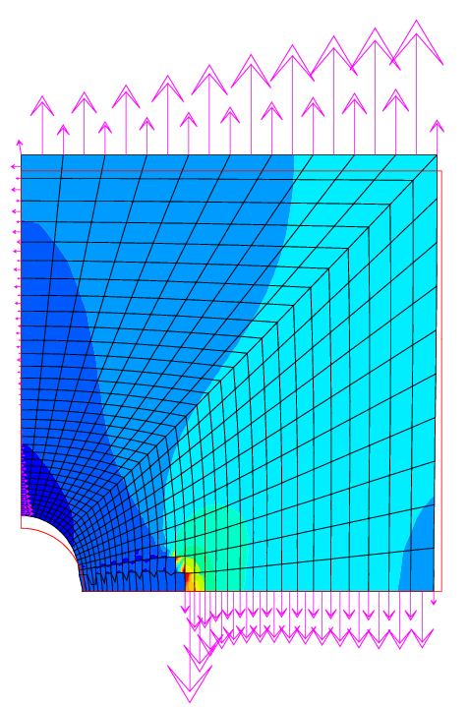
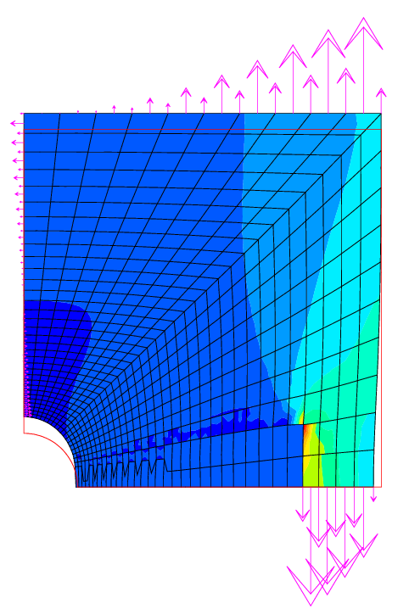
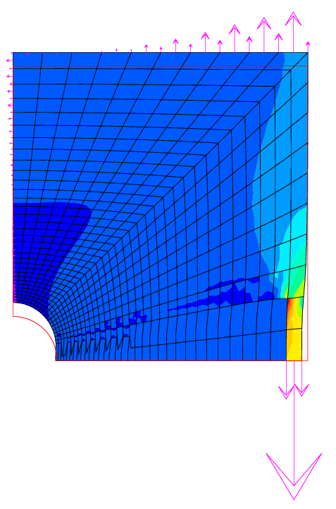
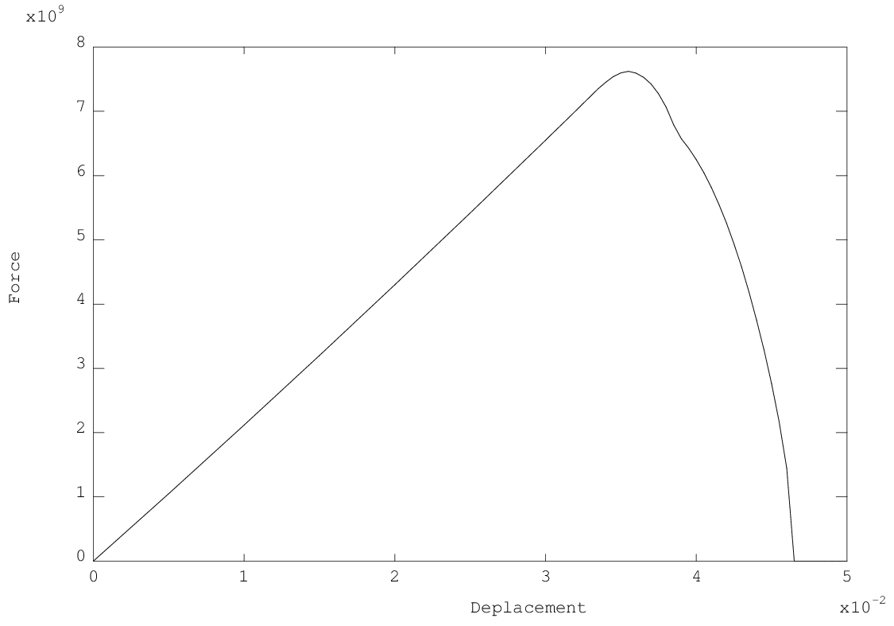
Exercise 2: rupture by elements removal
Results
Undependable model:
results quite sensitive to time/space discretization
Strength / displacement curve

Slide 44
Exercise 2: rupture by elements removal
Solution (bis)
- reduce time steps
- use the PERSO1 procedure
extract the model and the calculated stresses (T1 . ESTIMATION)
calculate the principal stresses
determine the mesh of intact elements
- reduce the boundary conditions on this mesh
- overwrite the boundary conditions in the working table WTABLE
DEBP PERSO1 T1*'TABLE' ;
MO1 = T1 . 'WTABLE' . 'MODELE' ;
MAIL1 = EXTR MO1 'MAIL' ;
SG1 = T1 . 'ESTIMATION' . 'CONTRAINTES' ;
SGP1 = PRIN SG1 MO1 ;
SG11 = CHAN 'GRAVITE' (EXCO 'SI11' SGP1) MO1 ;
MAIL2 = SG11 ELEM 'INFERIEUR' 2.2E10 ;
MAIL3 = DIFF MAIL1 MAIL2 ;
NE3 = NBEL MAIL3 ;
SI (NE3 > 0) ;
MESS ' [PERSO1 :] Removal of' NE3 'elements' ;
BL01 = T1 . 'WTABLE' . 'BLOCAGES_MECANIQUES' ;
MAILBL1 = EXTR BL01 'MAIL' ;
MAILBL2 = MAILBL1 ELEM 'APPU' 'LARG' MAIL3 ;
MAILBL3 = DIFF MAILBL1 MAILBL2 ;
BL02 = REDU BL01 MAILBL3 ;
T1 . 'WTABLE' . 'BLOCAGES_MECANIQUES' = BL02 ;
FINSI ;
FINP ;
TAB1 . 'PROCEDURE_PERSO1' = VRAI ;
TAB1 . 'TEMPS_CALCULES' = PROG 0.1 'PAS' 0.1 0.6
'PAS' 0.01 1. ;
PERSO1 procedure Main program

Slide 45
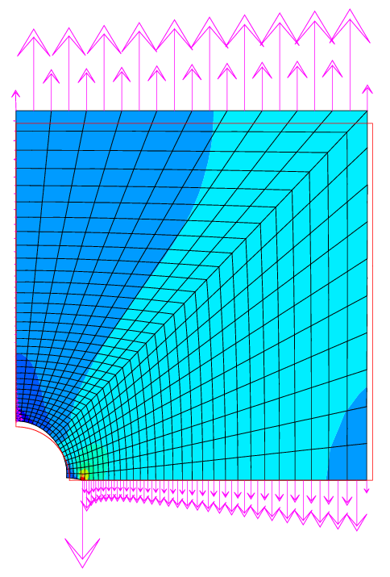
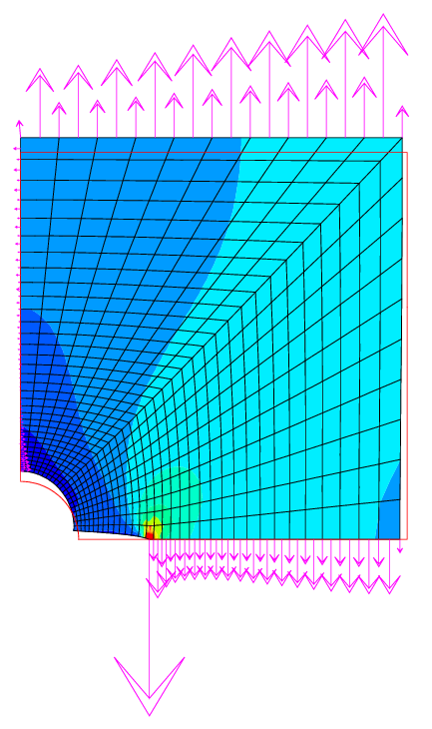
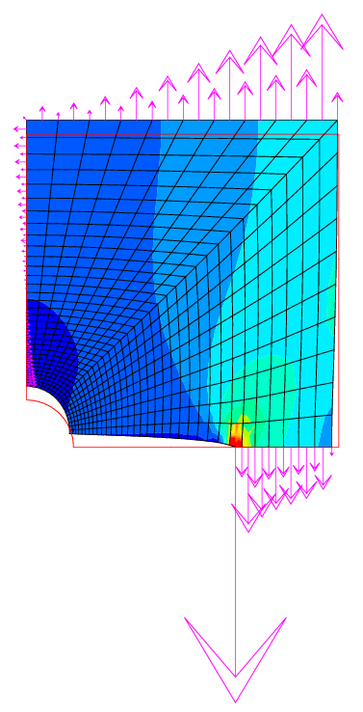
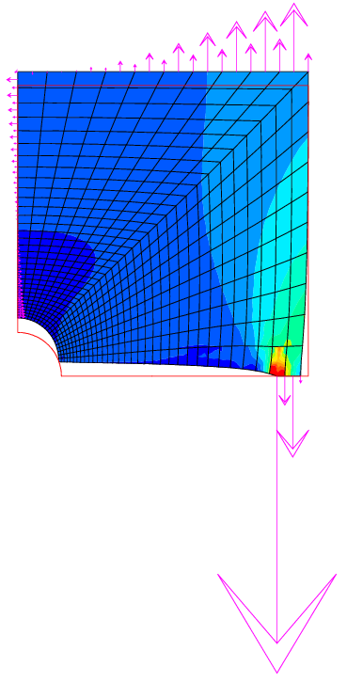
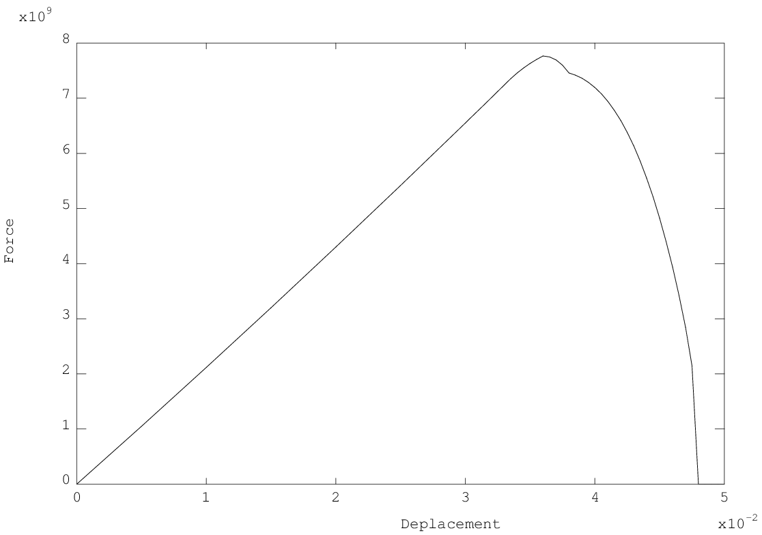
Exercise 2: rupture by elements removal
Results
Undependable model:
results quite sensitive to time/space discretization
Strength / displacement curve

Slide 46
TRANSNON operation thermal solver

Slide 47
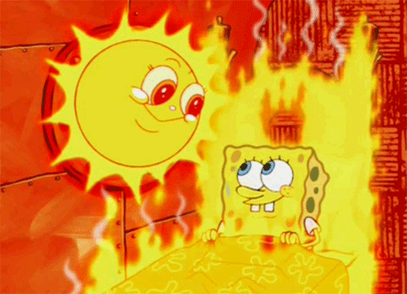
Reminder on equations
Local equations in transient thermal analysis
heat flux density $\vec{φ}=−λ \vec{grad}\left(T\right)$ on $V$
heat equation $ρc_{p}\frac{∂T}{∂t}+div \vec{φ}−q=0$ on $V$
prescribed flux $\vec{φ}.\vec{n}=φ_{imp}+\underset{convection}{\underbrace{h\left(T_{f}−T\right)}}+\underset{radiation}{\underbrace{εσ\left(T_{∞}^{4}−T^{4}\right)}}$ on $∂V^{φ}$
prescribed temperature $T=T_{imp}$ on $∂V^{T}$

Slide 48
Reminder on equations
Weak form + FE discretization
$$\left[C\right]\left\{\dot{T}\right\}+\left[K\right]\left\{T\right\}=\left\{F\right\}$$
Vectors of Equivalent Nodal Heat (W) $\left\{F\right\}={\left\{F\right\}}^{φ}+{\left\{F\right\}}^{V}$
${\left\{F\right\}}^{φ}=\int_{∂V^{φ}}{{\left[N\right]}^{T}φ_{imp}dS}$ to the prescribed surface heat flux $φ_{imp}$ (J.m⁻²) (FLUX)
$+\int_{∂V^{φ}}{{\left[N\right]}^{T}hT_{f}dS}$ to the prescribed convection flux $hT_{f}$ (J.m⁻²) (CONV)
$+\int_{∂V^{φ}}{{\left[N\right]}^{T}εσ\left(T_{∞}^{4}−T^{4}\right)dS}$ to the prescribed radiation flux (J.m⁻²)
${\left\{F\right\}}^{V}= \int_{V}{{\left[N\right]}^{T}q dV}$ to the prescribed volume heat $q$ (J.m⁻³) (SOUR)
Matrices
$\left[C\right]=\int_{V}{ρc_{p}{\left[N\right]}^{T}\left[N\right]dV}$ capacity matrix (J.K⁻¹) (CAPA)
$\left[K\right]=\int_{V}{{\left[B\right]}^{T}\left[λ\right]\left[B\right]dV}+\int_{∂V^{φ}}{h{\left[N\right]}^{T}\left[N\right]dS}$ conductivity matrix (W.K⁻¹) (COND)
$\left[N\right]$ matrix of shape (interpolation) functions
$\left[B\right]$ matrix of derivatives of shape functions

Slide 49
Theta method
Weak form + FE discretization
$$\left[C\right]\left\{\dot{T}\right\}+\left[K\right]\left\{T\right\}=\left\{F\right\}$$
Time discretization: theta method
$${\left[C\right]}_{∗}\frac{{\left\{T\right\}}_{n+1}−{\left\{T\right\}}_{n}}{Δt}+{\left[K\right]}_{∗}{\left\{T\right\}}_{∗}={\left\{F\right\}}_{∗}$$
with:
$∆t$ time step
${\left\{T\right\}}_{n}$ vector of nodal temperatures at time $t_{n}$
${\left\{T\right\}}_{n+1}$ vector of nodal temperatures at time $t_{n+1}$
${\left[C\right]}_{∗} {\left[K\right]}_{∗}$ and ${\left\{F\right\}}_{∗}$ are estimated:
at time $t_{∗}=θt_{n+1} +(1−θ)t_{n}$
at temperature ${\left\{T\right\}}_{∗}=θ{\left\{T\right\}}_{n+1}+(1−θ){\left\{T\right\}}_{n}$
$θ$ relaxation coefficient (between 0 and 1)
$θ=0$ explicit scheme
$θ=1$ implicit scheme (default value)

Slide 50
TRANSNON operation
Initializations, CHARTHER
Options, times calculated, units (°C or K), initial state, shape functions (for radiation)…
State of system at ${\left\{T\right\}}_{n} , t_{∗}$
PARATHER
Material updating
Matrix calculation ${\left[K\right]}_{∗}$ and ${\left[C\right]}_{∗}$
CHARTHER
Calculation of ${\left\{F\right\}}_{∗}$
External variables updating, material characteristics Calculation of conductivity matrix ${\left[K\right]}_{∗}$ (cond. + conv. + radi. + constrain.)
and capacity matrix ${\left[C\right]}_{∗}$ at temperature ${\left\{T\right\}}_{n}$ and time $t_{∗}$
Calculation of 2nd member ${\left\{F\right\}}_{∗}$ (T impo. + T conv. + T rayo. + Flux impo.) at temperature ${\left\{T\right\}}_{n}$ and time $t_{∗}$
We define the operator as: ${\left[L\right]}_{∗}=\frac{1}{∆t}{\left[C\right]}_{∗}+θ{\left[K\right]}_{∗}$
Convergence acceleration
Temperature increment calculation: $∆{\left\{T\right\}}^{i+1}={\left[L\right]}_{∗}^{−1}{\left\{F\right\}}_{∗}$
and so we get: ${\left\{T\right\}}_{n+1}^{i+1}={\left\{T\right\}}_{n}+∆{\left\{T\right\}}^{i+1}$
and also: ${\left\{T\right\}}_{∗}^{i+1}=θ{\left\{T\right\}}_{n+1}^{i+1}+(1−θ) {\left\{T\right\}}_{n}$
State of system at ${\left\{T\right\}}_{∗}^{i+1}, t_{∗}$
PARATHER
Material updating
CHARTHER
Calculation of ${\left\{F\right\}}_{∗}$
RESO
Measure the maximal difference on the temperature increment for two successive steps:
Crit = [MAXI 'ABS' $\left(∆{\left\{T\right\}}^{i+1}−∆{\left\{T\right\}}^{i}\right)$] / [MAXI 'ABS' ${\left\{T\right\}}_{n+1}^{i+1}$]
Criterion
no
i = i + 1
Convergence ?
If the criterion is small enough:
Crit ≤ 'PRECISION' (1.E-4 by default)
yes
PERSO2
User procedure
no
End of time steps?
Remark: when TRANSNON is called by PASAPAS,
the time step loop is performed once
Next step Initialization
yes
Results recording and exit

Slide 51
Exercise 3: heat source depending on temperature Download the starting file on the website: http://www-cast3m.cea.fr/index.php?page=exemples&exemple=formation_pasapas_3_initial

Slide 52
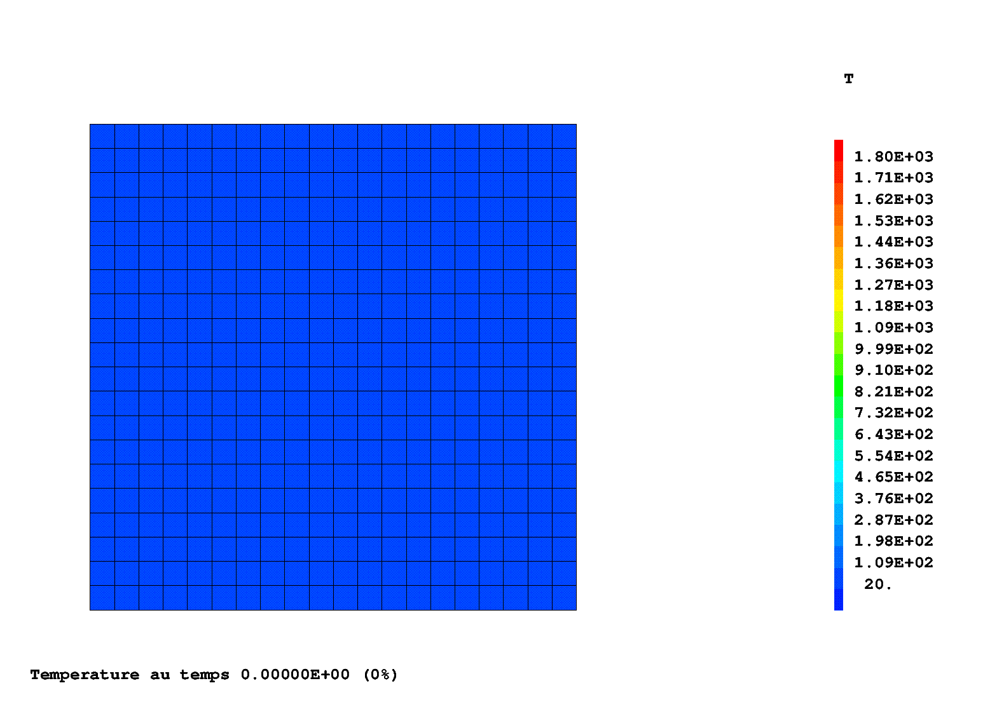
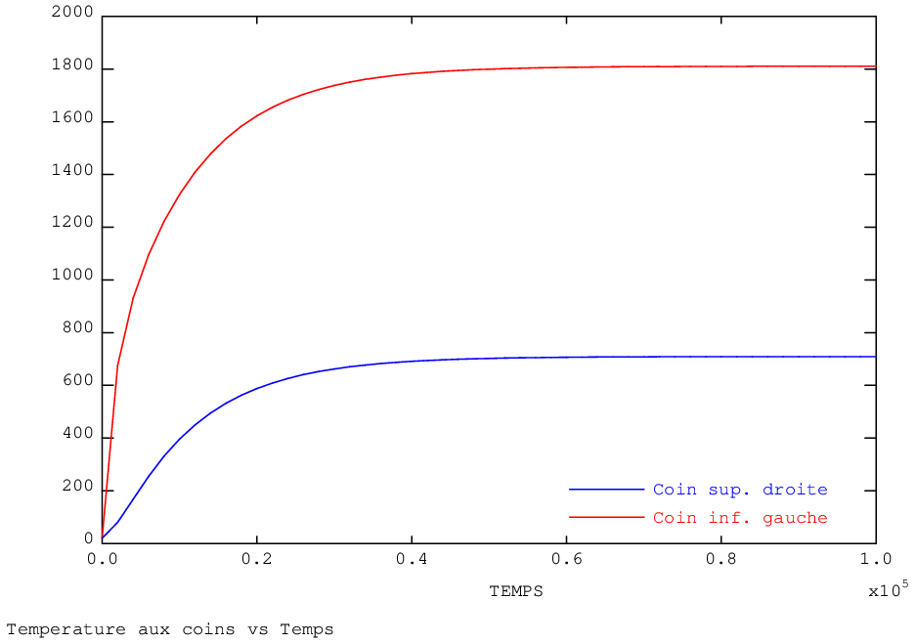
Exercise 3: heat generation depending on temperature
Square section with heat source and cooled by convection
Purpose: make the problem depending on parameters
→ Conductivity as a function of temperature
$λ\left(T\right)=0,3.T+200$
→ Convection as a function of time
→ Source as a function of temperature
$f\left(T\right)=4 000 000 e^{−{\left(\frac{T−1000}{700}\right)}^{2}}$
It’s up to you!
Convection
Convection
Heat source
h [W.m⁻².K⁻¹]
200
10
t [s]
0
10⁵

Slide 53
Exercise 3: heat generation depending on temperature
A few indications …
Useful objects
MAIL1 : source mesh
MOD1 : thermal model reduced on MAIL1
Useful operators
REDU : to reduce the temperature field on the "source“ area
SOUR : to impose a volumetric heat source

Slide 54
Exercise 3: heat generation depending on temperature
Solution
use the PERSO2 procedure (called at each time step)
recalculate the source (2nd member) as a function of temperatures at the beginning of the time step
create a “load” with it and overwrite the load in WTABLE
DEBP PERSO2 T1*'TABLE' ;
MA1 = T1 . 'AMOI' . 'MAIL' ;
MO1 = T1 . 'AMOI' . 'MODE' ;
* reduction du champ de temperatures au maillage de la source
CHT1 = T1 . 'ESTIMATION' . 'TEMPERATURES' ;
CHT2 = REDU CHT1 MA1 ;
* calcul du champ de source a partir du champ de temperature
CHS = 4.E6 * (EXP (-1. * (((CHT2 - 1000.) / 700.) ** 2))) ;
* creation du second membre et d'un chargement
CHFL1 = SOUR MO1 CHS ;
EV1 = EVOL 'MANU' (PROG 0. TPSMAX) (PROG 1. 1.) ;
CHA1 = CHAR 'Q' CHFL1 EV1 ;
* modification du chargement dans la table de calcul
T1 . 'WTABLE' . 'CHARGEMENT' = CHA1 ;
FINP T2 ;
LT = PROG -1.E6 1.E6 ;
LL = 200. + (0.3 * LT) ;
LAMBDA = EVOL 'MANU' 'T' LT 'K' LL ;
HCONV = EVOL 'MANU' 'TEMP' (PROG 0. TPSMAX) 'H' (PROG 10. 200.) ;
VSOUR = 4.E6 * (EXP (-1. * (((T_INI - 1000.) / 700.) ** 2))) ;
TAB1 . 'PROCEDURE_PERSO2' = VRAI ;
TAB1 . 'MY_DATA' = TABL ;
TAB1 . 'MY_DATA' . 'MAIL' = MAIL1 ;
TAB1 . 'MY_DATA' . 'MODE' = MOD1 ;
PERSO2 procedure Main program

Slide 55
Exercise 3: heat generation depending on temperature
Solution (bis)
- suppress loading CHA1 (heat source)
use the CHARTHER procedure (called at each step iteration)
recalculate the source (2nd member) as a function of temperatures at the beginning of the time step
DEBP CHARTHER T1*'TABLE' TPS1*'FLOTTANT' ;
MA1 = T1 . 'MY_DATA' . 'MAIL' ;
MO1 = T1 . 'MY_DATA' . 'MODE' ;
* reduction du champ de temperatures au maillage de la source
CHT1 = T1 . 'ESTIMATION' . 'TEMPERATURES' ;
CHT2 = REDU CHT1 MA1 ;
* calcul du champ de source a partir du champ de temperature
CHS = 4.E6 * (EXP (-1. * (((CHT2 - 1000.) / 700.) ** 2))) ;
* creation du second membre
CHFL1 = SOUR MO1 CHS ;
* sortie du second membre
T2 = TABL ;
T2 . 'ADDI_SECOND' = CHFL1 ;
FINP T2 ;
LT = PROG -1.E6 1.E6 ;
LL = 200. + (0.3 * LT) ;
LAMBDA = EVOL 'MANU' 'T' LT 'K' LL ;
HCONV = EVOL 'MANU' 'TEMP' (PROG 0. TPSMAX) 'H' (PROG 10. 200.) ;
***TAB1 . 'CHARGEMENT' = CHA2 ;
TAB1 . 'PROCEDURE_CHARTHER' = VRAI ;
TAB1 . 'MY_DATA' = TABL ;
TAB1 . 'MY_DATA' . 'MAIL' = MAIL1 ;
TAB1 . 'MY_DATA' . 'MODE' = MOD1 ;
CHARTHER procedure Main program

Slide 56
Exercise 3: heat generation depending on temperature
Solution (ter)
idem
use the CHARTHER procedure (called at each step iteration)
recalculate the source (2nd member) as a function of temperatures at previous iteration (i.e. at the end of the time step)
DEBP CHARTHER T1*'TABLE' TPS1*'FLOTTANT' ;
MA1 = T1 . 'MY_DATA' . 'MAIL' ;
MO1 = T1 . 'MY_DATA' . 'MODE' ;
* reduction du champ de temperatures au maillage de la source
CHT1 = T1 . 'WTABLE' . 'THER_COURANT' ;
CHT2 = REDU CHT1 MA1 ;
* calcul du champ de source a partir du champ de temperature
CHS = 4.E6 * (EXP (-1. * (((CHT2 - 1000.) / 700.) ** 2))) ;
* creation du second membre
CHFL1 = SOUR MO1 CHS ;
* sortie du second membre
T2 = TABL ;
T2 . 'ADDI_SECOND' = CHFL1 ;
FINP T2 ;
LT = PROG -1.E6 1.E6 ;
LL = 200. + (0.3 * LT) ;
LAMBDA = EVOL 'MANU' 'T' LT 'K' LL ;
HCONV = EVOL 'MANU' 'TEMP' (PROG 0. TPSMAX) 'H' (PROG 10. 200.) ;
***TAB1 . 'CHARGEMENT' = CHA1 ;
TAB1 . 'PROCEDURE_CHARTHER' = VRAI ;
TAB1 . 'MY_DATA' = TABL ;
TAB1 . 'MY_DATA' . 'MAIL' = MAIL1 ;
TAB1 . 'MY_DATA' . 'MODE' = MOD1 ;
CHARTHER procedure Main program

Slide 57
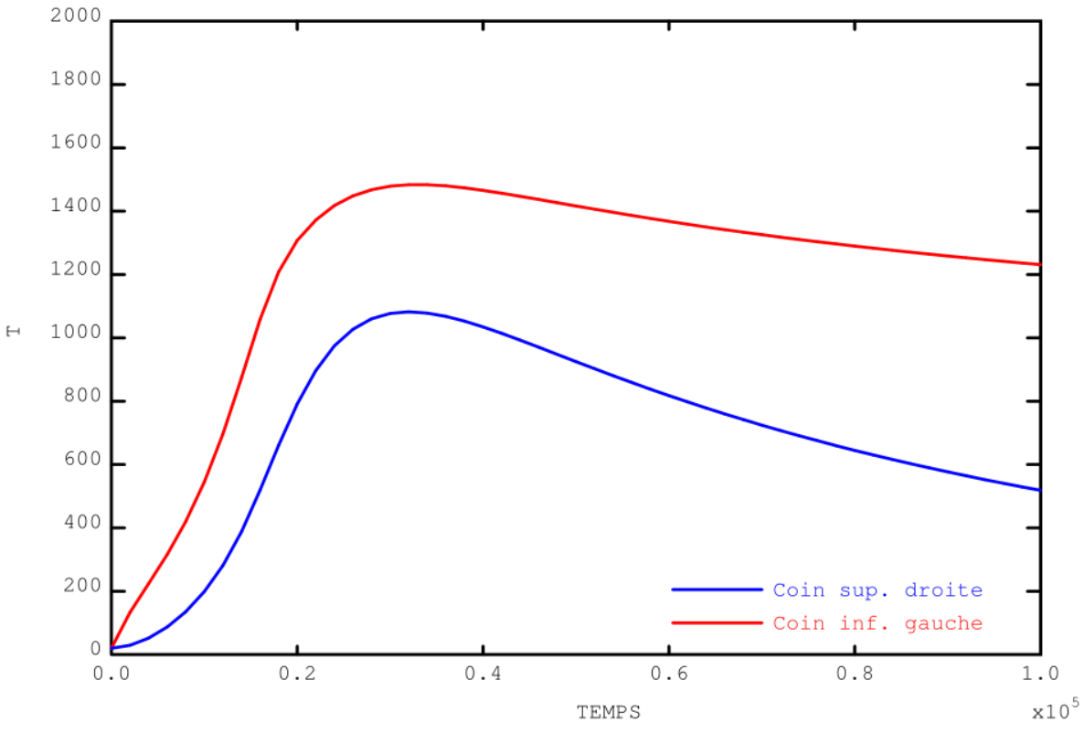
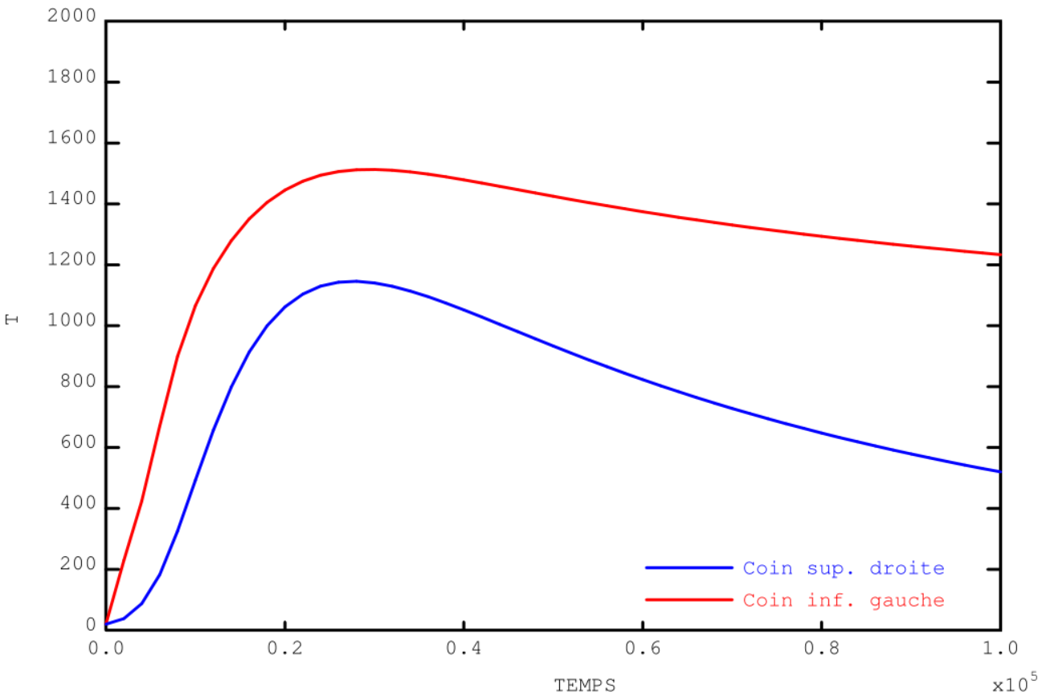
Exercise 3: heat generation depending on temperature
Results
PERSO2 or CHARTHER (beginning time step)
CHARTHER (end of time step)

Slide 58
Exercise 4: thermo-mechanical gap closing Download the starting file on the website: http://www-cast3m.cea.fr/index.php?page=exemples&exemple=formation_pasapas_4_initial

Slide 59
Exercise 4: thermo-mechanical gap closing
Two bars expand and get in contact
thermal expansion
unilateral mechanical contact
Purpose: add thermal contact, this is to say the heat transfer when the mechanical contact takes place.
It’s up to you!
gap
$$T_{1}=500 °C$$
$$T_{2}=20 °C$$
bar 1
$$T_{ini}=20 °C$$
$$T_{ini}=20 °C$$
bar 2

Slide 60
Exercise 4: thermo-mechanical gap closing
A few indications …
Useful objects
P2 et P3: points on the left/right of the gap
L2 et L3: lines on the left/right of the gap
Useful operators
COOR: points coordinates
RELA: relation between degrees of freedom
Modify thermal boundary conditions of WTABLE

Slide 61
Exercise 4: thermo-mechanical gap closing
Solution
check the mechanical + thermal convergence
create a new constraint: relation between the temperatures T on line L2 = T on line L3 with RELA operator
use REEV_MEC to modify the thermal boundary conditions
calculate the gap at iteration time
modify thermal boundary conditions in WTABLE as a function of the gap
DEBP REEV_MEC T1*'TABLE' N1*'ENTIER' ;
U1 = T1 . 'ESTIMATION' . 'DEPLACEMENTS' ;
WT = T1 . 'WTABLE' ;
TAM = T1 . 'MY_DATA' ;
* calcul du jeu
PT2 = TAM . 'POINT_2' ;
PT3 = TAM . 'POINT_3' ;
X2 = (COOR 1 PT2) + (EXTR U1 'UX' PT2) ;
X3 = (COOR 1 PT3) + (EXTR U1 'UX' PT3) ;
J1 = X3 - X2 ;
* si jeu ferme, on utilise le blocage thermique initial + le RELA
SI (J1 <EG 1.E-15) ;
WT . 'BLOCAGES_THERMIQUES' = (TAM . 'BLOQ_0') ET
(TAM . 'BLOQ_1') ;
* si jeu ouvert, on utilise le blocage thermique initial seul
SINON ;
WT . 'BLOCAGES_THERMIQUES' = TAM . 'BLOQ_0' ;
FINSI ;
FINP ;
TAB1 . 'CONVERGENCE_MEC_THE' = VRAI ;
TAB1 . 'PROCEDURE_REEV_MEC' = VRAI ;
TAB1 . 'MY_DATA' = TABL ;
TAB1 . 'MY_DATA' . 'POINT_2' = P2 ;
TAB1 . 'MY_DATA' . 'POINT_3' = P3 ;
TAB1 . 'MY_DATA' . 'BLOQ_0' = CL_TH ;
TAB1 . 'MY_DATA' . 'BLOQ_1' = RELA 'T' L2 - 'T' L3 ;
REEV_MEC Procedure Main program

Slide 62
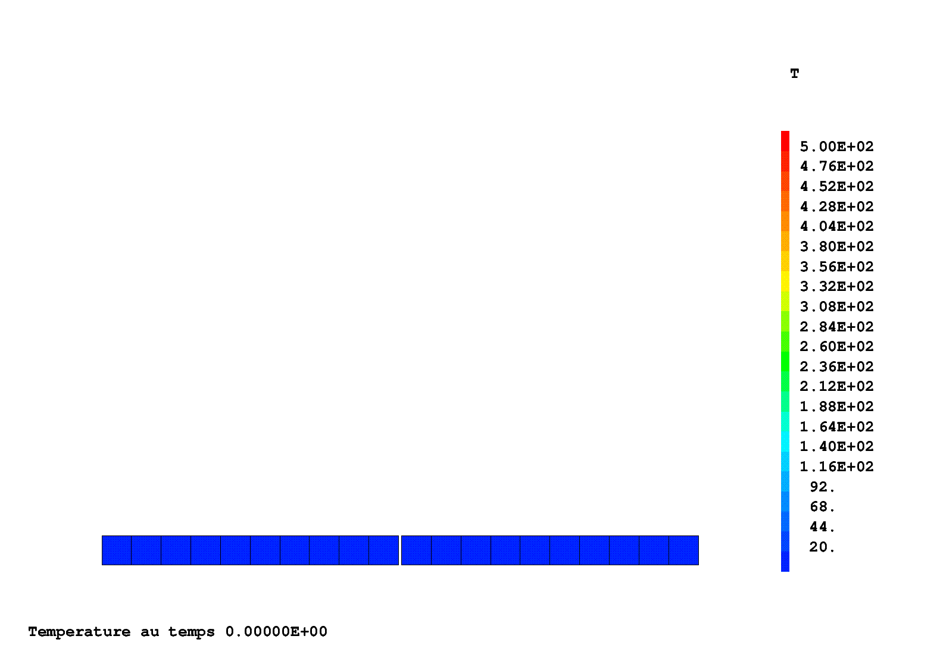
Exercise 4: thermo-mechanical gap closing
Results
Without contact: bars are insulated
During contact: "perfect" conduction

Slide 63
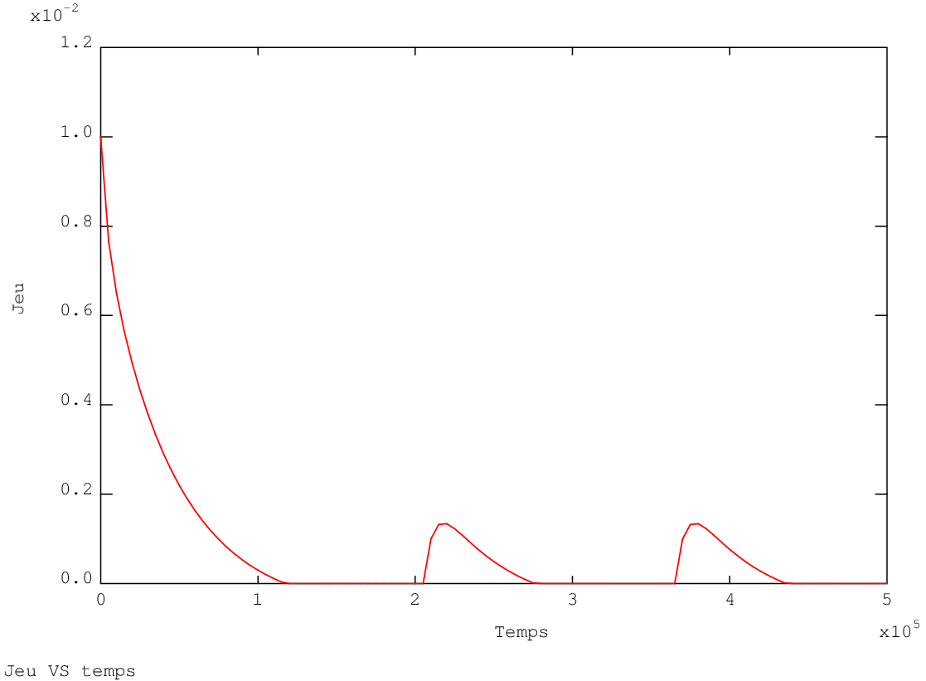
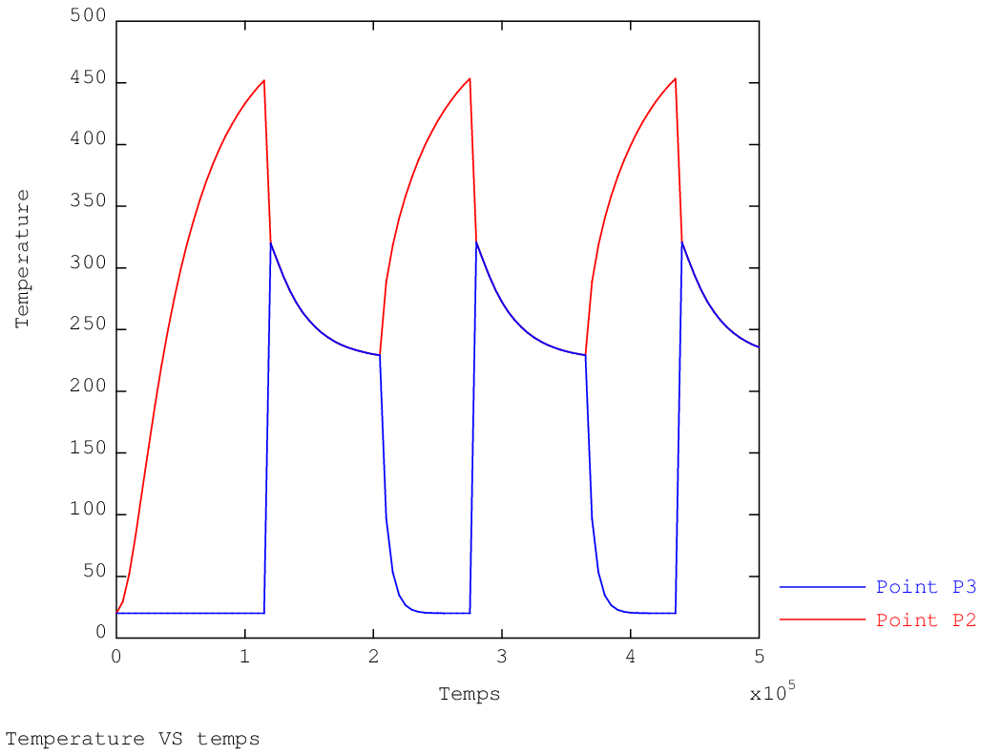
Exercise 4: thermo-mechanical gap closing
Results
Changes made in REEV_MEC are taken into account at the same time step (due to thermo-mechanics convergence loop BO_BOTH)
It will be different with PERSO1. Changes are taken into account at the next time step
Gap distance as a function of time
Temperatures as a function of time on the left side and on the riht side of the gap

Slide 64
Exercise 4: thermo-mechanical gap closing
Solution (bis)
convective heat transfer in a transition element
use of an heat transfer coefficient depending on pressure
pressure is described through a loading named 'PC'
updating of the loading 'PC' in REEV_MEC
** Modele de convection variable entre les barreaux
MRACC = RACC (1.1 * JEU_INI) L2 L3 ;
MODRACC = MODE MRACC 'THERMIQUE' 'CONVECTION' ;
HVSP = EVOL 'MANU' 'PC' (PROG 0. 5.E8 5.1E8)
'H' (PROG 0. 1.E4 1.E4) ;
MATRACC = MATE MODRACC 'H' HVSP ;
MOD_TH = MODT1 ET MODT2 ET MODRACC ;
MAT_TH = MATT1 ET MATT2 ET MATRACC ;
** Chargement initial decrivant la pression de contact
CH_PC = MANU 'CHPO' MRACC 'PC' 0. ;
CHA2 = CHAR 'PC' CH_PC EV1 ;
TAB1 . 'CHARGEMENT' = CHA1 ET CHA2 ;
TAB1 . 'CONVERGENCE_MEC_THE' = VRAI ;
TAB1 . 'PROCEDURE_REEV_MEC' = VRAI ;
TAB1 . 'MY_DATA' = TABL ;
TAB1 . 'MY_DATA' . 'LIGNE_3' = L3 ;
TAB1 . 'MY_DATA' . 'MAIL' = MRACC ;
TAB1 . 'MY_DATA' . 'EVOL' = EV1 ;
TAB1 . 'MY_DATA' . 'CHAR_0' = CHA1 ;
DEBP REEV_MEC T1*'TABLE' N1*'ENTIER' ;
R1 = T1 . 'ESTIMATION' . 'REACTIONS' ;
WT = T1 . 'WTABLE' ;
TAM = T1 . 'MY_DATA' ;
L3 = TAM . 'LIGNE_3' ;
MR = TAM . 'MAIL' ;
SI ((T1 . 'ESTIMATION' . 'TEMPS') NEG 0.) ;
* calcul de la pression de contact
PARA_P = (MAXI 'ABS' (RESU (REDU R1 L3))) / (MESU L3) ;
* chargment decrivant le parametre 'PC'
CH_PC = MANU 'CHPO' MR 'PC' PARA_P ;
EV1 = TAM . 'EVOL' ;
CHA3 = CHAR 'PC' CH_PC EV1 ;
* on ecrase le chargement global de WTABLE
WT . 'CHARGEMENT' = (TAM . 'CHAR_0') ET CHA3 ;
FINS ;
FINP ;
REEV_MEC procedure Main program

Slide 65
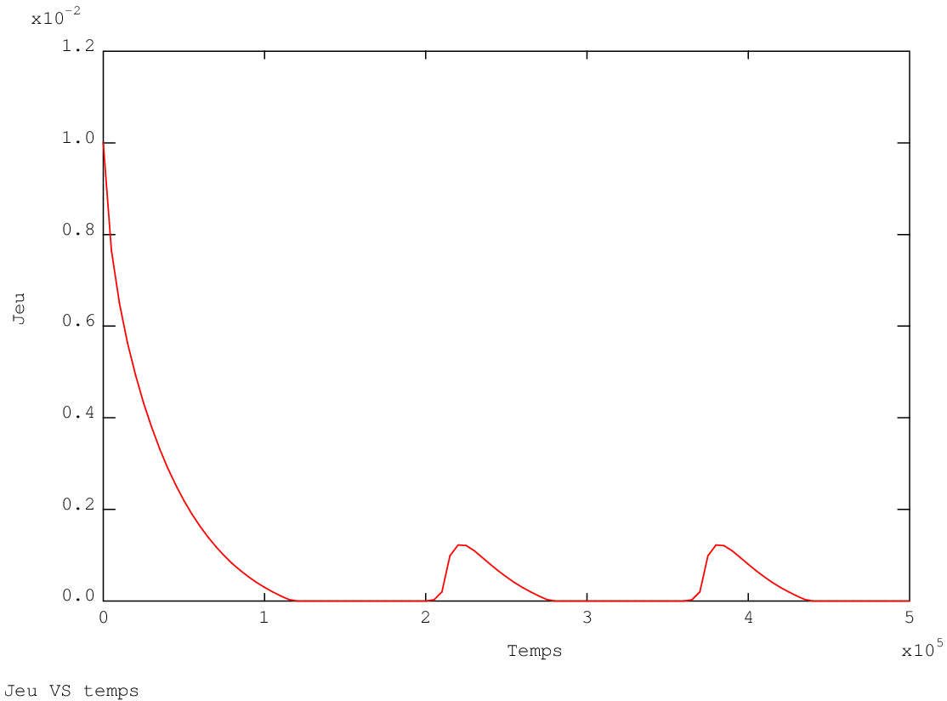
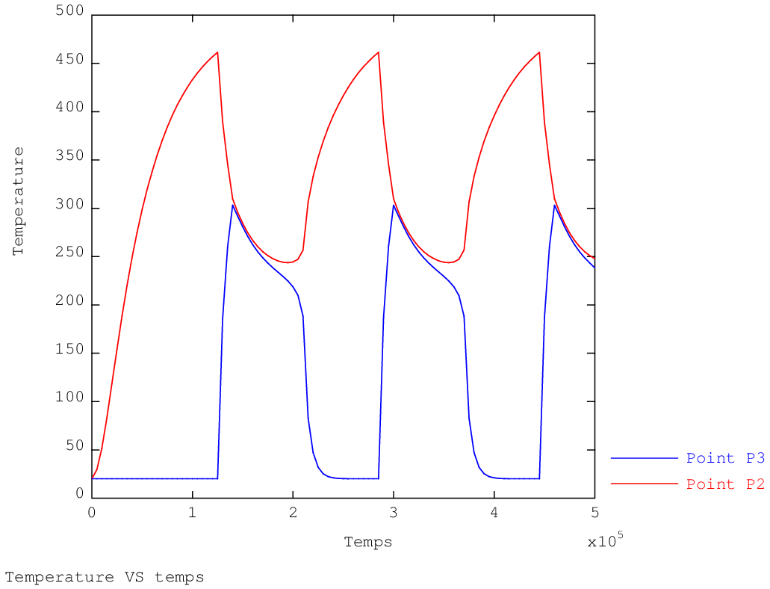
Exercise 4: thermo-mechanical gap closing
Results (bis)
The heat transfer is made with different temperatures over the gap
The temperature evolution is smoother
Gap distance as a function of time
Temperatures as a function of time on the left side and on the riht side of the gap

Slide 66
Annexes

Slide 67
Annex: algorithmic control parameters
General
NB_BOTH (ENTIER) Maximum number of iterations for the thermo-mechanical
convergence loop
MAXITERATION (ENTIER) Maximum number of iterations (49)
Mechanics
PRECISION (FLOTTANT) Criterion to compare the imbalance (1.E-4)
FTOL (FLOTTANT) Tolerance for strength equilibrium
MTOL (FLOTTANT) Tolerance for moments equilibrium
GRANDS_DEPLACEMENTS (LOGIQUE) Reference configuration = deformed configuration
PREDICTEUR = 'HPP' Small displacements hypothesis → 1st convergence
then use the
large displacements hypothesis → 2nd convergence PRECISINTER (FLOTTANT) Precision for the constitutive laws integration local
problem (1.E-8)
CONVERGENCE_FORCEE (LOGIQUE) Forced convergence use or not in case of non convergence (VRAI)
MAXSOUSPAS (ENTIER) Max. number of sub-steps during forced convergence (200)
DELTAITER (ENTIER) Number of steps over which non convergence is tested

Slide 68
Annex: algorithmic control parameters
Thermal
PROCEDURE_THERMIQUE (MOT) Procedures to call:
- NONLINEAR TRANSNON procedure - LINEAR TRANSLIN procedure
- DUPONT DUPONT2 procedure
RELAXATION_THETA (FLOTTANT) Relaxation coefficient for the θ-method (1)
Thermo-mechanical coupling
CONVERGENCE_MEC_THE (LOGIQUE) Indicates that the thermo-mechanical loop should be repeated in case of dependence (FAUX)
CRITERE_COHERENCE (FLOTTANT) Precision for the thermo-mechanical convergence, tested on thermal results (1.E-2)
PROJECTION (LOGIQUE) Indicates that the thermal and mechanical meshes are different while the problem is coupled (FAUX)

Slide 69
Annex: imbalance minimization in Gibiane
Simplified UNPAS algorithm (see the @SOLVMEC procedure)
[small displacements / strains]
fex1 = TIRE char tps1 ‘MECA’ ;
flx1 = TIRE char tps1 ‘DIMP’ ;
resi0 = fex1 + fr0 – fi0 + flx1 – flx0 ;
fref = MAXI ‘ABS’ (fex1 + fr0) ;
k = (RIGI mod mat) ET blo ;
REPE b1 100 ;
ddu = RESO k resi0 ;
u1 = u0 + ddu ;
fr1 = REAC blo u1 ;
eps1 = EPSI mod u1 ;
sig1 = ... COMP eps0 eps1 ...
fi1 = BSIG mod sig1 ;
resi1 = fex1 + fr1 – fi1 ;
crit1 = (MAXI ‘ABS’ resi1) / fref ;
SI (crit1 < precis) ;
QUIT b1 ;
FINSI ;
u0 = u1 ;
resi0 = resi1 ;
FIN b1 ;

Slide 70
Annex: imbalance minimization in Gibiane
Simplified UNPAS algorithm (see the @SOLVMEC procedure)
[large displacements, updated lagrangian]
fex1 = TIRE char tps1 ‘MECA’ ;
flx1 = TIRE char tps1 ‘DIMP’ ;
resi0 = fex1 + fr0 – fi0 + flx1 – flx0 ;
fref = MAXI ‘ABS’ (fex1 + fr0) ;
conf0 = FORM u0 ;
u00 = u0 ; moving to the current configuration (beginning of time step)
k = (RIGI mod mat) ET blo ET (KSIG mod sig0) ;
REPE b1 100 ;
ddu = RESO k resi0 ;
u1 = u0 + ddu ;
fr1 = REAC blo u1 ;
du = u1 – u00 ;
deps = EPSI mod du ; strain increment
eps1 = eps0 + deps ;
sig1 = ... (COMP eps0 eps1, EXCO, ...)
sig1 = PICA mod sig1 du ; moving stresses to the final configuration
FORM u1 ;
fi1 = BSIG mod sig1 ; integration on the final configuration
FORM conf0 ;
resi1 = fex1 + fr1 – fi1 ;
crit1 = (MAXI ‘ABS’ resi1) / fref ;
SI (crit1 < precis) ;
QUIT b1 ;
FINSI ;
u0 = u1 ;
resi0 = resi1 ;
FIN b1 ;

Slide 71
Annex: convergence criteria (UNPAS)
Convergence norms (after 1st RESO)
$F^{ref} =\frac{\left|δ{\left\{U\right\}}_{1}^{1}.{\left\{F\right\}}_{1}^{S+V}−{\left\{λ\right\}}_{1}^{1}.\left({\left\{d\right\}}_{1}−{\left[A\right]}^{T}.{\left\{U\right\}}_{1}^{0} \right)\right|}{\max_{dof depl}\left|δ{\left\{U\right\}}_{1}^{1}\right|+xsmall}+\frac{\max_{dof depl}\left|δ{\left\{U\right\}}_{1}^{1}\right|.max\left|\left[B\right]{\left\{σ\right\}}_{1}^{0}\right|}{\max_{dof depl}\left|δ{\left\{U\right\}}_{1}^{1}\right|+xsmall}+max\left|\left[B\right]{\left\{σ\right\}}_{1}^{0}\right|$
$M^{ref}=\frac{\left|δ{\left\{U\right\}}_{1}^{1}.{\left\{F\right\}}_{1}^{S+V}−{\left\{λ\right\}}_{1}^{1}.\left({\left\{d\right\}}_{1}−{\left[A\right]}^{T}.{\left\{U\right\}}_{1}^{0} \right)\right|}{\max_{dof rota}\left|δ{\left\{U\right\}}_{1}^{1}\right|+xsmall}+\frac{\max_{dof depl}\left|δ{\left\{U\right\}}_{1}^{1}\right|.max\left|\left[B\right]{\left\{σ\right\}}_{1}^{0}\right|}{\max_{dof rota}\left|δ{\left\{U\right\}}_{1}^{1}\right|+xsmall}+xsmall$
Unbalance measure (at each UNPAS iteration)
$XCONV =\frac{\max\left\{\max_{ddl depl}\left|{\left\{F\right\}}_{1}^{S+V}−{\left[A\right]}^{T}.{\left\{λ\right\}}_{1}^{i+1} −\left[B\right]{\left\{σ\right\}}_{1}^{i+1}\right| ; \max\left|{\left[A\right]}^{T}.\left({\left\{λ\right\}}_{1}^{i+1}−{\left\{λ\right\}}_{1}^{i}\right) \right|\right\}}{F^{ref}}$
$XCONVM=\frac{\max_{ddl rota}\left|{\left\{F\right\}}_{1}^{S+V}−{\left[A\right]}^{T}.{\left\{λ\right\}}_{1}^{i+1} −\left[B\right]{\left\{σ\right\}}_{1}^{i+1}\right|}{M^{ref}}$

Slide 72
Annex: convergence criteria (UNPAS)
Measure of strain increment variation between 2 iterations
$$DEPSTDM =\max\left|{∆\left\{ε\right\}}_{1}^{i+1}−{∆\left\{ε\right\}}_{1}^{i}\right|$$
Convergence is reached if
$XCONV$ < PRECISION
$XCONVM$ < PRECISION
$DEPSTDM$ < PRECISION

Slide 73
Annex: forced convergence to be finished…
If non convergence is confirmed, the step is re-calculated:
state at the beginning of the step is redefined
the last “out of equilibrium“ state with minimal imbalance is chosen
at the beginning of time step, are overwritten:
the instant
the material properties
the displacements
the internal variables
the inelastic strains
the stresses
UNPAS is re-started with a time-step equal to zero
no load increment, only disequilibrium
allows to find a solution with the right behavior and equilibrium but with a different loading path

Slide 74
DES/DANS DM2S SEMT
François DI PAOLA
Commissariat à l'énergie atomique et aux énergies alternatives
Centre de Saclay | 91191 Gif-sur-Yvette Cedex
Etablissement public à caractère industriel et commercial | R.C.S Paris B 775 685 019

